Slide 1
Biosimilars Market in the U.S. and Europe: Economics including Uptake and Pricing

Slide 2
How Does the EU Biosimilar Market Compare to the U.S.?
More Experience
  10 additional years of experience with biosimilars
  Twice as many approved biosimilars
    As of August 8, 2019:
      23 biosimilars approved in the U.S., 47 in the EU
      9 biosimilars launched in the U.S., 6 of which launched in 2019

Slide 3
What does the Biosimilar Market Look Like in Europe Compared to the U.S.?
Humira® (adalimumab)
  U.S. (4): Amjevita, Cyltezo, Hyrimoz, Hadlima
  EU (9): Amgevita, Imraldi, Cyltezo, Hyrimoz, Halimatoz, Hefiya, Hulio, Idacio, Kromeya
Avastin® (bevacizumab)
  U.S. (2): Mvasi, Zirabev
  EU (2): Mvasi, Zirabev
Epogen® /Procrit® (epoetin alfa)
  U.S. (1): Retacrit
  EU (5): Abseamed, Binocrit, Epoetin alfa Hexal, Retacrit (epoetin zeta), Silapo (epoetin zeta)
Enbrel® (etanercept)
  U.S. (2): Erelzi, Eticovo
  EU (2): Benepali, Erelzi
Neupogen® (filgrastim)
  U.S. (2): Zarxio, Nivestym
  EU (8): Biograstim, Tevagrastim, Filgrastim Hexal, Ratiograstim, Zarzio, Nivestim, Grastofil, Accofil
Remicade® (infliximab)
  U.S. (3): Inflectra, Renflexis, Ixifi
  EU (4): Inflectra, Remsima, Flixabi, Zessly
Neulasta® (pegfilgrastim)
  U.S. (2): Fulphila, Udenyca
  EU (6): Udenyca, Pelgraz, Pelmeg, Ziextenzo, Fulphila, Grasustek
Rituxan® (rituximab)
  US (2): Truxima, Ruxience
  EU (6): Truxima, Rixathon, Riximyo, Blitzima, Ritemvia, Rituzena
Herceptin® (trastuzumab)
  U.S. (5): Ogivri, Herzuma, Ontruzant, Trazimera, Kanjinti
  EU (5): Ontruzant, Herzuma, Kanjinti, Trazimera, Ogivri
EU Total: 47
U.S. drugs listed in red have launched. Drugs approved in the U.S. under the 505(b)(2) pathway such as insulin and teriparatide are not included. As of August 21, 2019.

Slide 4
What are Some Hurdles to Biosimilar Uptake in the U.S.?
Lack of experience
Unfamiliarity resulting in reluctance to use biosimilars
No automatic substitution
Increased marketing expenses similar to that of innovative drugs

Slide 5
What are Some Key Economic Differences in the U.S.?
Increased Government Involvement
  Direct involvement in pricing and payment such as use of mandatory rebates and tenders
  Involvement in prescriber and patient education
  Guidelines and quotas for prescribing biosimilars/lower priced drugs
  Incentives for doctors/hospitals who prescribe lower cost drugs and lower costs
  Greater biosimilar discounts compared to reference products

Slide 6
What are Some of the Economic Differences in Europe?
More pricing pressure in Europe
  Harder to recoup development costs
Mandatory discounts on list prices
  Biosimilars required to offer discounts off list price of originator
  Reference products required to give discounts before biosimilar launch
Tenders
Prescriber pricing awareness

Slide 7
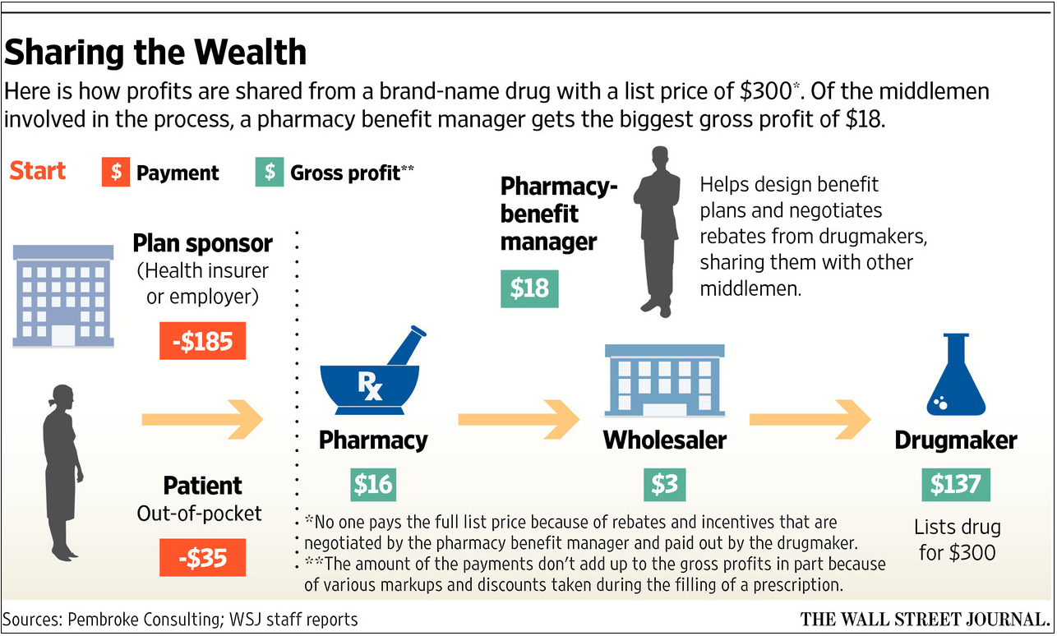
What are Some of the Pricing Considerations in the U.S.?
Free-pricing (market drives price)
Pricing and reimbursements differ based on insurance provider
Various middlemen add to costs
No government imposed price controls
Drug Channels (Aug. 2017), “Follow the Dollar Math: How Much Do Pharmacies, Wholesalers, and PBMs Make from a Prescription?”: https://www.drugchannels.net/2017/08/follow-dollar-math-how-much-do.html

Slide 8
What are Some of the Price Discounts Seen in the U.S. and in Europe?
In the U.S., we have generally seen price discounts of 15-35% for biosimilars
In the EU, price discounts vary by drug and country, but are upwards of 90%
EU Examples:
  Infliximab
    Remsima (called Inflectra in the U.S.): 30% discount (69% in Nordic countries); 35% of the market in 16 European countries as of 3Q 2018
  Adalimumab
    AbbVie offered up to an 89% off of Humira in tenders to remain in the market after biosimilar entry
    Biosimilars available at 10-80% discounts

Slide 9
  What do the Market Shares and Prices Currently Look Like in the U.S.?
  Filgrastim- Price discounts of 10-30%
  Biosimilars: Grainx (predates BPCIA, launched 11/2013), Zarxio (launched 9/2015), Nivestym (launched 10/2018)
  Most developed biosimilar market in the U.S. with biosimilars having ~50% market share
    Market Share: Neupogen (48.0%), Zarxio (31.7%), Granix (20.3%), Nivestym (0%)
  Pegfilgrastim- Price discounts of ~33%
  Biosimilars: Fulphila (launched 7/2018), Udenyca (launched 1/2019)
  Market Share: Neulasta OnPro (61.0%), Neulasta (38.2%), Fulphila (0.8%), Udenyca (just entered market 1/2019)
    July 2019 Biocon stated that Fulphila had gained 21% of the pegfilgrastim syringe market by volume
  Infliximab- Price discounts of ~35%
  Biosimilars: Inflectra (launched 11/2016), Renflexis (launched 7/2017), Ixifi (not launched)
  Market Share: Remicade (96.4%), Inflectra (3.2%), Renflexis (0.4%)
  Bevacizumab- Price discount of 15%
  Biosimilars: Mvasi (launched 7/2019)
  Trastuzumab- Price discount of 15%
  Biosimilars: Kanjinti (launched 7/2019)
Market Shares as of January 2019 according to IQVIA: https://www.centerforbiosimilars.com/conferences/aam-access-2019/iqvia-data-show-anda-approvals-on-the-rise-biosimilars-fighting-for-market-share

Slide 10
What are Some of the Key Takeaway Messages Concerning Uptake and Pricing?
Competition for market share
Ability to recuperate development costs and make a profit
Lowering costs for patients
Marketing expenses
Education for doctors and patients
Interchangeability- Benefit of automatic substitution
Experience with biosimilars

