Slide 1
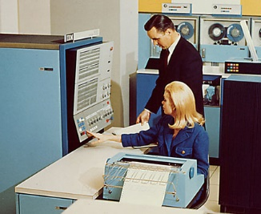
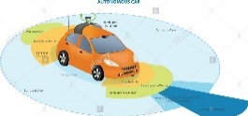
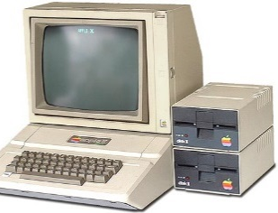
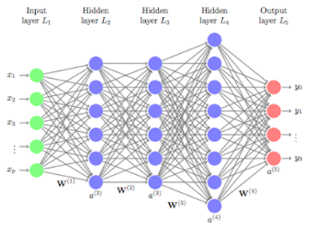
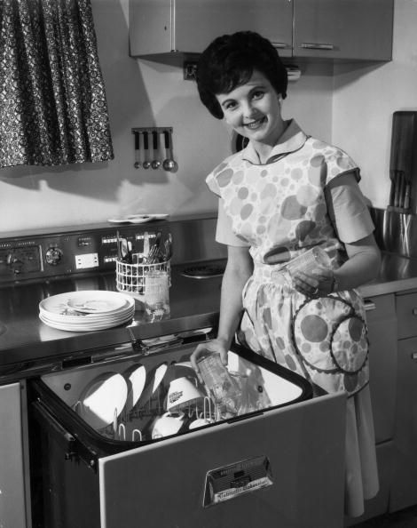
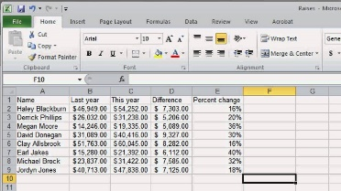
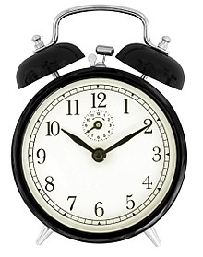
AI/Machine Learning Tutorial
?
Evolution of Intelligent Machines
Independent
Thought/
Sentience
• Artificial General
Intelligence (AGI)
Deep
Learning
General Purpose Computing
• past experience
Reactive Machines
• memory
• programmable
• real time learning
• memory
• goal-oriented
• no memory
• algorithms
• autonomous
re-programming
• no learning
© 2019 Peter S. Menell

Slide 2
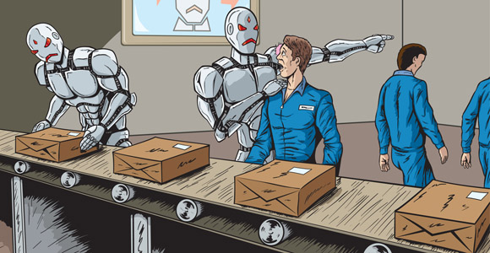
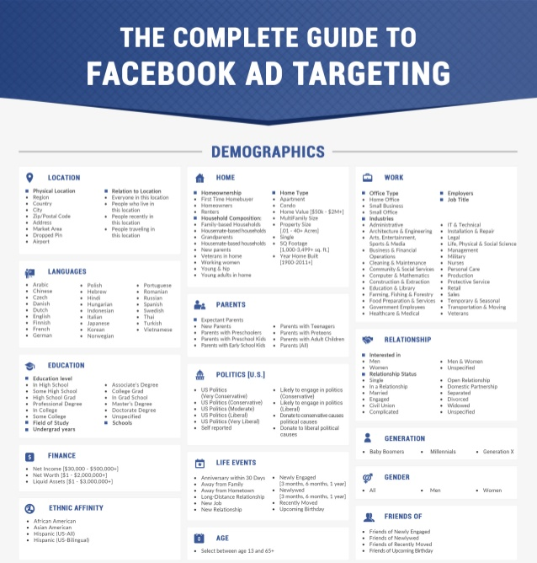
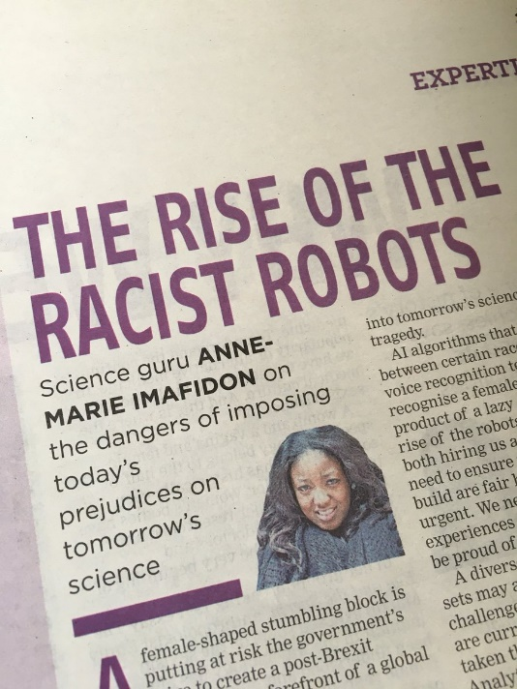
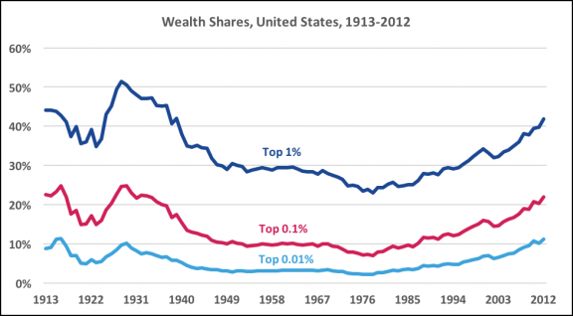
AI/Machine Learning Tutorial
Social Effects

