Slide 1
Patenting AI
Prof. Ted Sichelman
University of San Diego School of Law
April 26, 2019
* Adapted in part from material from Prof. Tabrez Ebrahim, Cal Western

Slide 2
Trends in Patenting AI
Fujii & Managai (2017), https://voxeu.org/article/trends-artificial-intelligence-technology-invention

Slide 3
Trends in Patenting AI
Carnegie Mellon Study, https://www.cmu.edu/block-center/images/center-images/AI-patent-project-media-summary.pdf

Slide 4
Trends in Patenting AI

Slide 5
Location of Invention
Carnegie Mellon Study, https://www.cmu.edu/block-center/images/center-images/AI-patent-project-media-summary.pdf

Slide 6
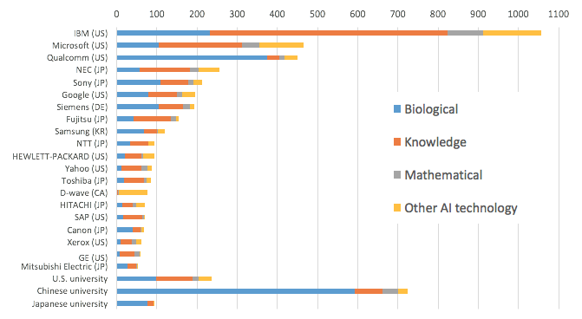
Top AI Patentholders
Fujii & Managai (2017), https://voxeu.org/article/trends-artificial-intelligence-technology-invention

Slide 7
Top AI Patentholders
Carnegie Mellon Study, https://www.cmu.edu/block-center/images/center-images/AI-patent-project-media-summary.pdf

Slide 8
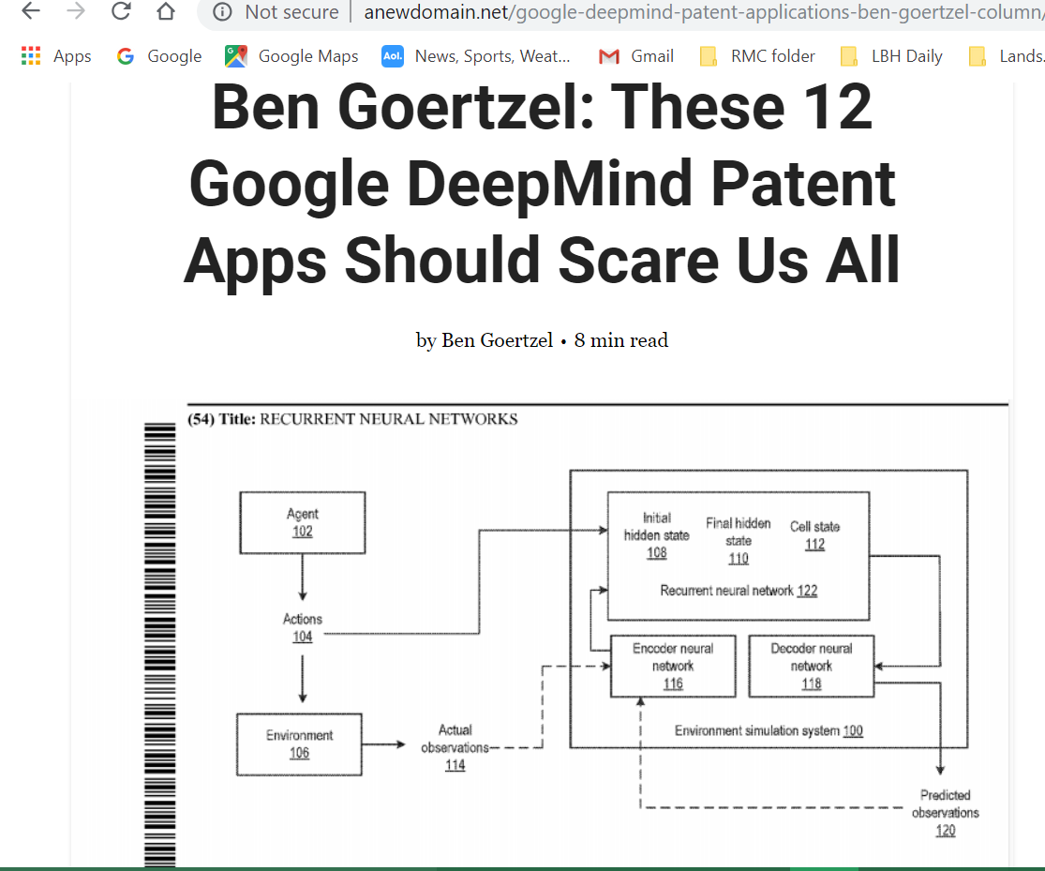
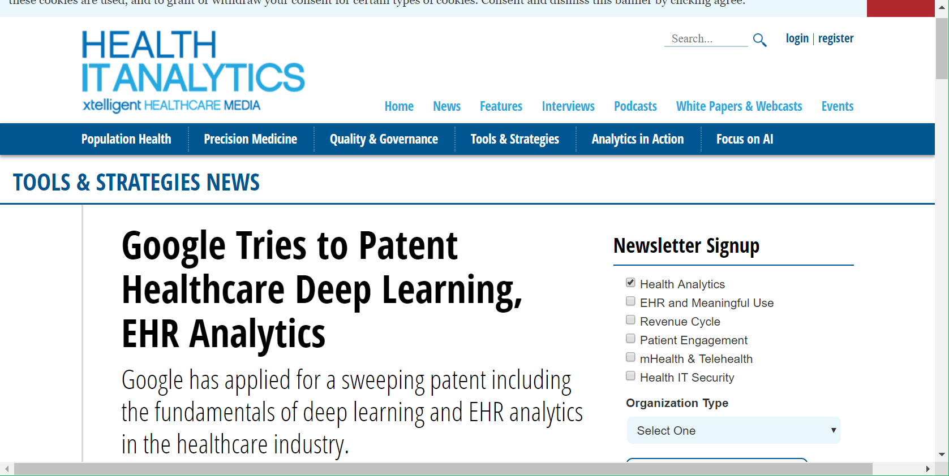
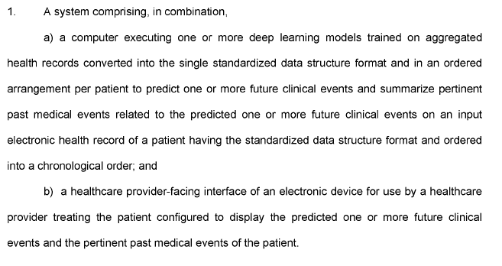
Current published Google AI Patent in Healthcare

Slide 9
AI Patent Litigation
PurePredictive, Inc. v. H2O.AI, Inc. (N.D. Cal. 2018)
  On appeal at the Federal Circuit
PurePredictive offers machine learning services and accused H2O.AI of infringement of its “predictive analytics factory” patent claims
Judge Orrick rejected the asserted as unpatentable under Section 101
Judge Orrick concluded “that this process is merely the running of data through a machine,” and that the claims “go to the general abstract concept of predictive analytics rather than any specific application.”

Slide 10
Section 101 Issues for Patent Applications
Most AI inventions relate to algorithms and algorithmic processes
Thus, most AI inventions are likely to be classified as covering “abstract ideas”
Because the application and implementation of these algorithms may often be viewed as “conventional,” AI inventions may have difficult under the Alice-Mayo two-step analysis
  See Electric Power Group, LLC v. Alstom S.A., 830 F.3d 1350 (Fed. Cir. 2016) (holding that patent claims directed to monitoring and reporting on the performance of an electric power grid were ineligible for patent protection as a result of merely being directed to generating, collecting and analyzing information).
PTO’s new guidance focusing on “practical applications” may be helpful to patenting AI

Slide 11
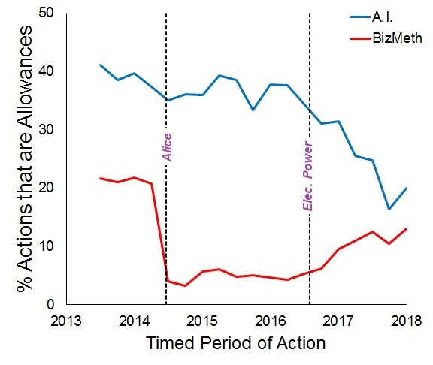
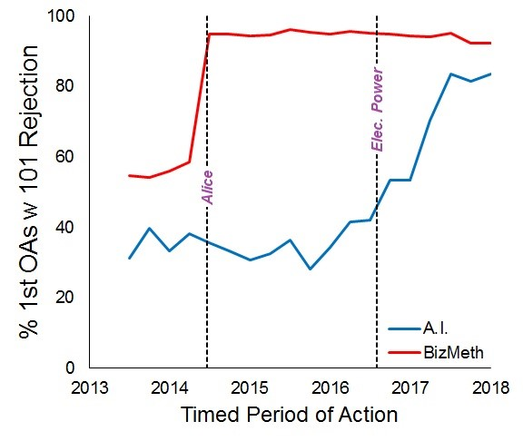
IP Watchdog “Study”

Slide 12
Other Issues for AI & Patents
Enablement/Written Description
Divided Infringement
Direct vs. Induced Infringement
“Unintentional” Infringement via AI Usage?
Ownership/Inventorship
Notes:
Enablement/Written description
-- A lot of the algorithms are hidden inside a black box, so may not be able to describe adequately. We have the code and all the excution, but we don’t necessarily understand what it is doing underneath (what’s it’s strategy in Go).
Divided Infringement
-- To the being the platform, training data, people using, how do you determine who is doing what?
Direct vs Induced infringement
-- Consider the method claim problem here – think of Globaltech.
“Unintentional infringement
-- Your AI goes through and does every permutation, but ends up accidentally infringing.
Ownership/Inventorship
-- How much should the original programmers get credit as opposed to the users, later programmers? Do the end-users assign patent rights back to the platform owners. (think about the AI generated music question)
-- Policy – Most of these tools are platform based, so the end user should have the right, and the seller can negotiate.

Slide 13
Prof. Ted Sichelman tsichelman@sandiego.edu

