Slide 1



April 28, 2019
Copyright Protection for
Computer-Generated Works
Peter S. Menell
Koret Professor of Law
Director, Berkeley Center for Law & Technology
UC Berkeley School of Law

Slide 2
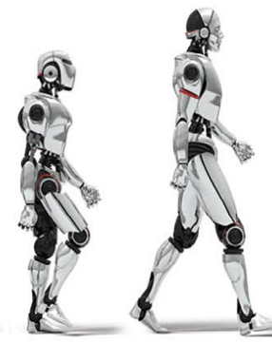
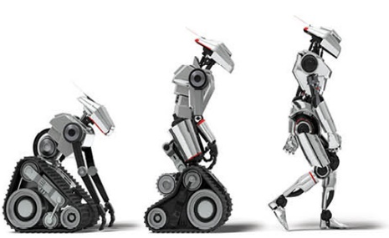


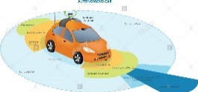

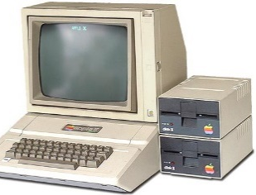
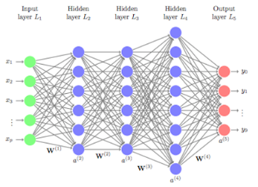
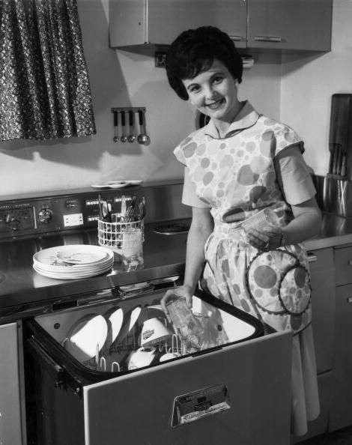

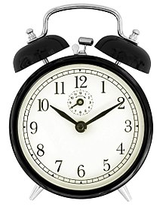
AI/Machine Learning Tutorial
?
Evolution of Intelligent Machines
Independent
Thought/
Sentience
• Artificial General
Intelligence (AGI)
Deep
Learning
General Purpose Computing
• past experience
Reactive Machines
• memory
• programmable
• real time learning
• memory
• goal-oriented
• no memory
• algorithms
• autonomous
re-programming
• no learning
© 2019 Peter S. Menell

Slide 3
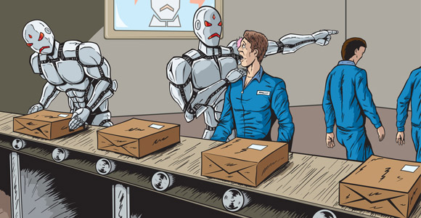
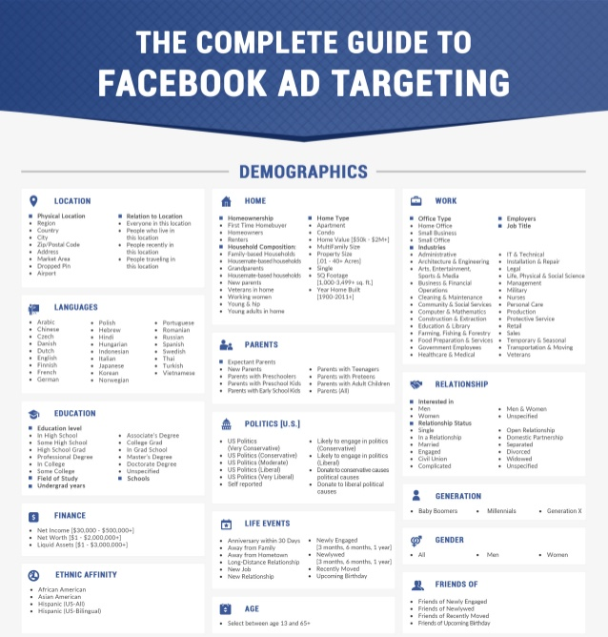
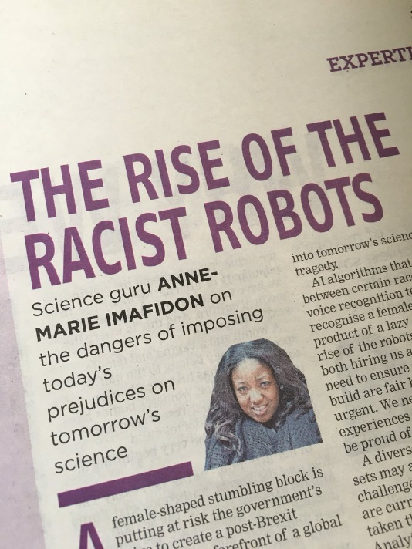
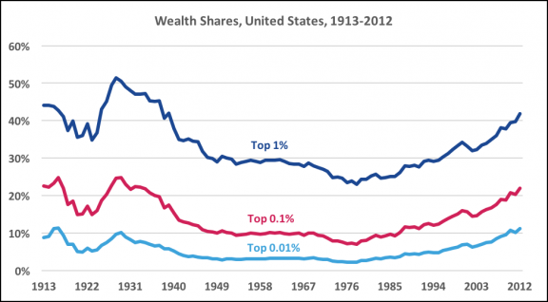

AI/Machine Learning Tutorial
Social Effects

Slide 4
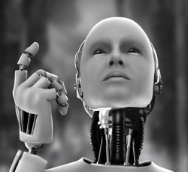
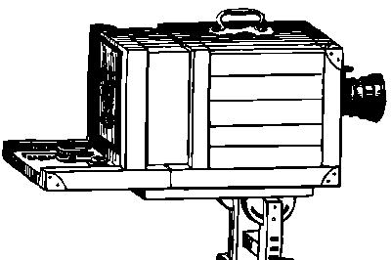
Computer-Generated Works
Human-Computer
Collaborative Works
AGI-Created
Works
• Analogy to Machine-
Assisted Works
• Photography
• Musical Instrument
• Word Processing

Slide 5
Artificial general intelligence (AGI) is the intelligence of a machine that could successfully perform any intellectual task that a human being can.
Notes:
Artificial general intelligence (AGI) is the intelligence of a machine that could successfully perform any intellectual task that a human being can. It is a primary goal of some artificial intelligence research and a common topic in science fiction and future studies.
On 7 March 2012, Quantic Dream released a short film entitled "Kara", displaying their new game engine that uses new motion capture technology running on a PlayStation 3. The short, displayed in real time, revolves around a newly constructed Android named Kara (played by Valorie Curry) who presents a dilemma to her operator after discovering the ability to think.
https://www.bostonglobe.com/ideas/2017/09/08/robots-need-civil-rights-too/igtQCcXhB96009et5C6tXP/story.html
IDEAS | ANNALEE NEWITZ

Slide 6
What Is Intelligence?
Intelligence Quotient (IQ): Knowledge, Processing Speed, Analytic Skill, Emotional/inter-personal Sensitivity, Goal-Oriented Behavior, Learning, Problem Solving, . . .
Learning: Experience, Adaptation, Strategic Interaction, . . .
Problem Solving: Optimization, Planning, Decisionmaking, Problem Solution, Problem Recognition
Visual/Spatial Awareness: Optimization, Object Recognition, Identifying Edges
Notes:
https://www.psychologytoday.com/us/blog/hide-and-seek/201811/what-is-intelligence
We Westerners tend to think of intelligence in terms of analytical skills. But in a close-knit hunter-gatherer society, intelligence might be defined more in terms of foraging skills, or social skills or responsibilities. Even within a single society, the skills that are most valued change over time. In the West, the emphasis has gradually shifted from language skills to more purely analytical skills, and it is only in 1960, well within living memory, that the Universities of Oxford and Cambridge dropped Latin as an entry requirement. In 1990, Peter Salovey and John D. Mayer published the seminal paper on emotional intelligence, and E.I. quickly became all the rage. In the same year, Tim Berners-Lee wrote the first web browser. Today, we cannot go very far without having some considerable I.T. skills (certainly by the standards of 1990), and computer scientists are among some of the most highly paid professionals. So what constitutes intelligence varies according to our priorities and values.
Our society holds analytical skills in such high regard that some of our leaders cite their ‘high I.Q.’ to defend their more egregious actions. This Western emphasis on reason and intelligence has its roots in Ancient Greece with Socrates, his pupil Plato, and Plato’s pupil Aristotle. Socrates held that ‘the unexamined life is not worth living’. He typically proceeded by questioning one or more people about a certain concept such as courage or justice, eventually exposing a contradiction in their initial assumptions and provoking a reappraisal of the concept. For Plato, reason could carry us far beyond the confines of common sense and everyday experience into a ‘hyper-heaven’ of ideal forms. He famously fantasized about putting a geniocracy of philosopher-kings in charge of his utopic Republic. Finally, Aristotle argued that our distinctive function as human beings is our unique capacity to reason, and therefore that our supreme good and happiness consists in leading a life of rational contemplation. To paraphrase Aristotle in Book X of the Nicomachean Ethics, ‘man more than anything is reason, and the life of reason is the most self-sufficient, the most pleasant, the happiest, the best, and the most divine of all.’ In later centuries, reason became a divine property, found in man because made in God’s image. If you struggled with your SATs, or thought they were pants, you now know who to blame.
article continues after advertisement
Unfortunately, the West’s obsession with analytical intelligence has had, and continues to have, dire moral and political consequences. Immanuel Kant most memorably made the connection between reasoning and moral standing, arguing (in simple terms) that by virtue of their ability to reason human beings ought to be treated, not as means to an end, but as ends-in-themselves. From here, it is all too easy to conclude that, the better you are at reasoning, the worthier you are of personhood and its rights and privileges. For centuries, women were deemed to be 'emotional', that is, less rational, which justified treating them as chattel or, at best, second-class citizens. The same could be said of non-white people, over whom it was not just the right but the duty of the white man to rule. Kipling’s poem The White Man’s Burden (1902) begins with the lines: Take up the White Man’s burden/ Send forth the best ye breed/ Go bind your sons to exile/ To serve your captives’ need/ To wait in heavy harness/ On fluttered folk and wild/ Your new-caught, sullen peoples/ Half-devil and half-child. People deemed to be less rational—women, non-white people, the lower classes, the infirm, the 'deviant'—were not just disenfranchised but dominated, colonized, enslaved, murdered, sterilized, in all impunity. Only in 2015 did the U.S. Senate vote to compensate living victims of government-sponsored sterilization programs for the, I quote, ‘feeble-minded’. Today, of all people, it is the white man who most fears artificial intelligence, imagining that it will usurp his status and privilege.
According to one recent paper, I.Q. is the best predictor of job performance. But that is not altogether surprising given that ‘performance’ and I.Q. have been defined in similar terms, and that both depend, at least to some extent, on third factors such as compliance, motivation, and educational attainment. Rather than intelligence per se, genius is defined more by drive, vision, creativity, and luck or opportunity, and it is notable that the minimum I.Q. necessary for genius—probably around 125—is not all that high.
William Shockley and Luis Walter Alvarez, who both went on to win the Nobel Prize for physics, were excluded from the Terman Study of the Gifted on account of…their modest I.Q. scores.
For the story, in later life Shockley developed controversial views on race and eugenics, setting off a national debate over the use and applicability of I.Q. tests.
References
Salovey P & Mayer JD (1990): Emotional intelligence. Imagination, Cognition and Personality 9(3):185–211.
Rees MJ & Earles JA (1992): Intelligence is the Best Predictor of Job Performance. Current Directions in Psychological Science 1(3): 86-89.
Saxon W (1989): Obituary William B. Shockley, 79, Creator of Transistor and Theory on Race. New York Times, August 14, 1989.

Slide 7

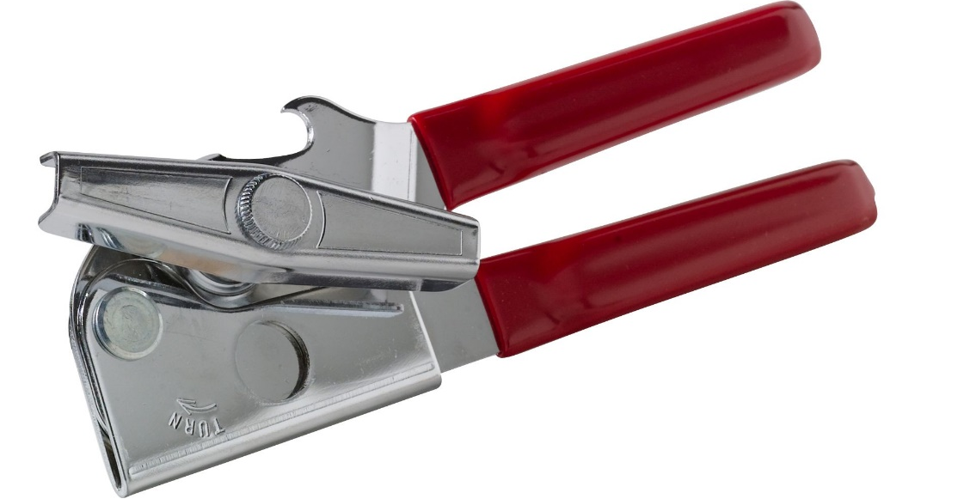
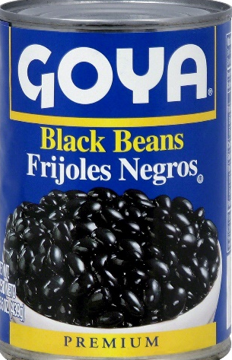

Slide 8
Neural Networks - https://www.youtube.com/watch?v=aircAruvnKk
How machines learn: https://www.youtube.com/watch?v=IHZwWFHWa-w
Slaughterbots
https://www.youtube.com/watch?v=9CO6M2HsoIA&t=

Slide 9
AGI-Created Works:
© Issues
• Authorship
• Derivative Works
• Ownership

Slide 10

Authorship/Originality Requirement
U.S. Constitution
Article I §8, cl. 8
Congress shall have power
To Promote the Progress of Science and the useful Arts, by securing for limited Times, to Authors, the exclusive Right to their respective Writings and Discoveries.

Slide 11
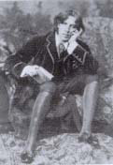
Modicum of Human Creativity
An author is “he to whom anything owes it origin; originator; maker; one who completes a work of science or literature;”
Copyright is “the exclusive right of a man to the production of his own genius or intellect.”
The author is “the cause of the picture” and “the man who … gives effect to the idea, fancy, or imagination.
Burrows-Giles Lithographic Co. v. Sarony, 11 U.S. 53, 57-58, 61 (1884)

Slide 12
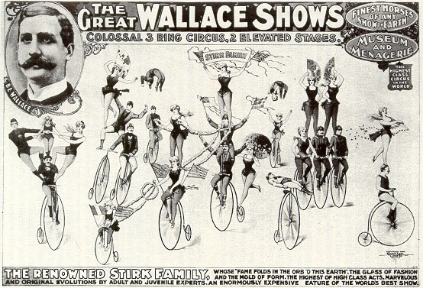
“The copy is the personal reaction of an individual upon nature. Personality always contains something unique. . . . something irreducible, which is one man’s alone. That something he
may copyright.”
Bleistein v. Donaldson Lithographing Co., 188 U.S. 239, 250 (1903)

Slide 13

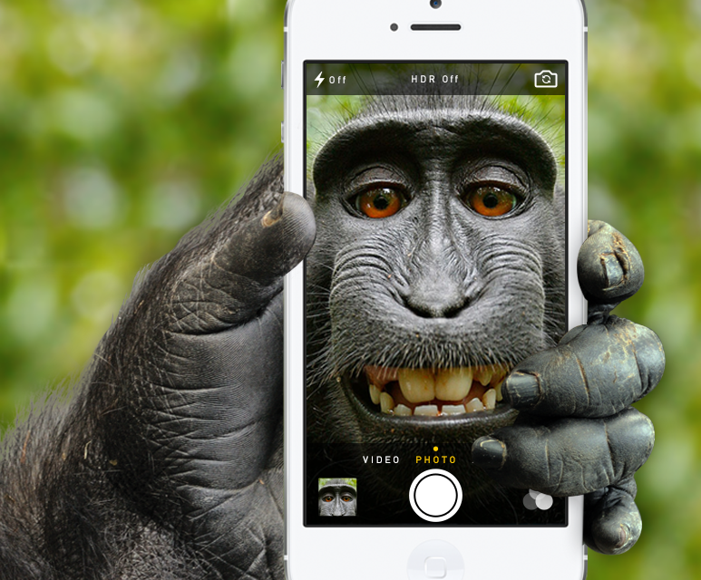
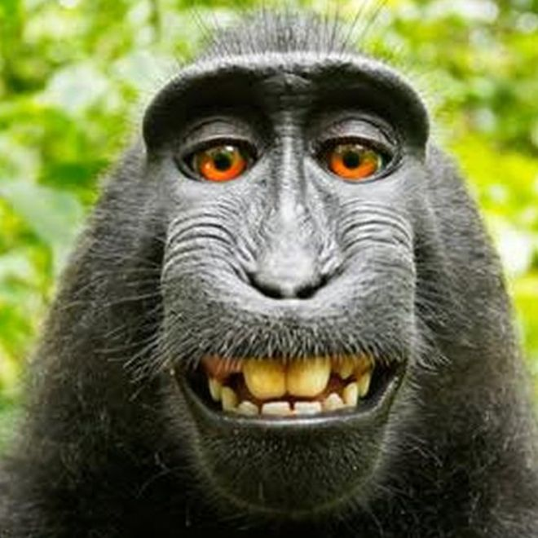
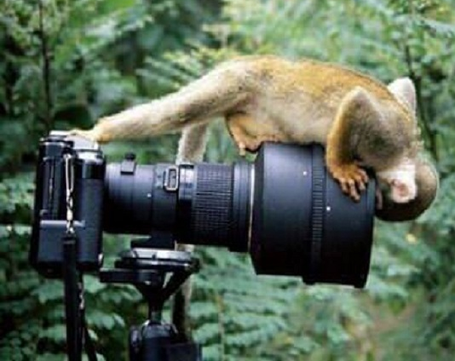
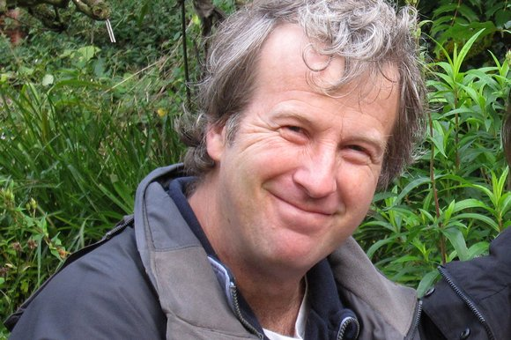
ND California
)
)
)
)
)
)
)
Naruto
vs.
David Slater
Copyright Infringement
Notes:
PETA sued wildlife photographer David Slater and the self-publishing book company Blurb, Inc., for infringing the copyright of Naruto, a six-year-old Sulawesi crested macaque.
‘Monkey Selfie' Not Eligible for Copyright Protection
Posted January 07, 2016, 4:35 P.M. ET
By Anandashankar Mazumdar
A “selfie” photograph taken by an Indonesian monkey named Naruto is not eligible for protection under U.S. copyright law, according to a preliminary bench ruling by the U.S. District Court for the Northern District of California yesterday.
In civil minutes issued after a brief hearing, the court stated that it agreed with the Copyright Office's opinion that the Copyright Act of 1976 extends protection only to works created by humans.
The animal rights organization People for the Ethical Treatment of Animals filed a complaint in September against David Slater, a photographer who set up a camera that was operated by Naruto, arguing that Slater and publisher Blurb Inc. violated Naruto's copyright interest by publishing Naruto's works.
* *
http://motherboard.vice.com/read/judge-gives-monkey-second-chance-to-sue-for-copyright-infringement
Back in September, PETA brought a copyright lawsuit on behalf of a viral-selfie-taking macaque. Although the judge dismissed the suit in a written opinion released Friday, the organization has leave to amend—meaning that if it wants, PETA can try yet again to get damages from nature photographer David Slater and the self-publishing company Blurb, Inc.
Slater has had his own troubles with the monkey over the years. Wikimedia has refused to take down what he views as his photograph, concluding that the selfie is public domain because it was taken by a non-human. However, he only went to court over it after the monkey lawyered up.
PETA argued that non-humans like Naruto, a Sulawesi crested macaque, are authors under the Copyright Act, and therefore they can sue for copyright infringement. Sulawesi crested macaques are critically endangered, and PETA says it would use the proceeds from licensing the photograph to benefit Naruto, his family, and his habitat.
The only problem is that in the 9th Circuit—an appellate jurisdiction that includes the Northern District of California, where PETA has brought the lawsuit—follows Cetacean v. Bush, which says that animals cannot be plaintiffs in court unless the law cited specifically says so.
In Cetacean, a “self-appointed attorney for all of the world’s whales, porpoises, and dolphins” sued under the Endangered Species Act, the Marine Mammal Protection Act, and the National Environmental Policy Act. The lawsuit was dismissed, since “if Congress and the President intended to take the extraordinary step of authorizing animals as well as people and legal entities to sue, they could, and should, have said so plainly.”
Following the same logic, Judge William H. Orrick handed down a written opinion last Friday, granting a motion to dismiss the suit.
In the court hearing on January 6, the judge may have been struggling to hide his amusement. He began the proceedings by thanking PETA for its filings, saying, “I thought your brief was…. interesting.” Right off the bat, he declared his intention to dismiss the complaint, but, “I’m very happy to hear any argument you want to make.”
The attorney for Naruto, David A. Schwarz suggested that a ruling in favor of the macaque would be a progressive step forward similar to women’s emancipation, or the liberation of the slaves. He analogized Naruto’s supposed inability to own a copyright to an enslaved African-American’s inability to own a patent prior to the adoption of the 14th Amendment.
After Schwarz spoke at great length, Andrew Dhuey, the attorney for photographer David Slater, stepped in. “It’s a question of whether a monkey has statutory standing to sue, which it does not,” he said sternly. “We’re engaging in somewhat of a Socratic debate and that is not appropriate.”
The judge ultimately dismissed the lawsuit, but gave PETA leave to file an amended complaint—meaning that Naruto the macaque will have a second shot at claiming his copyright.
But it’s unclear how PETA would get around the judge’s initial ruling. “[T]here is no mention of animals anywhere in the Copyright Act,” the judge wrote. He also noted that the self-appointed representatives of the monkey “have not cited, and I have not found, a single case that expands the definition of authors to include animals.”
PETA has not yet decided whether it will file an amended complaint. When asked for comment, PETA general counsel Jeffrey Kerr said, “My mentor told me that in social-cause cases, ‘First, you lose, you lose, you lose. Then you win.’ And we are treading that path for animal rights in the hope that we may lose, lose, lose, but that we will one day win.”
* *
http://motherboard.vice.com/read/in-monkey-selfie-lawsuit-lawyer-in-chippendales-garb-is-the-reasonable-one

Slide 14
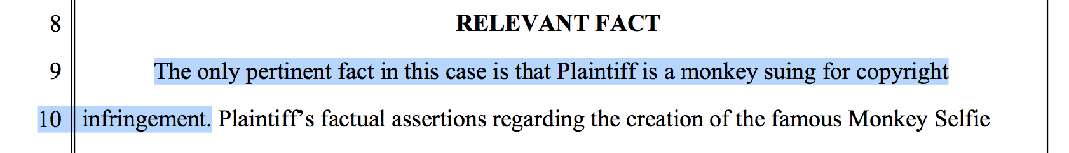
ND California
Dismissed
)
)
)
)
)
)
)
Naruto
vs.
David Slater
Copyright Infringement
Naruto v. David John Slater, 2016 WL 362231 (ND Cal 2016)
Notes:
PETA sued wildlife photographer David Slater and the self-publishing book company Blurb, Inc., for infringing the copyright of Naruto, a six-year-old Sulawesi crested macaque.
‘Monkey Selfie' Not Eligible for Copyright Protection
Posted January 07, 2016, 4:35 P.M. ET
By Anandashankar Mazumdar
A “selfie” photograph taken by an Indonesian monkey named Naruto is not eligible for protection under U.S. copyright law, according to a preliminary bench ruling by the U.S. District Court for the Northern District of California yesterday.
In civil minutes issued after a brief hearing, the court stated that it agreed with the Copyright Office's opinion that the Copyright Act of 1976 extends protection only to works created by humans.
The animal rights organization People for the Ethical Treatment of Animals filed a complaint in September against David Slater, a photographer who set up a camera that was operated by Naruto, arguing that Slater and publisher Blurb Inc. violated Naruto's copyright interest by publishing Naruto's works.
* *
http://motherboard.vice.com/read/judge-gives-monkey-second-chance-to-sue-for-copyright-infringement
Back in September, PETA brought a copyright lawsuit on behalf of a viral-selfie-taking macaque. Although the judge dismissed the suit in a written opinion released Friday, the organization has leave to amend—meaning that if it wants, PETA can try yet again to get damages from nature photographer David Slater and the self-publishing company Blurb, Inc.
Slater has had his own troubles with the monkey over the years. Wikimedia has refused to take down what he views as his photograph, concluding that the selfie is public domain because it was taken by a non-human. However, he only went to court over it after the monkey lawyered up.
PETA argued that non-humans like Naruto, a Sulawesi crested macaque, are authors under the Copyright Act, and therefore they can sue for copyright infringement. Sulawesi crested macaques are critically endangered, and PETA says it would use the proceeds from licensing the photograph to benefit Naruto, his family, and his habitat.
The only problem is that in the 9th Circuit—an appellate jurisdiction that includes the Northern District of California, where PETA has brought the lawsuit—follows Cetacean v. Bush, which says that animals cannot be plaintiffs in court unless the law cited specifically says so.
In Cetacean, a “self-appointed attorney for all of the world’s whales, porpoises, and dolphins” sued under the Endangered Species Act, the Marine Mammal Protection Act, and the National Environmental Policy Act. The lawsuit was dismissed, since “if Congress and the President intended to take the extraordinary step of authorizing animals as well as people and legal entities to sue, they could, and should, have said so plainly.”
Following the same logic, Judge William H. Orrick handed down a written opinion last Friday, granting a motion to dismiss the suit.
In the court hearing on January 6, the judge may have been struggling to hide his amusement. He began the proceedings by thanking PETA for its filings, saying, “I thought your brief was…. interesting.” Right off the bat, he declared his intention to dismiss the complaint, but, “I’m very happy to hear any argument you want to make.”
The attorney for Naruto, David A. Schwarz suggested that a ruling in favor of the macaque would be a progressive step forward similar to women’s emancipation, or the liberation of the slaves. He analogized Naruto’s supposed inability to own a copyright to an enslaved African-American’s inability to own a patent prior to the adoption of the 14th Amendment.
After Schwarz spoke at great length, Andrew Dhuey, the attorney for photographer David Slater, stepped in. “It’s a question of whether a monkey has statutory standing to sue, which it does not,” he said sternly. “We’re engaging in somewhat of a Socratic debate and that is not appropriate.”
The judge ultimately dismissed the lawsuit, but gave PETA leave to file an amended complaint—meaning that Naruto the macaque will have a second shot at claiming his copyright.
But it’s unclear how PETA would get around the judge’s initial ruling. “[T]here is no mention of animals anywhere in the Copyright Act,” the judge wrote. He also noted that the self-appointed representatives of the monkey “have not cited, and I have not found, a single case that expands the definition of authors to include animals.”
PETA has not yet decided whether it will file an amended complaint. When asked for comment, PETA general counsel Jeffrey Kerr said, “My mentor told me that in social-cause cases, ‘First, you lose, you lose, you lose. Then you win.’ And we are treading that path for animal rights in the hope that we may lose, lose, lose, but that we will one day win.”
* *
http://motherboard.vice.com/read/in-monkey-selfie-lawsuit-lawyer-in-chippendales-garb-is-the-reasonable-one

Slide 15
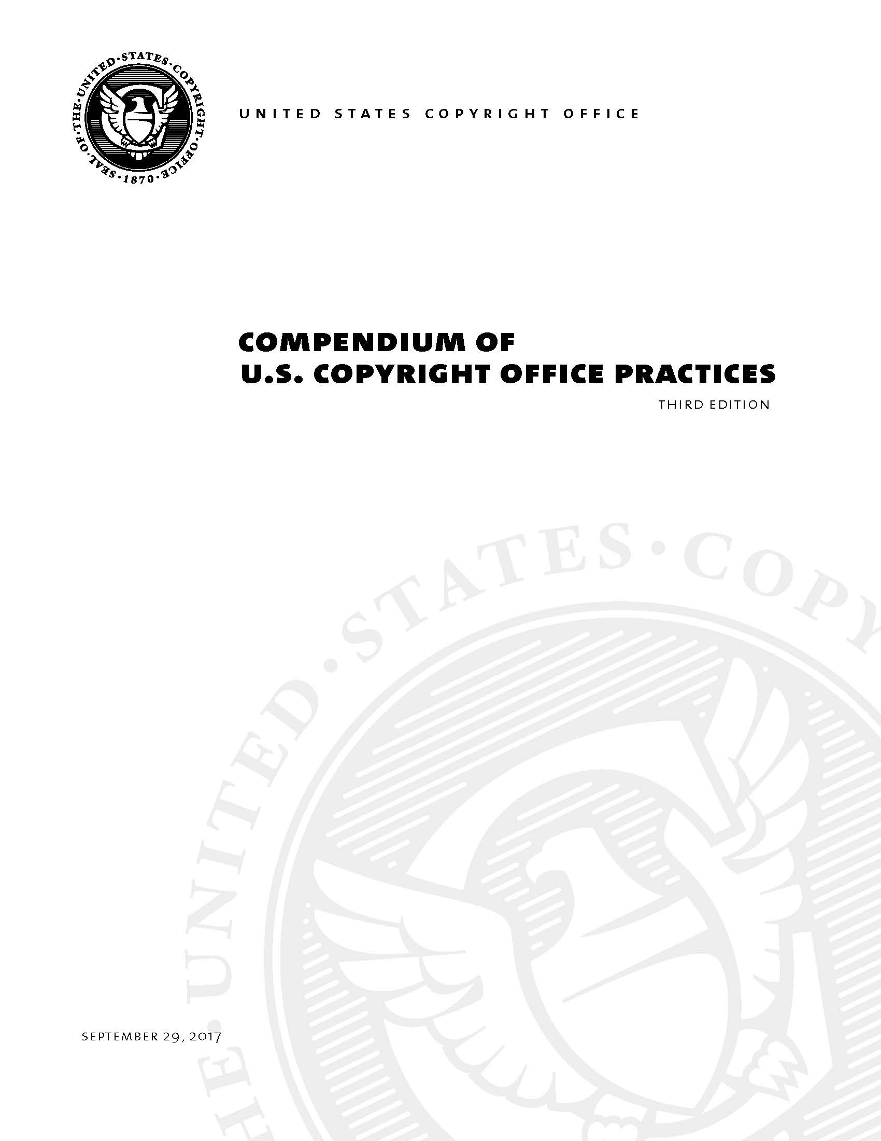
September 27, 2017

Slide 16
313 Uncopyrightable Material
The U.S. Copyright Office has no authority to register works that are not protected by copyright law.
313.2 Works That Lack Human Authorship
As discussed in Section 306, the Copyright Act protects “original works of authorship.” 17 U.S.C. § 102(a) (emphasis added). To qualify as a work of “authorship” a work must be created by a human being. See Burrow-Giles Lithographic Co., 111 U.S. at 58. Works that do not satisfy this requirement are not copyrightable.
The Office will not register works produced by nature, animals, or plants. Likewise, the Office cannot register a work purportedly created by divine or supernatural beings, although the Office may register a work where the application or the deposit copy(ies) state that the work was inspired by a divine spirit.
Examples:
• A photograph taken by a monkey.
• A mural painted by an elephant.

Slide 17
313.2 Works That Lack Human Authorship
Similarly, the Office will not register works produced by a machine or mere mechanical process that operates randomly or automatically without any creative input or intervention from a human author.
Examples:
• Reducing or enlarging the size of a preexisting work of authorship.
• Making changes to a preexisting work of authorship that are dictated by
manufacturing or materials requirements.
• Converting a work from analog to digital format, such as transferring a motion
picture from VHS to DVD.
• Declicking or reducing the noise in a preexisting sound recording or converting
a sound recording from monaural to stereo sound.
• Transposing a song from B major to C major.
• Medical imaging produced by x-rays, ultrasounds, magnetic resonance imag-
ing, or other diagnostic equipment.
• A claim based on a mechanical weaving process that randomly produces
irregular shapes in the fabric without any discernible pattern.

Slide 18
AGI-Created Works:
© Issues
• Authorship
• Derivative Works
• Ownership

Slide 19
Derivative Works
§101. A “derivative work” is a work based on one or more preexisting works, such as a translation, musical arrangement, dramatization, fictionalization, motion picture version, sound recording, art reproduction, abridgement, condensation, or any other form in which a work may be recast, transformed, or adapted. A work consisting of editorial revisions, annotations, elaborations, or other modifications which, as a whole, represent an original work of authorship, is a “derivative work.”

Slide 20
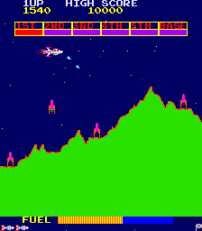
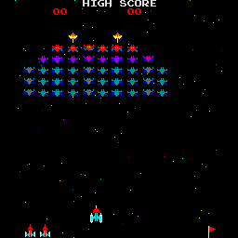
Fixation: Videogame Cases
Are audiovisual images generated by a video game fixed in a tangible medium of expression?
Does the participation of the player prevent the fixation of audiovisual images?
Scramble
Galaxian
Yes: they are fixed in a computer program stored in the game’s read only memory (ROM) chips
No: the shape of aliens, what they look like, and how they move are fixed in the computer’s memory.
Midway Mfg. v. Artic Int’l, 704 F.2d 1009 (7th Cir. 1983), cert. denied, 464 U.S. 823 (1983)
Stern Electronics v. Kaufman, 669 F.2d 852 (2d Cir. 1982)

Slide 21
AGI-Created Works:
© Issues
• Authorship
• Derivative Works
• Ownership

Slide 22
Works Made for Hire
freelance artist
1976 Act Regime
(1) employee
(2) independent contractor
• agency relationship– multi-factor test:
• “specially ordered or commissioned”
• Right to control work being performed
• within an enumerated category:
• Skill required
• Source of instrumentalities and tools
• contribution to collective work
• Location of work
• part of motion picture/AV work
• Duration of relationship
• translation
• Right to assign additional projects
• supplementary work
• Hired party’s discretion
• compilation
• Method of payment
• Role in hiring and paying assistants
• test
• Regular course of employer’s business
• answer material for a test
• Payment of employee benefits, taxes
• atlas
• within scope of employment
• written agreement signed by both
parties expressly stating “work made
for hire.”

Slide 23
Computer-Generated Works
(UK, New Zealand, Ireland, Hong Kong, South Africa, India)
Definition: A work that is generated by a computer “such that there is no human author,” or in relation to which the author “is not an individual.”
Ownership: Authorship is given to the person by whom the arrangements necessary for the creation of the work are undertaken, or to the person who causes the work to be created.
Term of Protection: 50 year from date of creation (UK)

Slide 24
Policy Analysis
U.S. Constitution
Article I §8, cl. 8
Congress shall have power
To Promote the Progress of Science and the useful Arts, by securing for limited Times, to Authors, the exclusive Right to their respective Writings and Discoveries.

Slide 25
Policy Analysis: Promote Progress
• Patents Are Best Suited to Promote Technological
Advances (Methods, Systems)
• Need to Protect Autonomous Outputs by © ?
• Integrated products (e.g., A/V works) can be
protected through human collaboration
• Contract, advertising, and DRM provide other
appropriability mechanisms

