Slide 1
2019 LAIPLA Fireside Chat with Regan Smith
Hosted by
Erica Van Loon
Partner, Lathrop Gage
April 27, 2019

Slide 2
Session Agenda
Background
A day in the life at the Copyright Office
Trends in Copyright Law
Recent and Pending Copyright Cases
Concluding Remarks
Q&A

Slide 3
Background
Career experiences prior to Copyright Office
Qualities and skills essential to success in the role
Mandates and objectives for leading the Office of General Counsel

Slide 4

A day in the life at the Copyright Office
Average day at the Office
Structure and organization of the Office
Biggest challenges
Notable achievements

Slide 5
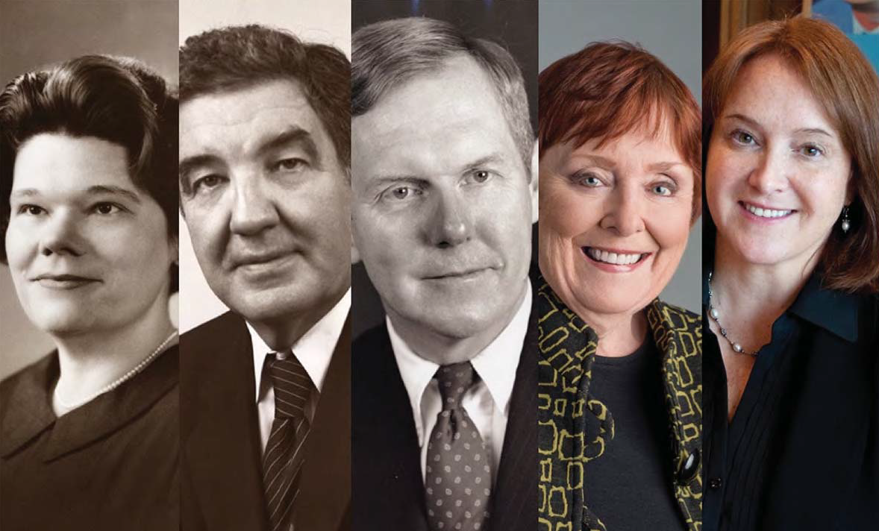
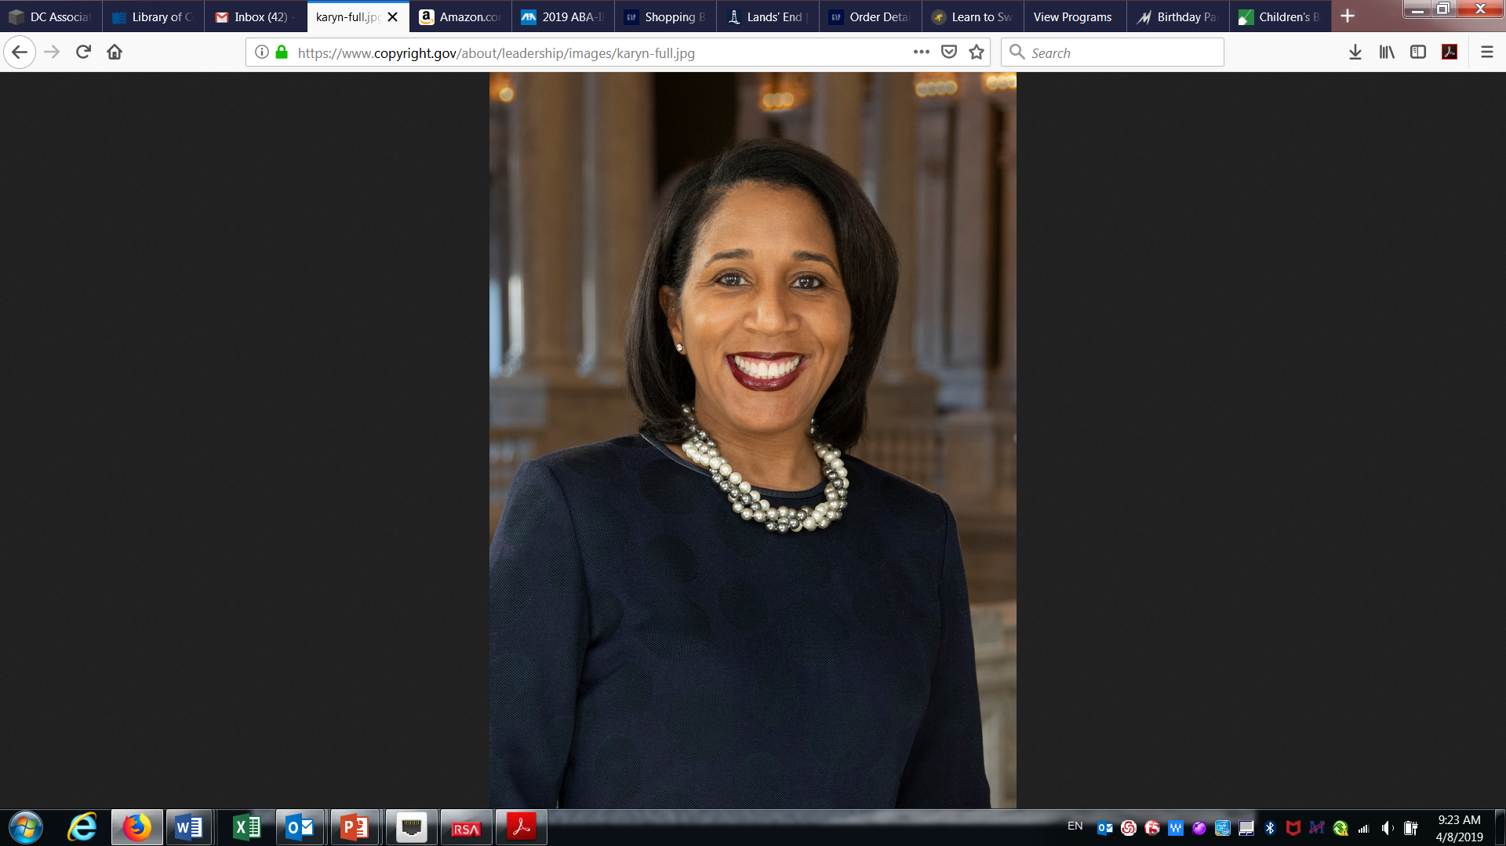
A new appointed Register!

Slide 6
By the numbers – FY 2018
Recorded nearly 21,700 documents for over 757,400 works
Registered 560,013 claims for copyright
Received over 540,000 claims for registration

Slide 7
By the numbers – FY 2018
Put more than 17.5 million digital images of cards online
Collected over $221 million in royalties; managed over $1.3 billion
Answered 195,750 public inquiries

Slide 8
Improved processing times
The average processing time for all registration applications is 5 months

Slide 9
Modernization – Notice of Inquiry
Looked for input on registration modernization
How users interact with the registration system
Information requested on applications
How people are engaging with and managing Copyright Office records
Deposit requirements, including searchable database of deposits
Reviewing comments now

Slide 10
Modernization: What We’re Working On
Welcome screen
Applications screen
Recordation Development
Initial limited pilot expected
2020

Slide 11
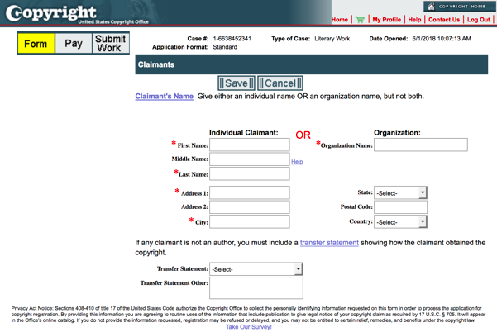
Modernization: What We’re Working On
Current eCO
Initial draft concept
Registration Outreach

Slide 12
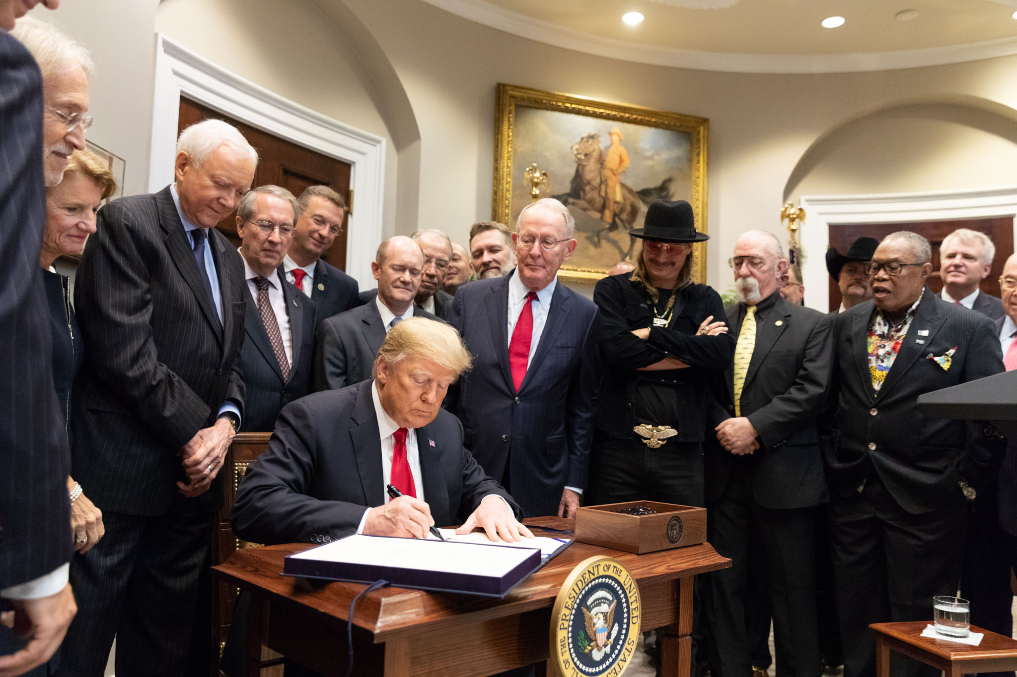
Copyright Law Trends
Music Modernization Act
  Intended to modernize copyright law for songwriters, music publishers, digital music services, record labels, and others involved in music creation and distribution.

Slide 13




Copyright Law Trends
Music Modernization Act
  Most substantial copyright change in 20 years.
  Responds to new problems presented by streaming services like Spotify, Amazon Prime, and Apple Music.
  Received broad bipartisan support from both sides of the aisle, as well as from artists and the streaming services.
  Promises to provide more revenue for the artists while providing more certainty for the distributers, who were spending time and money to ascertain rights, license works, and respond to lawsuits.

Slide 14
Copyright Law Trends
Music Modernization Act
  Title I – Music License Modernization
    Establishes a blanket mechanical licensing scheme for digital music service provides, and collect and distribute royalties to rights holders.
  Title II – CLASSICS Act
    Creates a digital performance right in pre-1972 sound recordings equivalent to post-1972 works.
    Permits “certain non-commercial uses of [pre-1972 orphan works] that are not being commercially exploited.”
  Title III – AMP Act
    Creates statutory right to royalties for producers, mixers, and sound engineers, absent a separate agreement with the recording artist.

Slide 15
Copyright Law Trends
Digital Millennium Copyright Act (DMCA) reform
  Copyright Office streamlined the process for the section 1201 rulemaking; recommendations and final rule were widely praised
  The Office also proposed several reforms to the section 1201 anti-circumvention provision, including new or expanded permanent exemptions for:
    Security research and reverse engineering
    Disability assistive technology
    Mobile device unlocking
    Diagnosis, maintenance, and repair

Slide 16
Copyright Law Trends
Digital Millennium Copyright Act (DMCA) reform
  Copyright Office has been collecting public comment on the section 512 safe harbor provision
  15 Music Industry (RIAA, etc.) groups comments:
    Notice and takedown not a sufficient remedy for infringement
    Imposes burdens and costs on the aggrieved copyright owner
    Statutory term “expeditiously” is undefined
    Search algorithms promote infringing sites regardless of takedown notice and compliance
    Safe harbor provisions apply beyond ISPs to entertainment providers that profit off the infringing activity before receiving a takedown notice

Slide 17
Copyright Law Trends
Digital Millennium Copyright Act (DMCA) reform
  Computer and Communications Industry Ass’n (representing ISPs) comments:
    DMCA fostered the growth of the then-nascent internet industry
    DMCA has reduced copyright litigation by providing out-of-court resolution process
    Flexible standards are needed for different-sized providers since small providers can’t respond as quickly as larger entities
    Harsher standards would necessarily stifle creativity since some non-infringing work would necessarily be removed, in Fair Use situations, for example.

Slide 18
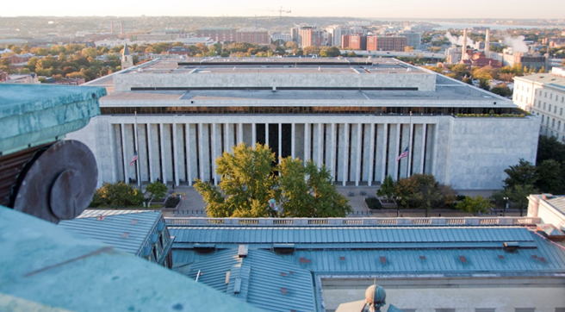
Copyright Law Trends
Copyright “small claims court”
  Copyright Alternative in Small-Claims Enforcement (CASE) Act of 2017: proposed voluntary small claims board within the Copyright office of $15K per work and $30K total.

Slide 19

Copyright Law Trends
Rapid changes in technology and its effects on copyright
Artificial Intelligence
Blockchain as a tool to protect rights holders

Slide 20
Recent Cases
Fourth Estate Pub. Benefit Corp. v. Wall-Street.com, LLC, 139 S. Ct. 881 (2019) (Registration of a copyright claim occurs, and a copyright claimant may commence an infringement suit, when the Copyright Office registers a copyright, not when a copyright owner submits the application, materials, and registration fee to the Copyright Office.)

Slide 21
Recent Cases
Fourth Estate Pub. Benefit Corp. v. Wall-Street.com, LLC, 139 S. Ct. 881 (2019)
  Copyright Office co-authored Amicus Brief on behalf of the U.S., supporting Court of Appeals interpretation (ultimately affirmed by a unanimous Supreme Court), that a copyright infringement suit cannot be commenced until the Office grants or refuses a registration.
    Supported by textual analysis and historical precedent.

Slide 22
Recent Cases
Rimini Street v. Oracle, 139 S.Ct. 873 (2019) (A federal district court’s discretion to award “full costs” to a copyright litigant is limited to the six categories defined by statute).
  “Full costs” simply means the full amount in those categories authorized by statute.
  Specifically, litigation expenses are not included in this list, so the $12.8 million the district court ordered Rimini to pay Oracle was improper.

Slide 23
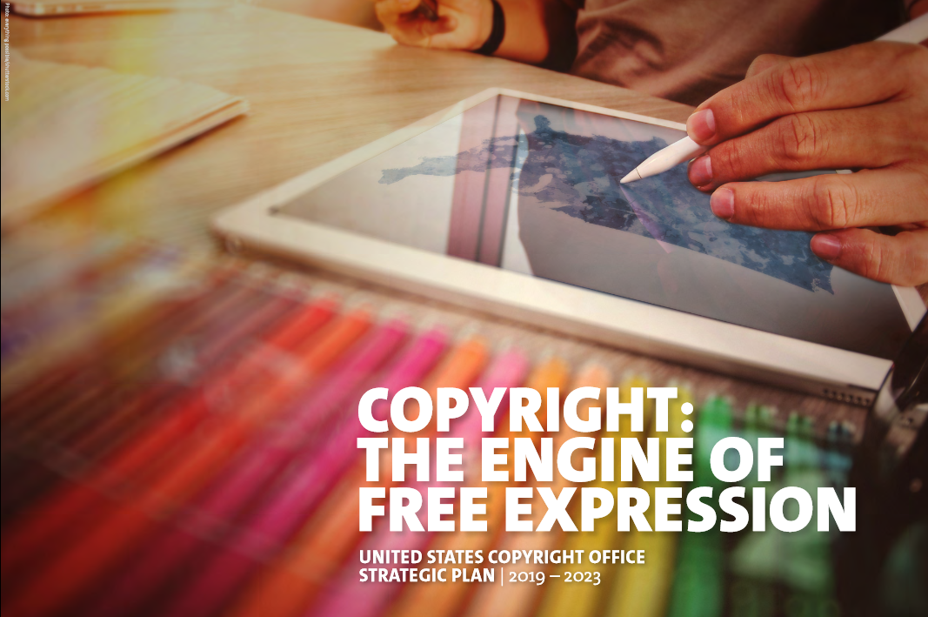
Concluding Remarks
Goals for the coming year
Five-year outlook
Final Thoughts
Questions and Answers

