Slide 1
& LAIPLA Spring Seminar
Adding a European Tour To Your Patent Dispute Strategy

Slide 2
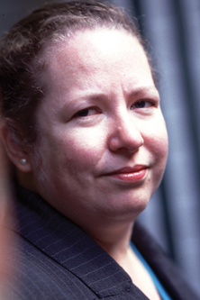
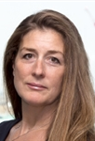
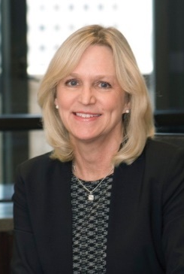

Introducing the Panel
Morag Macdonald
    Morag Macdonald is Joint Head of the International Intellectual Property Group of Bird & Bird LLP, based in London.
Sophie Eyre
    Sophie is a Co-Head of the London Dispute Resolution group of Bird & Bird LLP.
Debra Condino
Debra is currently Vice President of Intellectual Property at Sienna Biopharmaceuticals, Inc., based in Westlake Village, California.
Karen P. Anderson
Karen is the Vice President of Global Litigation, Employment Law, and Intellectual Property at Verifone, based in San Jose, California.

Slide 3
European classic patent infringement
German attack by patentee
Infringement and validity handled in separate courts
​Invalidity proceedings cannot be brought during the pendency of an EPO opposition
Even if no EPO opposition, invalidity proceedings reach decision at least 6 months after infringement proceedings
Infringement relief will only be stayed if patent clearly invalid

Slide 4
UK counterattack by infringer
    ​For invalidity and potentially for declaration of non-infringement
    Will get a product and process description from the Defendant
    Will get a first instance decision on the merits within 12-15 months or even sooner in PI type circumstances

Slide 5
European timing options
Jurisdiction differences
Fastest jurisdictions the Netherlands, UK and Germany
Slowest jurisdictions Italy, Belgium and some of the Nordics
But interim declarations of non-infringement and invalidity available in Italy

Slide 6
US/European differences
Regulatory approval for medical devices earlier
UK and the Netherlands and sometimes Mannheim as fast as the ITC
Injunctions a remedy in all jurisdictions
No discovery in most jurisdictions and only documentary discovery in UK and Ireland
Doctrine of equivalence in come cases without any file wrapper estoppel
PIs may or may not need “urgency”

Slide 7
European wrinkles you might not know
Dutch patent infringement and invalidity proceedings can take just 9 months
In Italy you can get an expert search and seizure plus interim injunction order
Search and seizure orders are also available in France, Belgium and the Netherlands
To start patent infringement proceedings in Spain you need an “expert” report

Slide 8
Obtaining documents and evidence in Europe for use in US proceedings
No equivalent to 1782 but have to file letters rogatory
Can be filed against any individual based in any European country
Can be challenged if too broad and/or unspecific
Key considerations for drafting effective letters rogatory

Slide 9
Trade secrets
      What do you mean to do?
      Timing
      Impact on wider litigation

Slide 10
Trade secrets
What do you want?
      Destruction
      Delivery up
      Disclosure
      3rd party disclosure

Slide 11
Brexit??
      Enforcement in the UK
      Service
      In/out of EU
      Taking of evidence in Europe
      Lugano
      Conventions?

Slide 12
Discovery
Not available in any European countries except for UK and Ireland
Only documentary discovery available in UK and Ireland

Slide 13
Thank you
Morag Macdonald Sophie Eyre
  morag.macdonald@twobirds.com sophie.eyre@twobirds.com

