Slide 1

LAIPLA Spring Seminar 2019
Leveraging the Right Venues for Successful Patent Litigation
Ronald A. Antush, Nokia
Laurie M. Charrington, Intel
Honorable S. James Otero, U.S. District Court, C.D. Cal.
Ryan Koppelman, Alston & Bird
H. James Abe, Alston & Bird

Slide 2
Overview
I.
The effect of TC Heartland and current stats
II.
Regular & established places of business
III.
Alter ego and corporate formalities
IV.
Hypothetical

Slide 3
Overview
I.
The effect of TC Heartland and current stats
II.
Regular & established places of business
III.
Alter ego and corporate formalities
IV.
Hypothetical

Slide 4
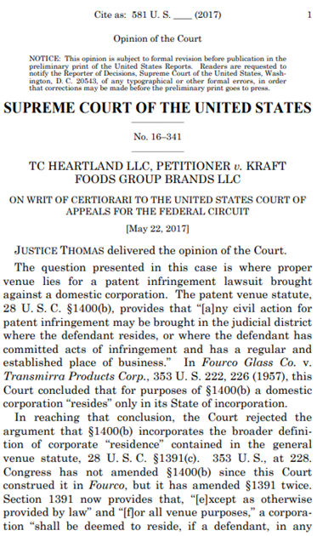
TC Heartland LLC v. Kraft Foods Group Brands LLC, 137 S. Ct. 1514, (2017)
“In Fourco … this Court concluded that for purposes of §1400(b) a domestic corporation ‘resides’ only in its State of incorporation, rejecting the argument that §1400(b) incorporates the broader definition of corporate ‘residence’ contained in the general venue statute, 28 U. S. C. §1391(c).”
For domestic corporations:
  where the defendant resides, i.e., State of incorporation
  where the defendant has committed acts of infringement and has a regular and established place of business

Slide 5
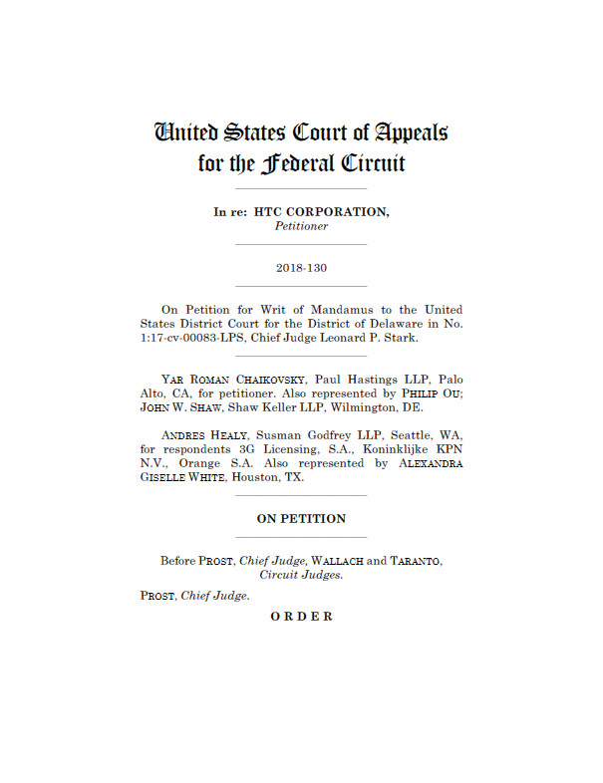
In re HTC Corp., 889 F.3d 1349 (Fed. Cir. May 2018)
TC Heartland did not address venue non-U.S. resident entities
For foreign defendants, suit is proper in any judicial district in accordance with 28 U.S.C. § 1391(c)(3)

Slide 6
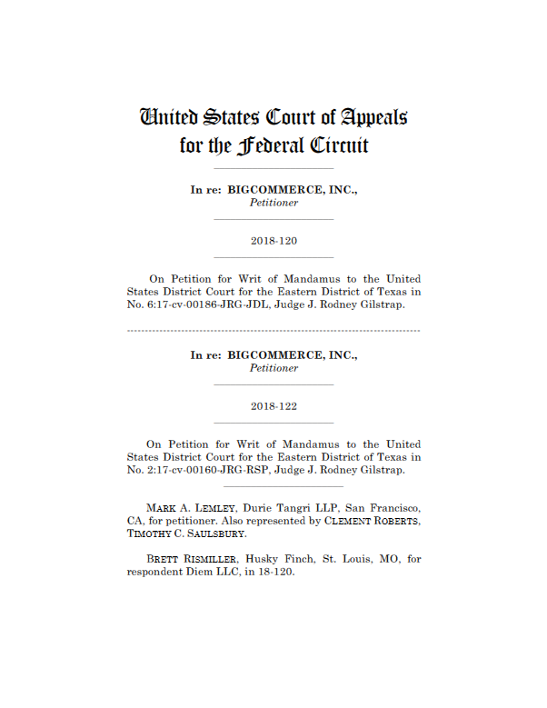
In re BigCommerce, Inc., 890 F.3d 978 (Fed. Cir. May 2018)
Defendant incorporated in Texas and headquartered in Austin (W.D. Tex.).
Complaint filed in E.D. Tex.
Fed. Cir. held for venue in a state having multiple judicial districts, a “resides” only in the single judicial district within that state where it maintains a principal place of business

Slide 7
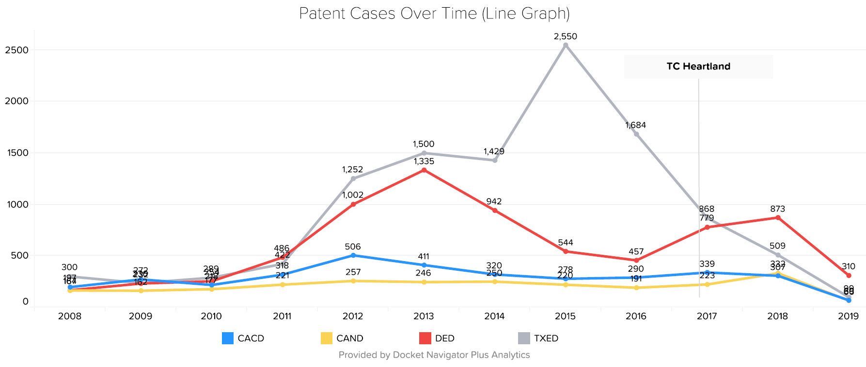
New Patent Case Filings

Slide 8
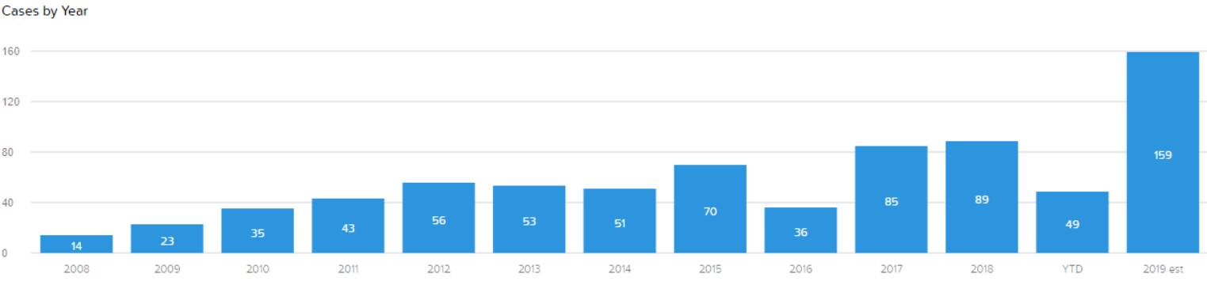
New Patent Case Filings
Wester District of Texas

Slide 9
Increase in U.S. International Trade Commission Cases

Slide 10
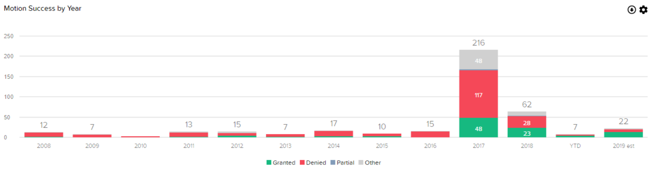
Venue Motions to Dismiss/Transfer
Eastern District of Texas

Slide 11
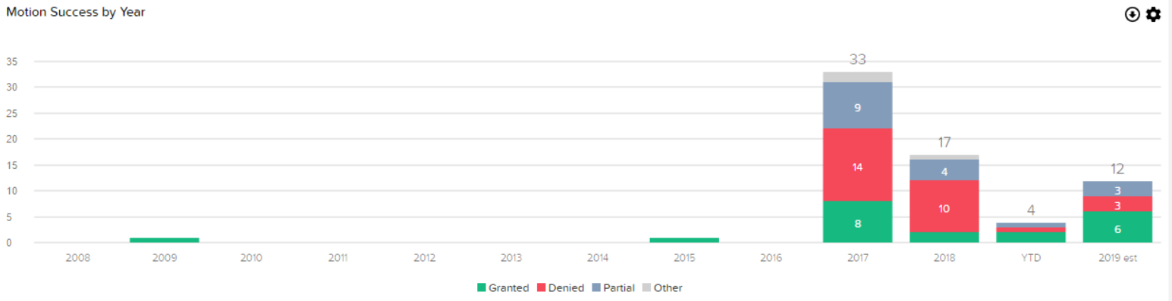
Motions for Venue Discovery

Slide 12
Stays Pending PTAB Proceeding

Slide 13
Motions Under Section 101

Slide 14
Overview
I.
The effect of TC Heartland and current stats
II.
Regular & established places of business
III.
Alter ego and corporate formalities
IV.
Hypothetical

Slide 15
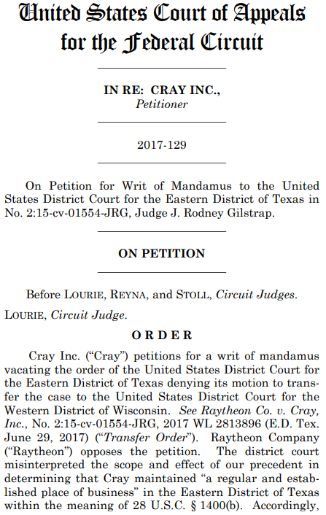
In re Cray Inc., 871 F.3d 1355 (Fed. Cir. 2017)
Granted mandamus relief
  Salesperson working from home
A “regular and established place of business” requires:
  a physical, geographic location
  “regular” (sporadic activity cannot create venue) and “established” (settled certainly, or fixed permanently)
  must be the place of the defendant (not solely the place of an employee)

Slide 16
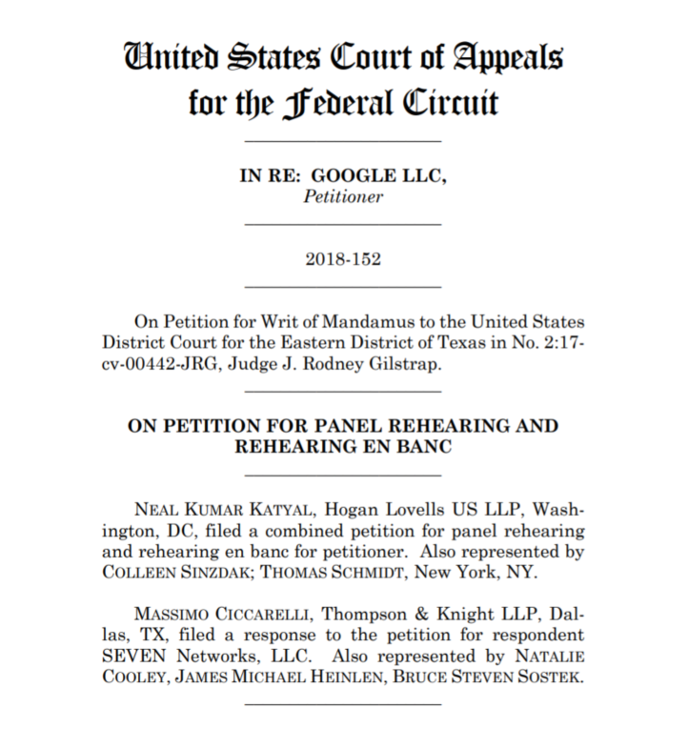
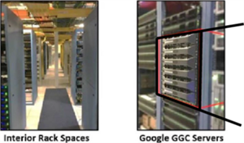
In re Google LLC, 914 F.3d 1377 (Fed. Cir. 2019)
Dist. Ct. denied motion to dismiss
  Google owned servers located at ISP facilities
  Strong contractual control over servers by Google
Fed. Cir. denied mandamus relief
Petition for rehearing denied

Slide 17
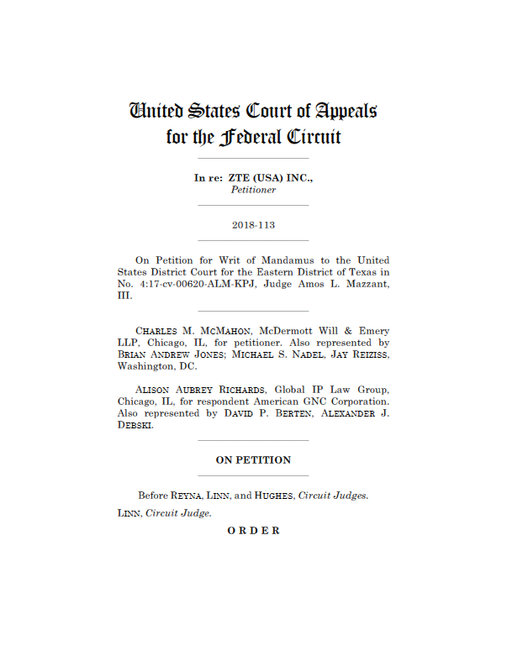
In re ZTE (USA) Inc., 890 F.3d 1008 (Fed. Cir. May 2018)
Burden on the plaintiff to establish proper venue.
Strengthens defendants’ arguments against venue in E.D. Tex.
“as a matter of Federal Circuit law that, upon motion by the Defendant challenging venue in a patent case, the Plaintiff bears the burden of establishing proper venue.”
“Section 1400(b)’s intentional narrowness supports placing the burden of
establishing proper venue on the Plaintiff.”

Slide 18
Overview
I.
The effect of TC Heartland and current stats
II.
Regular & established places of business?
III.
Alter ego and corporate formalities
IV.
Hypothetical

Slide 19
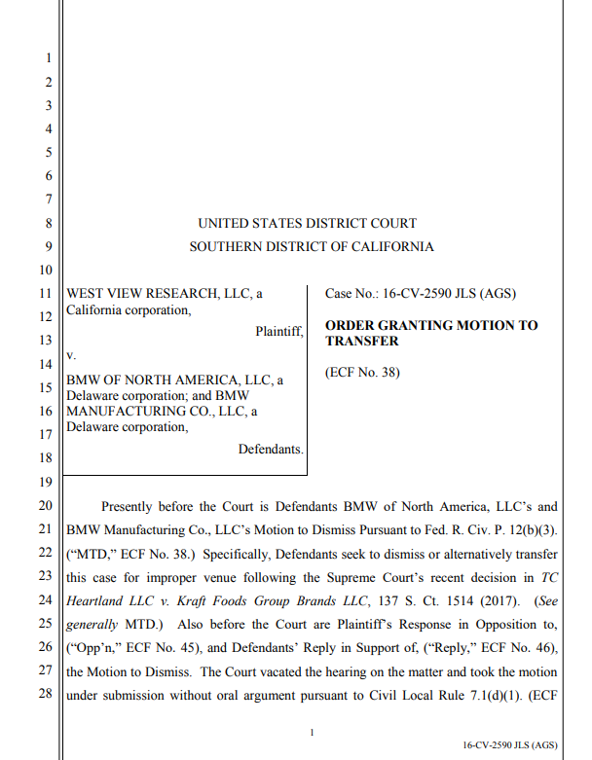
West View Research, LLC v. BMW of N. Am., LLC, No. 16-cv-2590 (C.D. Cal. Feb. 5, 2018)
Court addressed whether a distribution agreement with a third party can give rise to venue.
Held that dealerships that are owned by other companies, not defendants, do not count for venue purposes where corporate formalities are followed.

Slide 20
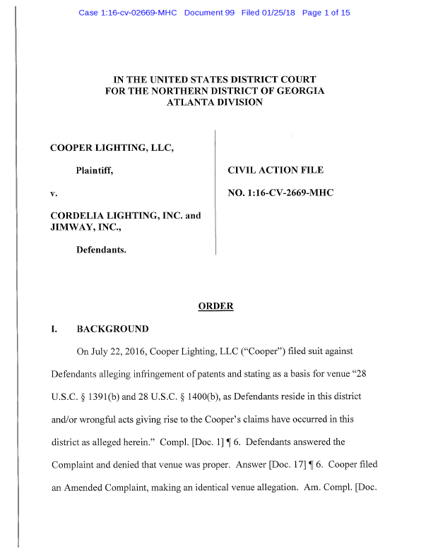
Cooper Lighting, LLC v. Cordelia Lighting, Inc., No. 1:16-cv-2669-MHC (N.D. Ga. Jan. 25, 2018)
Venue was not appropriate in the Northern District of Georgia, even where internal memorandum by Defendant made reference to the employees “of our Atlanta office …” and “our Atlanta associates.”
Venue cannot be imputed so long as corporate formalities are maintained.

Slide 21
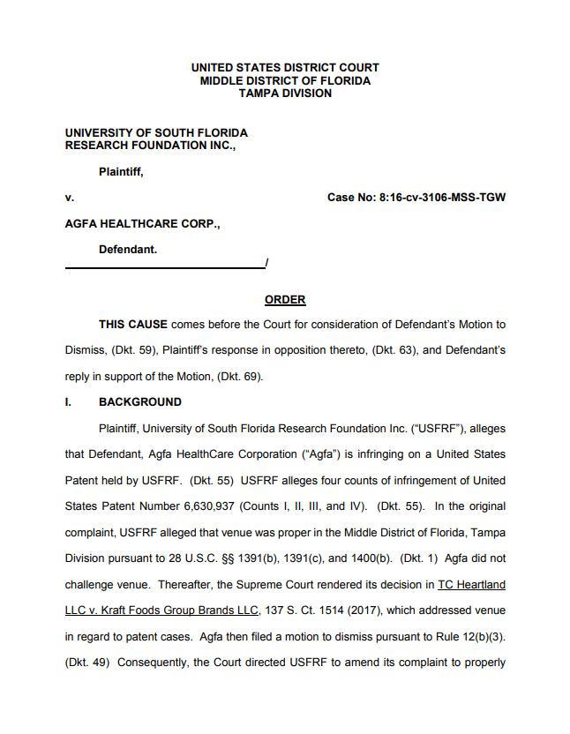
Univ. S. Fla. Research Found. v. AGFA Healthcare Corp., No: 8:16-cv-3106 (M.D. Fla. Dec. 29, 2017)
47 employees who work from home in the district not a “regular and established place of business” because defendant did not ratify that as a place of business.
For corporate affiliates, need to show corporate formalities ignored to impute presence for venue purposes.

Slide 22
Overview
I.
The effect of TC Heartland and current stats
II.
Regular & established places of business?
III.
Alter ego and corporate formalities
IV.
Hypothetical

Slide 23
Hypothetical
Plaintiff and exclusive licensee
  Assertion, LLC, a Delaware corporation, headquartered in Los Angeles
Patent owner and licensor
  Big Research, Inc., a German company that owns the patents
  Big Research USA is a U.S. subsidiary incorporated in California, located in San Jose that conducts R&D related to the licensed patents
Global Defendants
  Global, Inc., a German company
  Global U.S., Inc., a U.S. subsidiary incorporated in Delaware, headquartered in Oakland
  Together operate a shipping company and launched a cloud based shipping management system
  The system transmits video from each shipping container to its cloud servers in Plano, TX and Germany
  The devices installed in each container are assembled in China and imported into the U.S.
  The installation is performed by contractors in Long Beach, California, who are contracted by Global U.S., Inc. and based on a ship owned by Global, Inc.
Small Fry, Inc.
  A self-storage company incorporated in Delaware, headquartered in San Diego
  Has multiple self-serve, kiosk-operated, self-storage locations throughout California
  Imports the accused security cameras into the port in Long Beach from China
  IT employees install them in the storage units and connect them to servers in Los Angeles and Plano, TX

Slide 24

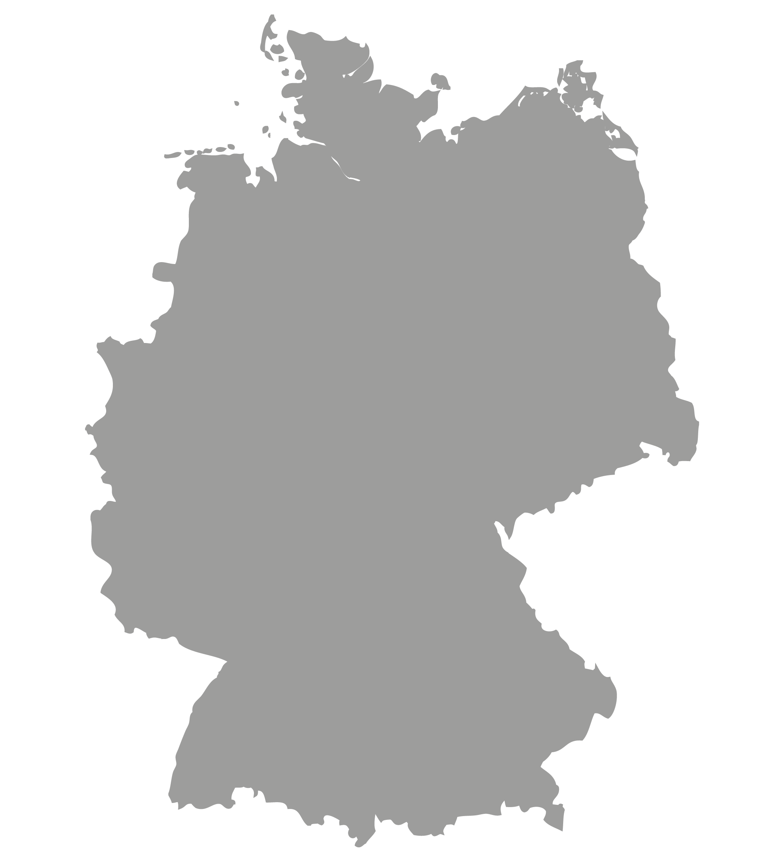
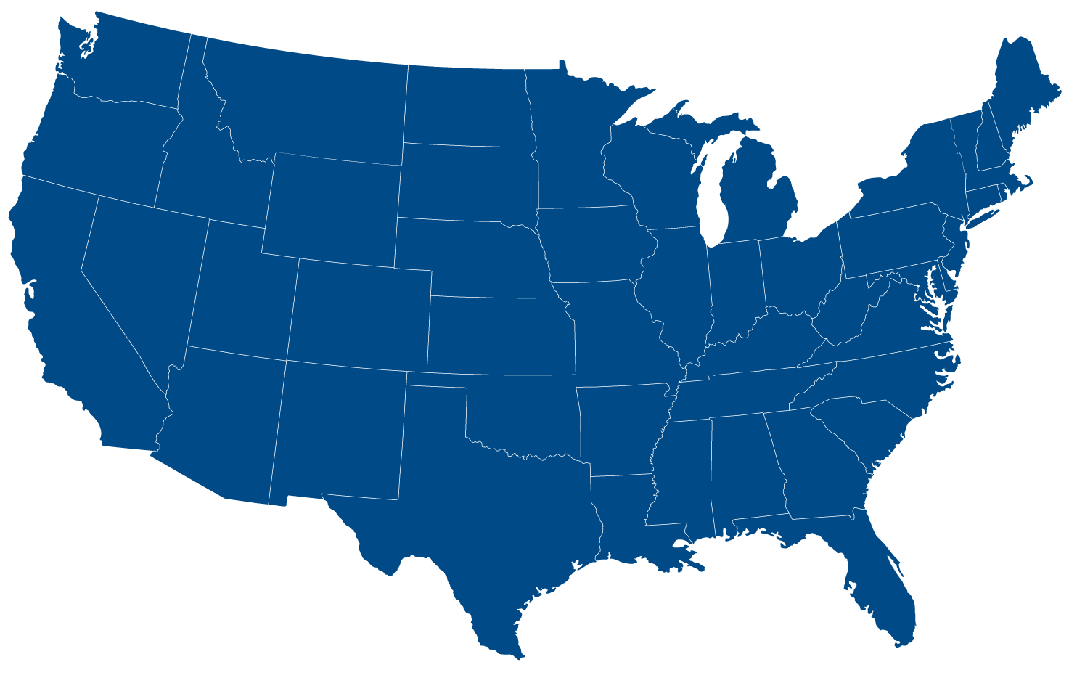
















Hypothetical
CHINA
GERMANY
LEGEND
COLOR KEY
Headquarters
Subsidiary
Cloud-Based Servers
Delaware corporation
Big Research, Inc.
Storage
Assembled
Contractor
Patents
Assertion, LLC.
Global, Inc.
Small Fry, Inc.

