Slide 1
Patent Law “Top 10” of 2018
Prof. Ted Sichelman
University of San Diego School of Law
April 26, 2019
* Adapted in part from material from Prof. Jonathan Barnett, USC

Slide 2
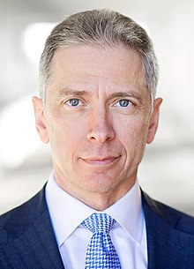
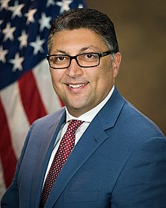
#1: LA Goes to DC
USPTO Director
Andrei Iancu
(confirmed February 2018)
Assistant Attorney General Makan Delrahim (DOJ Antitrust)
(confirmed September 2017)

Slide 3
#2: PTAB Filings & Institutions Stabilizing

Slide 4
#2: PTAB Filings & Institutions Stabilizing
Pendency of appeals: 11.9 month median time from institution.
IPR results for instituted proceedings (2018): 64% all claims invalidated; 17% some claims invalidated; 19% no claims invalidated.

Slide 5
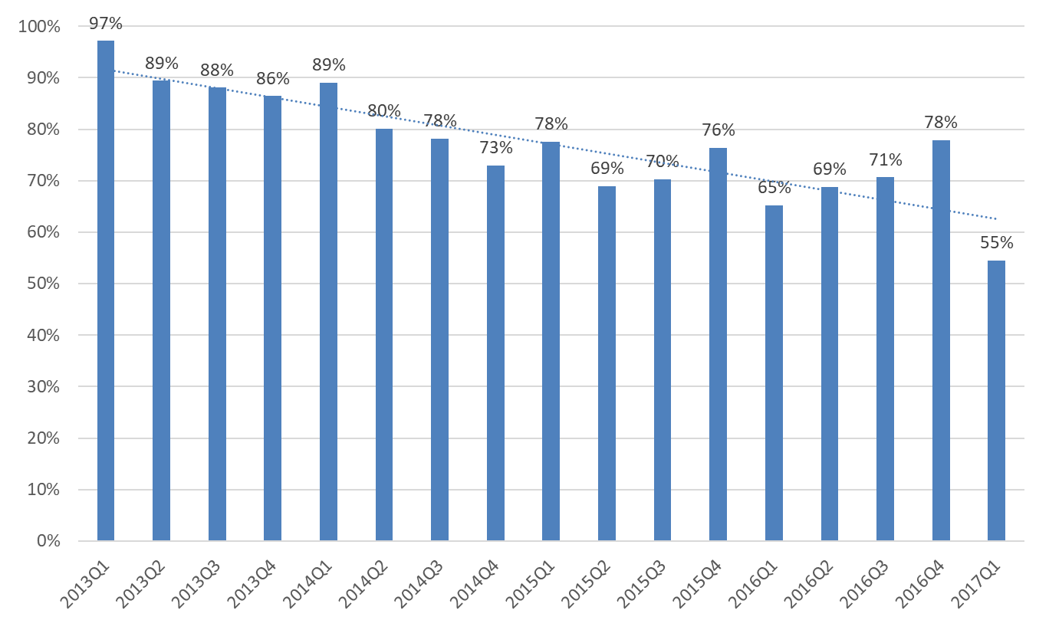
First-Time Institution Rate
Love, Miller & Ambwani (2018)
Notes:
We report here that the institution rate has been declining over time and we think this counts against the assertion made by some that PTAB has been acting as a patent “death squad” “killing property rights”.
However, I will say that the “death squad” description seemed apt after the first year when the institution rate averaged 90%. Since then it’s averaged just above 70%.
Note: over whole time period the average first-time institution rate is 75%.
Note: About 40% of patents at least partially invalidated when issue litigated. Allison et al (cases filed in 2008 and 2009).

Slide 6
Is the PTAB Constitutional?
In Oil States Energy v. Greene’s Energy Group (Apr. 2018) (7-2), the Supreme Court addressed whether inter partes review, and the PTAB’s ability to invalidate a patent, is an unconstitutional exercise of judicial powers by a non-Article III tribunal.
Petitioners’ argument rested on language in the Patent Act stating that patents “shall have the attributes of personal property” (§261). However, the Court rejected this argument, stating that the patent is a “public franchise” and a matter involving “public rights.” Hence Congress can elect to review and revoke issued patents through an administrative tribunal.
Caveat: “Our decision should not be misconstrued as suggesting that patents are not property for purposes of the Due Process Clause or the Takings Clause.”

Slide 7
PTAB Issues Addressed in 2018-19 (Selected)
Partial institution of challenged claims
Time-bar determinations
Standing to bring and appeal PTAB actions?
Claim construction standard
Motions to Amend
IPRs and tribal sovereign immunity

Slide 8
Must the PTAB Institute All Challenged Claims?
SAS Institute Inc. v. Iancu (Apr. 2018) (5-4): Yes. The AIA does not permit the PTAB to partially institute a petition for inter partes review. If the PTO institutes an IPR, it must decide the patentability of all claims the petitioner challenged.
Bottom line: The petitioner, not the PTO, identifies the claims that will be reviewed in the IPR.
Somewhat overlooked takeaway: Notwithstanding Chevron deference, Court adopted a narrow understanding of §314(d) (Director’s institution decisions are non-appealable) and emphasized strong presumption in favor of judicial review.

Slide 9
Time-Bar on IPR Petitions
Background: Under the AIA, institution precluded if petition filed more than one year after petitioner or real party in interest is served with infringement complaint (§315(b)).
Procedural History: Patentee (Applications in Internet Time) filed infringement suit against Salesforce. In consultation with Salesforce, RPX subsequently filed IPR against AIT patents. If Salesforce were deemed real party in interest, then §315(b) would time-bar RPX’s IPR petitions. PTAB rejected argument and invalidated claims.

Slide 10
Time-Bar on IPR Petitions
Background Holdings:
Wi-Fi One, LLC v. Broadcom Corp. (Fed. Cir. Jan. 2018) (en banc): Notwithstanding AIA §314(d), PTAB time-bar determinations are reviewable by federal court.
Wi-Fi One, LLC v. Broadcom Corp. (Fed. Cir. April 2018): Majority affirms “control” over IPR as valid test for determining whether petitioner is “in privity” with defendants in district court litigation.
AIT v. RPX Holding:
Applications in Internet Time v. RPX Corp. (Fed. Cir. July 2018): Relies on common law principles to hold that “real party in interest” inquiry for purposes of time-bar determination should focus on “who will benefit from having [the challenged] patent’s . . . claims canceled or invalidated,” and enunciates a number of factors to consider in making such a determination.
  E.g., the fact that RPX worked to ascertain its client’s interests, “taking last-minute efforts to avoid obtaining an express statement of such desires”
  Held that 315(b) does not presume one real party-in-interest

Slide 11
Who has standing to bring IPRs?
Return Mail Inc. v. U.S. Postal Service (forthcoming SCT 2019)
Is the U.S. government and its agencies a “person” entitled to bring an IPR?
Arguments heard at the Supreme Court and a decision expected this Term
Answer likely “yes,” but somewhat unclear from oral argument.

Slide 12
Who has standing to appeal PTAB decisions?
Suppose petitioner loses at the IPR and wishes to appeal in federal court. If the petitioner is a defendant in a parallel federal court litigation, then it clearly has standing.
Open question: Absent a parallel district court litigation, does the non-defendant/petitioner have standing to appeal an adverse PTAB decision?
Federal Circuit: Yes, but only if the appellant can show “injury in fact”. This requires actual or threatened patent infringement assertion against petitioner (RPX Corp. v. Chanbond, Fed. Cir. 2018; JKETK Corp. v. GKN Automotive Ltd., Fed. Cir. 2018).
Cases to watch: “Cert” petition in RPX v. Chanbond pending and Court has invited the Solicitor General to file a brief.
  Similar petition pending in JKETK v. GKN

Slide 13
New PTAB Claim Construction Standard
October 2018: PTO issues final rule on claim construction for all PTAB proceedings. Two key components:
Eliminates “broadest reasonable interpretation” standard used by PTO in pre-issuance examination with the Phillips v. AWH (2005) standard used in patent infringement litigation in federal court. This may result in a narrower claim construction, improving patent’s chances of surviving IPR process.
When construing a claim term, the PTAB will take into account any prior claim construction in a civil action or ITC proceeding. Note that approx. 80%-85% of patents subject to PTAB proceedings are also litigated in federal court.

Slide 14
Amendments at the PTAB (2019)
Pilot Program for Motions to Amend during IPR, PGR, CBM
(1) Patentee may choose to receive preliminary guidance from the Board on its motion to amend.
(2) Patentee may choose to file a revised motion to amend after receiving petitioner’s opposition to the original motion to amend and/or after receiving the PTAB’s preliminary guidance (if requested).

Slide 15
St. Regis Mohawk Tribe v. Mylan Pharmaceuticals et al. (Fed. Cir. July 2018)
Background: Patent owner (Allergan) filed infringement suit in response to ANDA filings by generics. Generics initiated IPR proceeding against asserted patents.
Tribal sovereign immunity defense: Allergan then assigned challenged patents to a Native American tribe, which sought to terminate IPRs on grounds of tribal sovereign immunity. PTAB declined to terminate.
Federal Circuit: Tribal sovereign immunity does not provide a defense to PTAB challenge because PTAB proceeding is closer to action by a federal agency (see Oil States) than litigation initiated by a private party.
Case to watch: Cert petition pending.

Slide 16
#3-5: Effects of Recent Supreme Court Patent Decisions
Attorneys fees: Octane Fitness v. ICON Health & Fitness (2014)
Willful infringement: Halo Electronics v. Pulse Electronics (2016)
Venue: TC Heartland v. Kraft Foods (2017)

Slide 17
#3: Attorney’s Fees in the Post-Octane Era
Octane Fitness v. ICON Health & Fitness, Highmark Inc. v. Allcare Health Mgmt. (S.Ct. 2014)
Supreme Court adopted a more flexible and deferential standard for appellate review of judicial decisions to award reasonable attorneys fees for “exceptional” case under §285
Based on a “totality of the circumstances” inquiry, including litigation conduct and the “substantive strength” of a patentee’s litigating position.

Slide 18
#3: Attorney’s Fees in the Post-Octane Era
Post-Octane, courts have predictably granted more fee awards. Example: Howmedica Osteonics Corp. v. Zimmer Inc. (D.N.J. Apr. 2018)
  $13M in attorneys fees. “Exceptional” finding relied on questionable conduct during patent prosecution
    Failure to disclose information to the PTO (preponderance standard for fee award)
    Litigation misconduct relating to indefinite claim construction
    Avoidance of belatedly discovered prior art that potentially invalidated the asserted patents.
Stone Basket Innovations v. Cook Medical (Fed. Cir. June 2018): Court upholds denial of attorneys fees b/c prevailing defendant did not provide “clear notice” of the patent’s invalidity based on a specific prior art reference or “early, focused and supported” notice that it was being subjected to “exceptional” litigation behavior.

Slide 19
Attorneys’ Fees for PTAB § 145 Appeals
Background: A patent applicant may appeal a PTAB affirmance of the examiner’s rejection of a patent application to the Federal Circuit (§141) or file action against the PTO Director in the E.D. Va. (§145). In the latter case (involving more expansive proceedings), statute provides that “all the expenses of the proceedings shall be paid by the applicant.”
NantKwest, Inc. v. Iancu (Fed. Cir. July 2018) (en banc): “All the expenses of the proceedings” does not include PTO’s legal fees (as distinguished from travel, printing and expert witness fees). Court relies on PTO’s historical application of §145, language in other fee-shifting statutes, and strong presumption in favor of the “American rule” in civil litigation.
Case to watch: Supreme Court has granted “cert” on this decision.

Slide 20
#4: Willful Infringement in the Post-Halo Era
Halo Electronics v. Pulse Electronics (S.Ct. 2016): Rejected Federal Circuit’s “rigid” requirement of objective recklessness for willful infringement. Evidence of “highly culpable” conduct can be sufficient, although court retains discretion concerning enhanced damages.
Post-Halo Effects: Mixed. Increasing success rate for willful infringement motions but slight decrease in average enhancement damages (PWC Litigation Study 2018).
Polara Engineering v. Campbell Co. (Fed. Cir. 2018):
  Defendant had unsuccessfully challenged patents under pre-AIA §102, based on “public use” bar being purportedly triggered by plaintiff’s testing of prototypes in public.
  Fed. Cir. upholds jury finding of willful infringement but vacates judicial award of 2.5x enhanced damages. Emphasizes that district court must explain basis for enhanced damages award, esp. in light of “close call” on public use bar and almost-maximum enhancement.

Slide 21
#5: Venue in the Post-TC Heartland Era
28 U.S.C. §1400(b): A patent infringement suit may only be filed against defendant corporation in (1) the judicial district where it “resides”, OR (2) where it “has committed acts of infringement and has a regular and established place of business.”
TC Heartland v. Kraft Foods (2017): a defendant corporation “resides” in its state of incorporation.
  Immediate effect: substantial shift in litigation from E.D. Tex. to other courts (esp. D. Del., C.D. Cal., N.D. Cal.) (see nex slide)
In In re BigCommerce, Inc. (Fed. Cir. 2018):
  If the defendant’s state of incorporation has multiple districts, then it is deemed to “reside” only in the single judicial district where it maintains a principal place of business.
  If the entity does not have a principal place of business in the state of incorporation, then it is deemed to reside in the district where its registered office is located.
Takeaway: Patentee-plaintiffs now have even fewer venues in which to bring suit against alleged infringers.

Slide 22
Macro Impact of TC Heartland
Court | Year before | Year after | Δ # cases | % Increase
E.D.Tex. | 1626 (38%) | 521 (13.8%) | -1105 | -68%
D.Del. | 521 (12%) | 898 (24%) | 377 | 72%
C.D.Cal. | 265 (6.2%) | 344 (9.1%) | 79 | 30%
N.D.Cal. | 128 (3.0%) | 272 (7.2%) | 144 | 113%
D.N.J. | 153 (3.6%) | 197 (5.2%) | 44 | 30%
N.D.Ill. | 206 (4.8%) | 195 (5.2%) | -11 | -5%
S.D.N.Y. | 89 (2.1%) | 113 (3.0%) | 24 | 26%
S.D.Fla. | 104 (2.4%) | 71 (1.9%) | -33 | -32%
D.Mass. | 96 (2.2%) | 72 (1.9%) | -24 | -25%
W.D.Tex. | 52 (1.2%) | 81 (2.1%) | 29 | 56%
S.D.Cal. | 69 (1.6%) | 62 (1.6%) | -7 | -10%
M.D.Fla. | 71 (1.7%) | 59 (1.6%) | -12 | -17%
N.D.Tex. | 36 (0.8%) | 80 (2.1%) | 44 | 122%
Total | 4283 | 3768 | -515 | -12%
From S. Miller (forthcoming 2019)

Slide 23
#6-7: Extraterritorial Issues
Can a patent owner ever seek damages relating to an infringer’s profits outside the U.S.?
Can the International Trade Commission deny an exclusion order to the importation of infringing goods?

Slide 24
#6: Extraterritoriality and Damages
Western Geco LLC v. ION Geophysical Corp. (2018) (7-2): Dispute involved patents owned by WesternGeco, which developed technology for surveying the ocean floor, and ION Geophysical, a competitor. ION manufactured infringing components in the U.S. and then shipped and assembled them outside U.S. as a competing surveying product.
Holding: patent owner may sue for lost foreign profits for infringement under §271(f)(2).
Effect?: Expands damages potentially available to patent owners. However, given the strong presumption against extraterritorial application of the patent laws, lower courts will very likely view the decision as being limited to cases involving domestic infringement followed by export to foreign markets.

Slide 25
#7: Showdown at the ITC
July 2017: Qualcomm initiated action at the International Trade Commission (ITC), seeking limited Section 337 exclusion order barring importation of certain iPhones and other Apple devices that include baseband processors from suppliers other than Qualcomm. (Apple’s only other supplier is Intel.)
Sept. 2018: ITC found that Qualcomm’s patents were not invalid and had been infringed by the Apple devices. However, the ITC administrative judge denied the exclusion order based on statutory “public interest” factors relating to competitive conditions in the U.S. economy.
Note: This is only the fourth time that an ITC judge has denied an exclusion order following a finding of validity and infringement and the first time since 1984. The ITC was reviewing the judge’s decision not to grant relief but settlement has ended this action.

Slide 26
#8: Narrowing of Alice/Mayo?
Refresher -- Alice/Mayo Two-Step Test for Eligible Subject Matter:
  STEP ONE: Are the asserted claims directed to ineligible subject matter?
  STEP TWO: If so, do the claims nonetheless recite additional elements that constitute a patent-eligible “inventive concept”? This can be satisfied by claim limitations that do NOT capture “well-understood, routine and conventional activity”.
Practical effect: Both decisions (and subsequent case law) cast substantial doubt on the patentability of medical diagnostic methods (Mayo) and non-technical business methods (Alice). More generally, the patentability of certain software-enabled inventions (Alice) has become less certain.
Post-Alice litigation impact: Substantial increase since Alice decision (2014) in §101 subject-matter invalidations in patent infringement litigation, but with a decline observed in 2018. Reasons that decline may continue . . .

Slide 27
Berkheimer in the Courts and the PTO
February 2018 --Berkheimer v. HP Inc. (Fed. Cir. 2018)
  Section 101 challenge to patents claiming digital archiving functions. Claims directed to ineligible subject matter but, for purposes of Mayo/Alice step two, arguably encompass inventive concepts that were “unconventional” to a “skilled artisan in the field.”
  Patent eligibility under §101 (esp., Mayo/Alice step two) is a question of law that may sometimes contain underlying facts. Court reverses summary judgment given open factual questions.
  “The mere fact that something is disclosed in a piece of prior art … does not mean it was well-understood, routine, and conventional.”

Slide 28
Berkheimer in the Courts and the PTO
April 2018 – PTO’s “Berkheimer Memo”: In revised examination guidelines on subject matter eligibility, PTO references Berkheimer with respect to determining, under Mayo/Alice step two, “whether a particular technology is well-understood, routine and conventional to a skilled artisan in the field.” Absent evidence of common use, prior art disclosure by itself is not sufficient to meet this threshold.
Case to watch: “cert” petition pending on Berkheimer v. HP Inc.

Slide 29
Are Method-of-Treatment Claims Patentable?
April 2018 -- Hikma Pharmaceuticals USA Inc. v. Vanda Pharmaceuticals Inc. (Fed. Cir.): In an infringement case brought by pharmaceutical firm (Vanda) in response to ANDA filing
CAFC finds medical treatment claims patent-eligible insofar as they were directed to “a specific method of treatment for specific patients using a specific compound at specific doses to achieve a specific outcome.”
CAFC distinguishes Mayo as not concerning a “method treatment”

Slide 30
Are Method-of-Treatment Claims Patentable?
June 2018 -- PTO Memo to Examiners:“’[M]ethod of treatment’ claims that practically apply natural relationships should be considered patent eligible . . . It is not necessary for ‘method of treatment’ claims that practically apply natural relationships to include nonroutine or unconventional steps to be considered patent eligible . . .”
Dec. 2018 -- Cert petition (filed by alleged infringer (Hikma)): Whether method-of-treatment claims in medical context are patentable “even if they apply a natural law using only routine and conventional steps”?
Petitioner challenges distinction between medical method-of-treatment claims upheld by Federal Circuit in this case and diagnostic method claims deemed ineligible by the Supreme Court in Mayo

Slide 31
New PTO Guidance on 101
(1) Three “enumerated groupings” of ineligible abstract ideas from judicial precedent.
  Mathematical concept, method of organizing human activity, mental process
  Anything outside those groupings “should not be treated as too abstract” except in “rare” circumstances.
  In such rare cases, Examiners must obtain specific approval from a highly-placed “Technology Center Director” to reject these unusual claims under Section 101.

Slide 32
New PTO Guidance on 101
(2) Requires Examiners to find claims eligible if they “integrate” any abstract ideas into a “practical application.”
  It emphasizes that mere inclusion of an abstract idea in a claim is not fatal, since such ideas form the basic building blocks of all patent claims. It does not require the practical application itself to be unconventional.
  Examples and counter-examples of practical applications.
(3) If no practical application, does claim add “significantly more”?
    Essentially, “inventive concept” approach: “well-understood, routine, and conventional”

Slide 33
#9: Watch Out for Prior Art
“Secret” Sales
  On-sale bar (§102(a)): Sale by inventor to a third party triggers the one-year grace period during which the application must be filed to avoid failure due to lack of novelty.
  Helssin Healthcare, S.A. v. Teva Pharm. USA Inc. (S. Ct. 2019) (9-0): Prior to filing patent application, Helsinn had entered into a publicly disclosed marketing and distribution agreement with a third party.
  Court holds that this can trigger “on-sale bar” even though third party was subject to a confidentiality agreement and the invention was not made available to the public.
    Fact that agreement itself was publicly disclosed does not appear relevant to the holding

Slide 34
#9: Watch Out for Prior Art
“Printed Publications” as Prior Art
  Jazz Pharmaceuticals v. Amneal Pharmaceuticals (Fed. Cir. 2018): Jazz appealed from IPR holding certain claims of its patents invalid as obvious in light of anticipatory prior art.
  Federal Circuit upheld PTAB’s prior art treatment as “printed publications” of slides and a meeting transcript that were only publicly accessible through a hyperlink in a notice filed in the Federal Register.

Slide 35
#10: Standard-Essential Patents
Policy shift:
  Background: Standard-essential patents are subject to “fair, reasonable and non-discriminatory” (FRAND) licensing commitment to standard-setting organizations (SSOs).
  Since mid-2000s: DOJ Antitrust had emphasized patent holdup risk and issued guidance that SSOs could define FRAND terms with greater specificity without material antitrust risk.
  Since Nov. 2017: DOJ Antitrust has indicated low concern over risk of patent holdup and strong concern about potential use by SSOs/implementers of FRAND requirements to depress royalty rates below competitive levels.

Slide 36
#10: Standard-Essential Patents
Qualcomm-Related Litigation (Selected, US only):
  ITC proceeding: Qualcomm seeks limited exclusion order. Final decision pending.
  All litigation settled April 2019.
  However, FTC v. Qualcomm, still pending: Antitrust action initiated in January 2017 with respect to certain Qualcomm patent licensing practices. In partial summary judgment ruling (Nov. 2018), N.D. CA interpreted SSO’s FRAND commitment under CA contract law as requiring patent licensing at the component, rather than device, level. Final decision pending.

Slide 37
Prof. Ted Sichelman tsichelman@sandiego.edu

