Slide 1

Spring Seminar 2019
Trademark Year in Review
Jane Shay Wald
Partner emeritus
Irell & Manella LLP

Slide 2
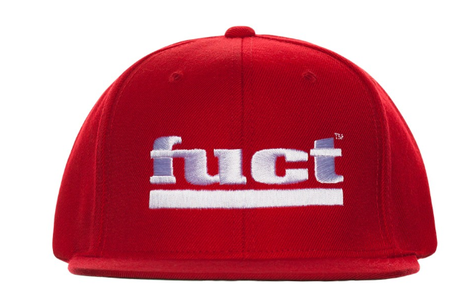
In re Brunetti, 877 F.3d 1330 (Fed. Cir. 2017), cert. granted sub nom. Iancu v. Brunetti,
No. 18-302 (Jan. 4, 2019)
Gov’t argues Sec. 2(a) provision precluding ® of “scandalous and immoral” marks is viewpoint neutral. “Fuck” isn’t a viewpoint. SCOTUS previously ruled Matal v. Tam – SLANTS -- Sec. 2(a) provision precluding ® of “disparaging” marks violated First Amendment.

Slide 3

Mission Prod. Holdings, Inc. v. Tempnology, LLC, 879 F.3d 389 (1st Cir.), cert. granted in part, 139 S. Ct. 397 (Oct. 26, 2018) (No. 17-1657)
Whether, under §365 of the Bankruptcy Code, a debtor-licensor’s “rejection” of a license agreement—which “constitutes a breach of such contract,” 11 U.S.C. §365(g)—terminates rights of the licensee that would survive the licensor’s breach under applicable nonbankruptcy law.

Slide 4
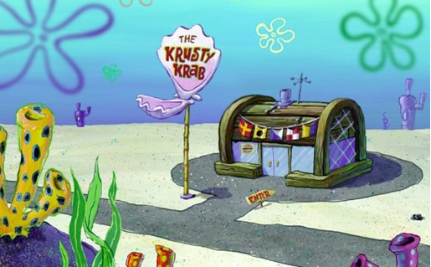
Viacom Int’l v. IJR Capital Invs., L.L.C.,
891 F.3d 178 (5th Cir. 2018)
5th Cir. affirmed MSJ to Viacom on infringement and unfair comp claims from def’s plans to use The Krusty Krab for seafood restaurants. Q: “Can specific elements from within a television show – as opposed to the title of the show itself – receive trademark protection?” A: Yes. The Krusty Krab created a separate and distinct commercial impression and is recognized in itself as an indication of origin. Its central role in the multi-billion dollar SpongeBob franchise was strong evidence of this. Viacom’s subsidiary, Paramount, had licensed Bubba Gump Shrimp Co. for seafood restaurants based on the fictional business from Forest Gump.

Slide 5
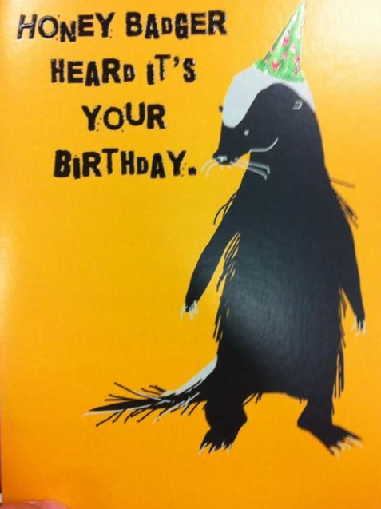
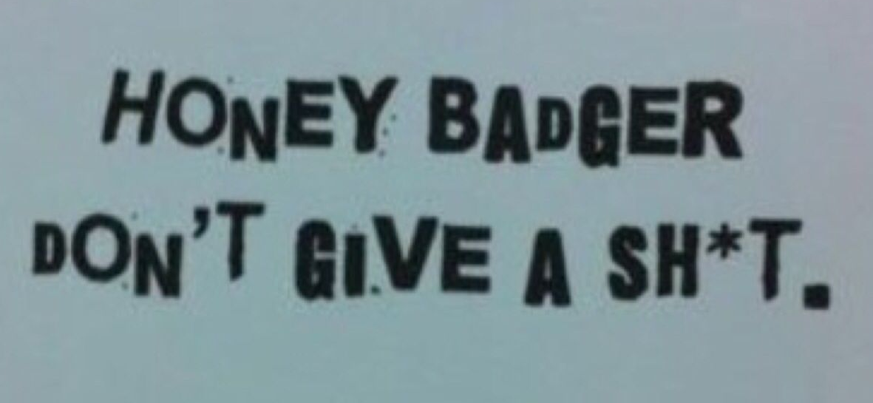
Gordon v. Drape Creative, Inc.,
909 F.3d 257 (9th Cir. 2018)
9th Cir. withdrew its prior panel opinion and filed superseding opinion, reversing the district court’s grant of MSJ to defendants.
9th Cir. here:
“Although on every prior occasion [where the 9th Cir. applied Rogers] we have found that it barred an infringement claim as a matter of law, this case presents a triable issue of fact.”
Greeting cards are 1st Amendment expressive works.
Def satisfied first prong of Rogers v. Grimaldi test – no triable issue of fact re “artistic relevance.”
Jury on remand may find for pl only if he proves that defs’ use of his mark is “explicitly misleading as to the source or content of the greeting cards.”

Slide 6

Dr. Seuss Enterprises, L.P. v. ComicMix LLC, No. 16-CV-2779-JLS (BGS), 2018 WL 2306733 (S.D. Cal. May 21, 2018), appeal docketed, No. 19-55348 (9th Cir. Mar. 28, 2019)
On appeal to 9th Cir.
Def’s book title: “Oh! The Places You’ll Boldly Go!” did not infringe Dr. Seuss Enterprises’ book title “Oh! The Places You’ll Go!” Def’s title of a 1st Amendment expressive work had greater than zero reference to the content and did not expressly mislead. Def’s use protected by Rogers v. Grimaldi, 875 F. 2d 994 (2d Cir. 1989), interpreted by the 9th Cir. in e.g. ESS Entm’t 2000, Inc. v. Rock Star Videos, Inc., 547 F. 3d 1095 (9th Cir. 2008) and Twentieth Century Fox Television v. Empire Distrib., Inc., 875 F. 3d 1192 (2017). Court granted def’s motion for judgment on the pleadings as to title count (only).

Slide 7
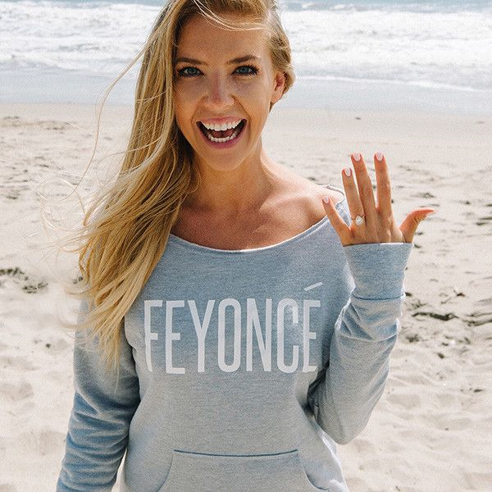
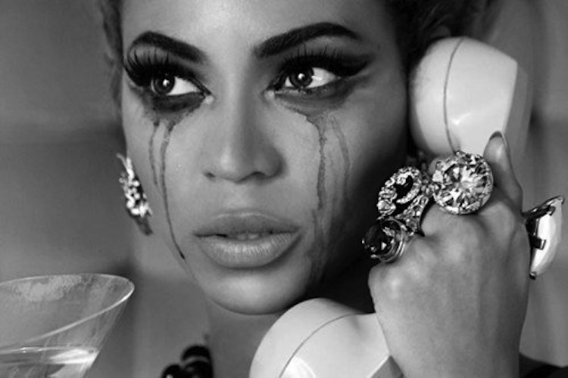
Knowles-Carter v. Feyoncé, Inc.,
347 F. Supp. 3d 217 (S.D.N.Y. 2018)
SDNY denied Beyoncé’s MSJ against defs’ use of trademark FEYONCÉ for goods marketed to those engaged to be married – fiancés. “… no dispute that … defs chose FEYONCÉ … to capitalize off the exceedingly famous BEYONCÉ mark. But that alone does not establish likelihood of confusion.” Consumers probably understand the pun and are not confused –question of fact. “In the case of parody the intent is not necessarily to confuse … but to amuse”. Because defs repurposed BEYONCÉ in a way that can be distinguished from original, “a reasonable factfinder could also conclude little risk of dilution.” But the jury should decide.

Slide 8
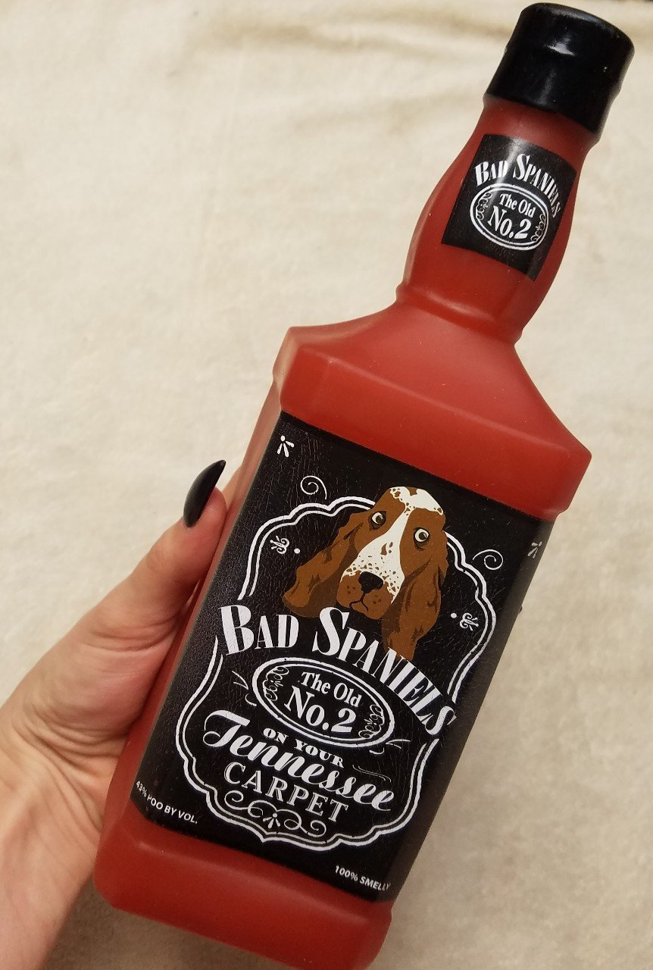
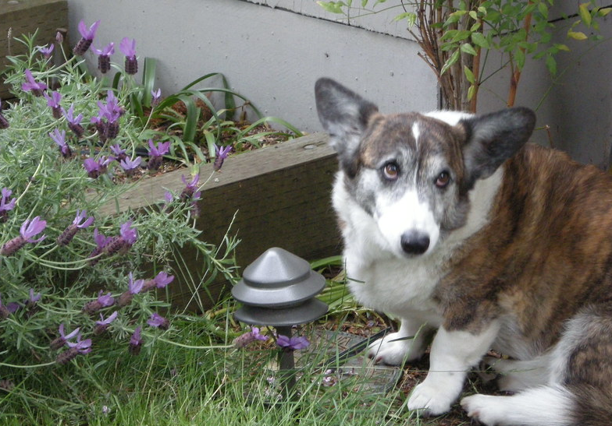
VIP Prod., LLC v. Jack Daniel's Properties, Inc.,
291 F. Supp. 3d 891 (D. Ariz. 2018), appeal docketed, No. 18-16012 (9th Cir. June 4, 2018)
On appeal to 9th Cir.
Jack Daniels prevailed in its DJ on dilution by tarnishment and infringement against a squeaky dog toy closely resembling a bottle of Jack Daniel’s. Tarnishment: “43% POO BY VOL” – Court said “human consumption and canine excrement don’t mix.” And “Jack Daniel’s … reputation will be harmed due to the negative mental association of evoking whiskey with children….” Infringement: Goods are related. Jack Daniel’s has licensed dog leashes, collars and dog houses.

Slide 9
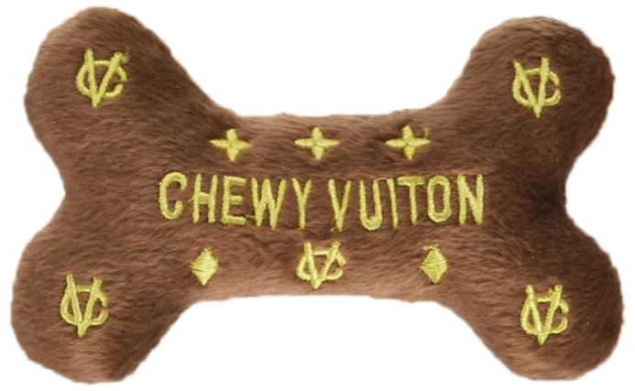
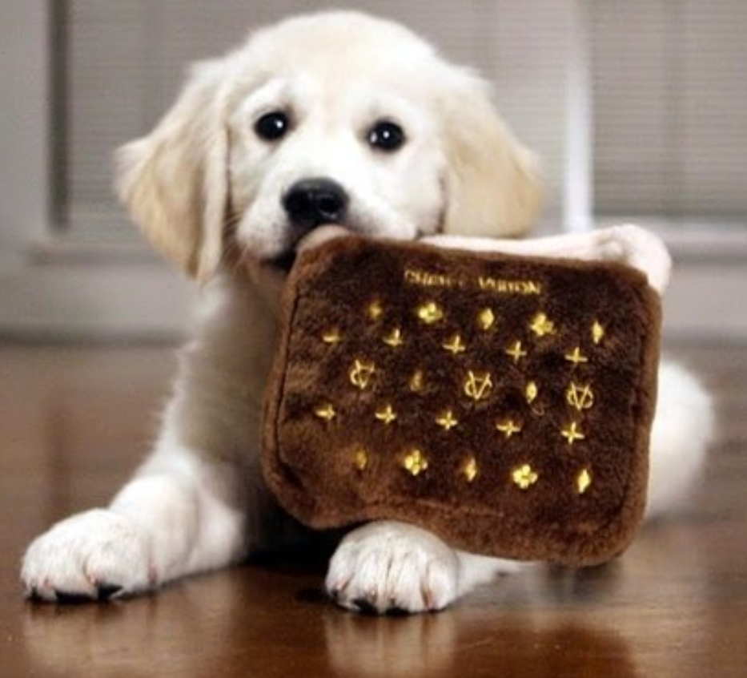
VIP Prods., LLC v. Jack Daniels Props., Inc.,
291 F. Supp. 3d 891 (D. Ariz. 2018), appeal docketed, No.18-16012 (9th Cir. June 4, 2018)
Different result from Louis Vuitton Malletier S.A. v. Haute Diggity Dog, LLC, 507 F.3d 252 (4th Cir. 2007) (Chewy Vuitton pet toy).

Slide 10
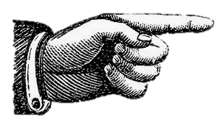
Applied Underwriters, Inc. v. Lichtenegger,
913 F.3d 884 (9th Cir. 2019)
9th Cir. affirmed: Failure to state a claim. Defs’ use of pl’s financial service company’s marks, Applied Underwriters and EquityCorp, was nominative fair use. Defs’ materials used pl’s marks to lambast the pl. Defs’ seminars touted one def as the person who broke a spate of negative stories about pl’s branded programs.
“Criticism of a product tends to negate the possibility of confusion as to sponsorship.”

Slide 11
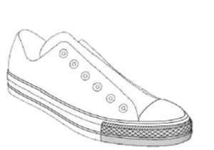
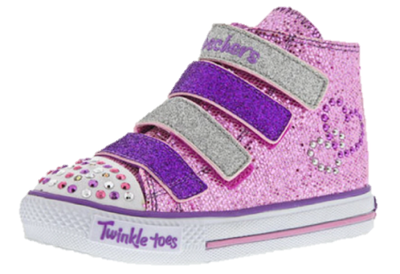
Converse, Inc. v. ITC,
909 F.3d 1110 (Fed. Cir. 2018)
Converse appealed determination of ITC that found its trademark (trade dress) in the midsole of its shoe invalid. The Fed. Cir. vacated and remanded for proceedings to determine the date of any secondary meaning in the trade dress.

Slide 12
Converse, Inc. v. ITC,
909 F.3d 1110 (Fed. Cir. 2018)
Fed. Cir.: Lanham Act entitles the owner to a presumption of validity regarding alleged infringement after the mark has registered, but only for users whose first alleged infringing use occurred after registration. For users whose first alleged infringing use occurred before registration, the owner must establish its mark had acquired secondary meaning at the time of the first alleged infringing use without the presumption of validity. This is true even for injunction only cases.

Slide 13
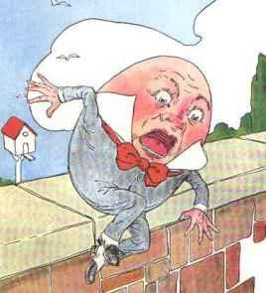
adidas Am. Inc. v. Skechers USA, Inc.,
890 F.3d 747 (9th Cir. 2018)
9th Cir. affirmed finding of irreparable injury, per Herb Reed Ent. affirming infringement of def’s “Onyx” shoe. Found evidence of “extensive and targeted advertising and unsolicited media, along with tight control of the supply” of pl’s Stan Smiths sufficient evidence.
Reversed prelim inj against Skecher’s Cross Court finding no proof of irreparable injury – argument of harm to ability to control brand image insufficient.

Slide 14


Pinkette Clothing, Inc. v. Cosmetic Warrior Ltd.,
894 F.3d 1015 (9th Cir. 2018)
Principles in Petrella v. MGM 134 S.Ct. 1962 (2014) (laches can’t bar copyright claim within 3 yr. statute of limitations) and SCA Hygiene Prods. v. First Quality Baby Prods., LLC, 137 S. Ct. 954 (2017) (laches can’t bar patent claim within 6 yr. statute of limitations) don’t apply to Lanham Act. Lanham Act has no statute of limitations and expressly makes laches a defense to cancellation. 9th Cir. allowed laches defense, looking to Calif’s 4 year statute of limitations.
Evidence of mark in Canada not relevant to US case, under territoriality principle.

Slide 15
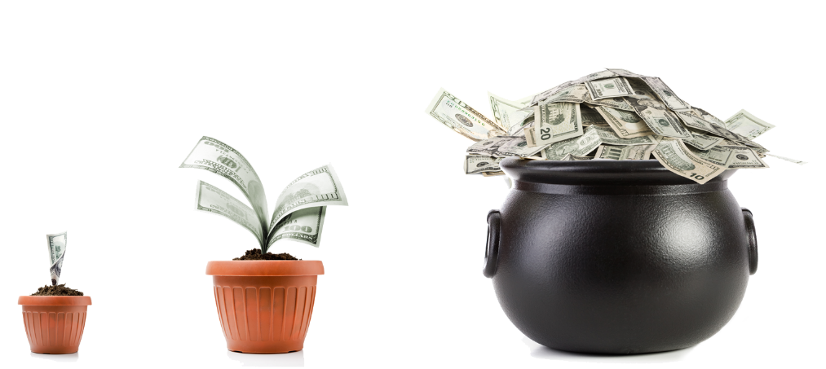
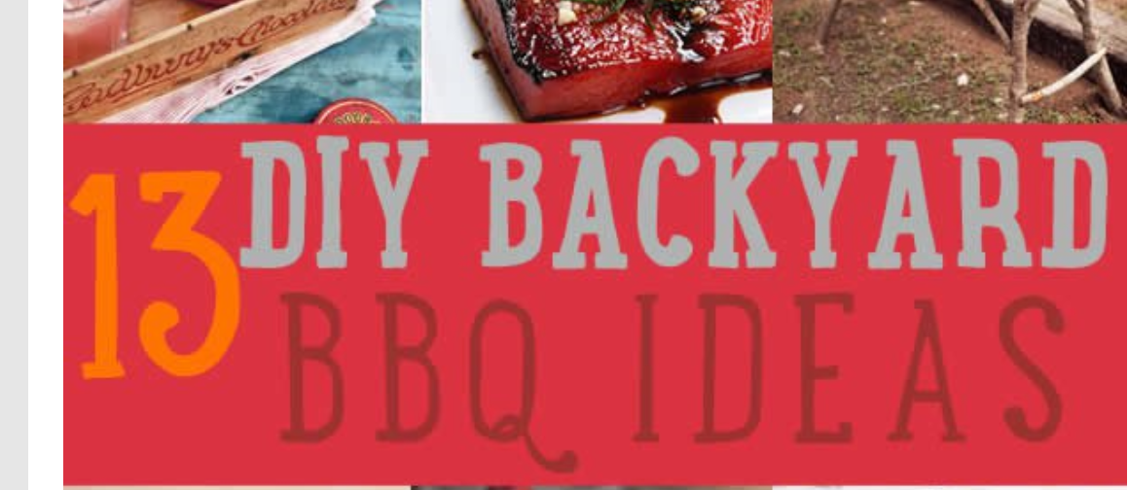
Variety Stores, Inc. v. Wal-Mart Stores, Inc.,
888 F.3d 651 (4th Cir. 2018)
DC NC: Summary Judgment for Variety on BACKYARD mark. Bench trial on damages -- $32M award. Fourth Cir. reversed (vacated award). New jury trial on liability and damages. First jury trial found Wal-Mart liable. Second jury trial awarded $95M. Wal-Mart seeks new trial.
?

Slide 16
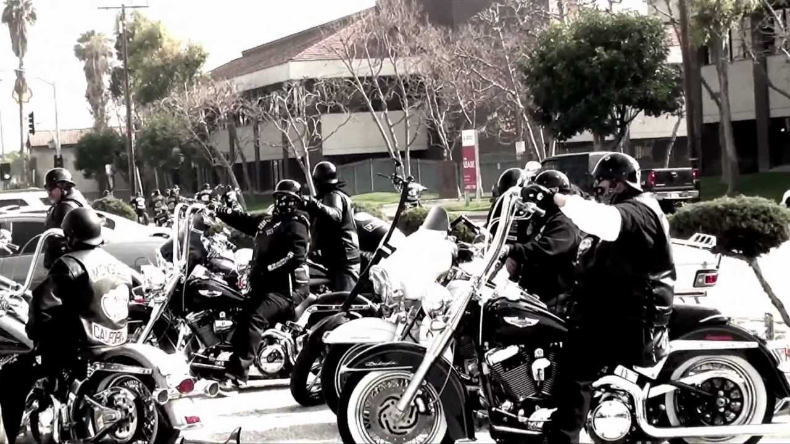

United States v. Mongol Nation,
No. CR 13-0106-DOC-1, 2019 WL 988432 (C.D. Cal. Feb. 28, 2019)
Gov’t stated it wanted the right to rip branded jackets off the members’ backs as RICO remedy. Court found this a misunderstanding of trademark rights/collective marks. 1st and 8th Amendments precluded forfeiture.

Slide 17
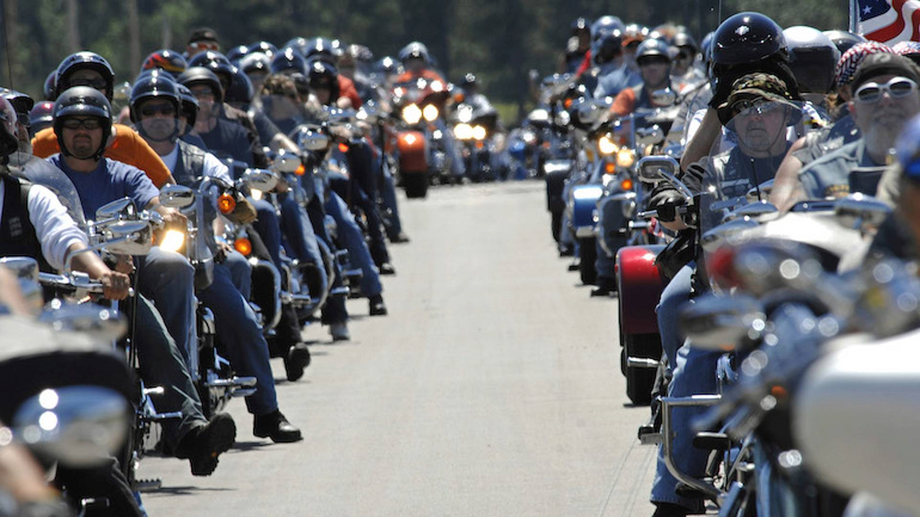

Sturgis Motorcycle Rally, Inc. v. Rushmore Photo & Gifts, Inc., 908 F.3d 313 (8th Cir. 2018)
Plaintiff was created in 2010 to license STURGIS rally-related trademarks. It failed to prove ownership of STURGIS marks. No single source. No entity “produces” the rally. “The rally is a pluralistic endeavor.”

Slide 18
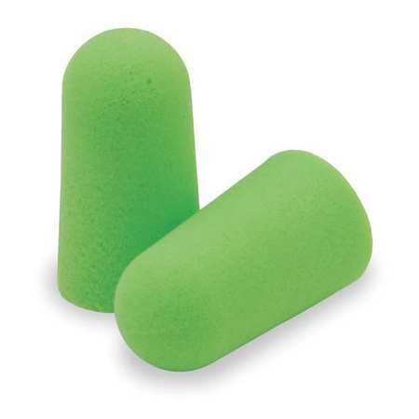
Moldex-Metric, Inc. v. McKeon Prods., Inc.,
891 F.3d 878 (9th Cir. 2018)
9th Cir. reversed District Court’s MSJ for def. and remanded – again. Evidence of alternative colors should have been considered in deciding functionality of this mark. Where an aesthetic feature like color serves a function, Court must determine whether pl’s exclusive use would interfere with competition in order to decide whether trademark can be protected. Def’s position: Safety: Bright green best shows that earplugs are in use in different lighting conditions.

Slide 19

Booking.com v. USPTO,
915 F. 3d 171 (4th Cir. 2019)
Q of first impression: Which party bears the burden of proving genericness on appeal when registration of a mark is denied? A: The PTO. Why? “Fed. Cir. has long held … that in registration proceedings, the USPTO ‘always bears the burden’ of establishing that a proposed mark is generic.”
In registered trademark infringement proceedings, b/p lies with party claiming mark is generic: Reg gives presumption of validity. Unregistered mark with genericness defense? Pl’s b/p to show not generic. Fourth Cir. reversed TTAB’s grant of summary judgment of genericism. PTO failed to satisfy its burden that mark taken as a whole referred generally to online booking services.
Once a term is deemed generic, it cannot subsequently become non-generic. Per Shammas v. Focarino, fee award to PTO was (reluctantly) affirmed.

Slide 20
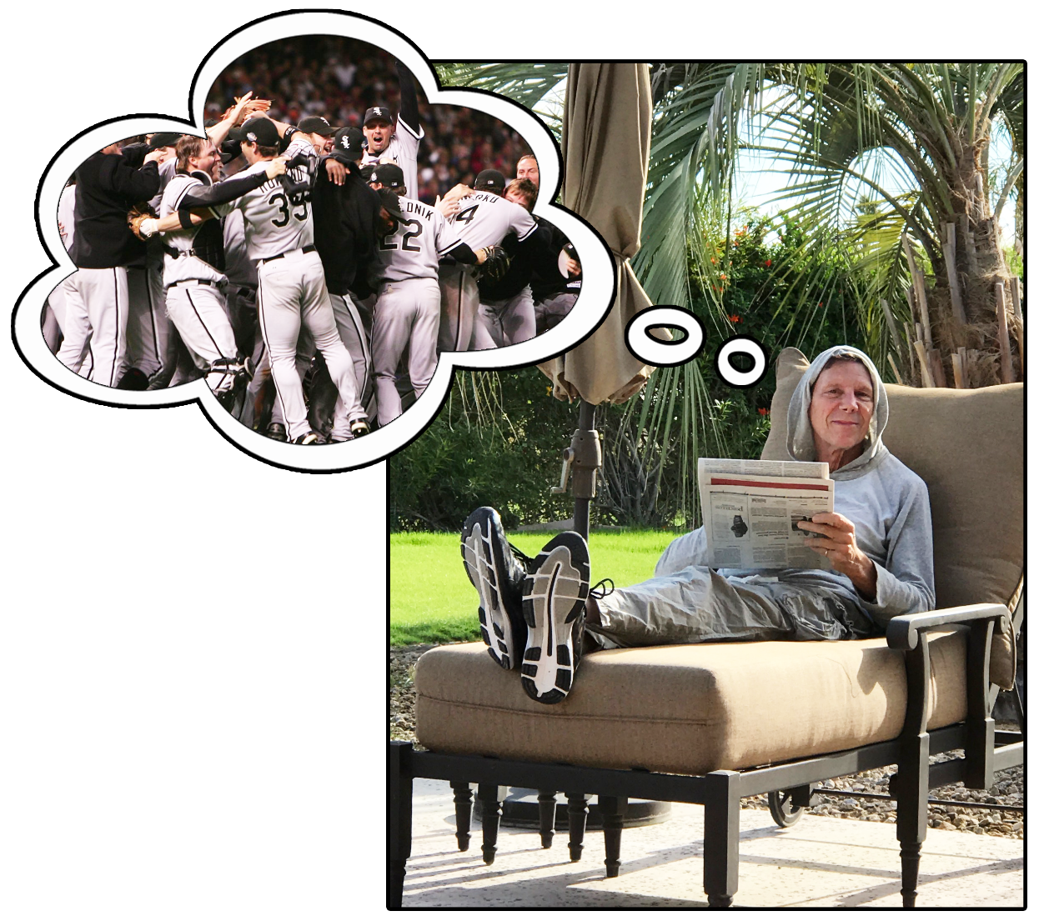
A&H Sportswear Co., Inc. v. William W. Yedor, (TTAB 3/29/19)
Mere hope that alleged condition precedent to using the mark –
the Chicago White
Sox winning the World
Series – would occur
someday is insufficient to
show bona fide intent to
use mark in commerce with the identified goods. Evidence to show bona fide intent requires firm and demonstrable evidence, not just a subjective belief.

Slide 21
In re Gillard, Ser. No. 87469115 (TTAB 2019)
TTAB affirmed refusal to register. An avalanche of evidence showed that #COVFEFE (or COVFEFE) failed to function as a trademark for Applicant’s goods. COVFEFE “has been widely used by the public in dialogue and on merchandise in a non-source identifying manner, and it does not identify Applicant as the sole source….” COVFEFE “is in the nature of a verbal Rorschach test….” Before Trump’s tweet was deleted, it had been re-tweeted over 127,000 times and “liked” more than 162,000 times “and the word ‘covfefe’ had been trending all night.”

Slide 22
In re Gillard, Ser. No. 87469115 (TTAB 2019)

Slide 23
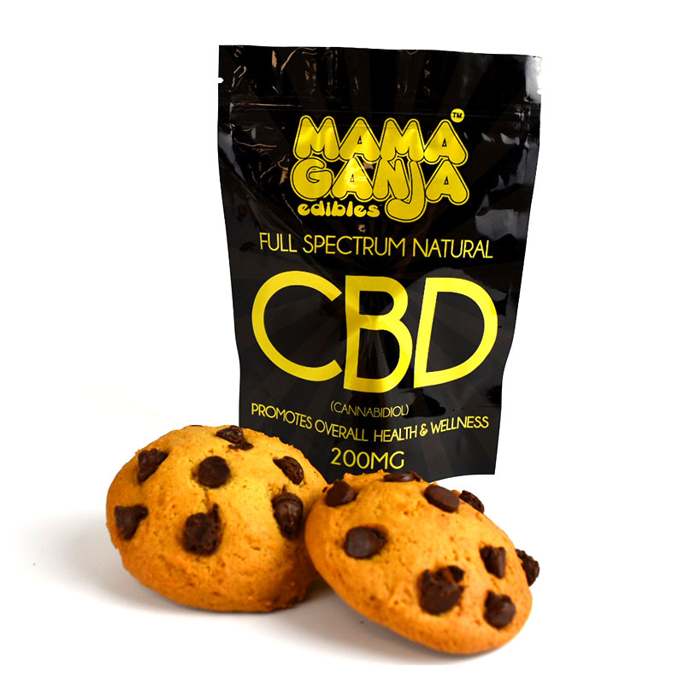
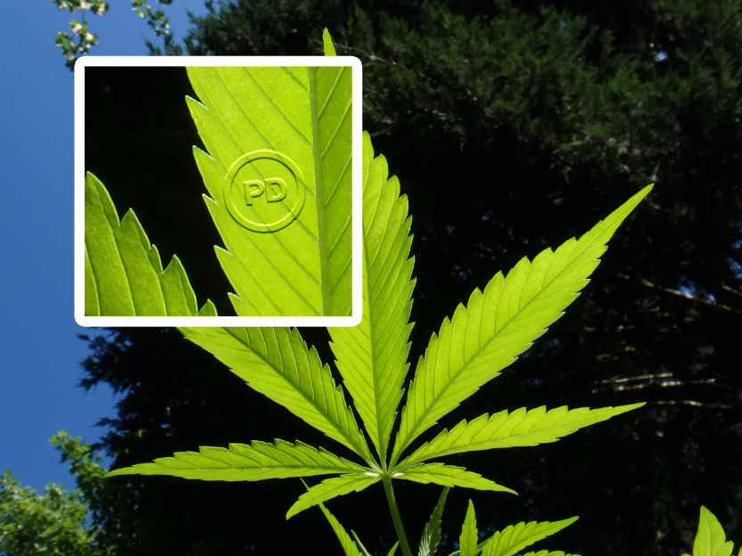
Registration of Hemp CBD Marks vs. Marijuana
CBD products from hemp with less than 0.3% THC now legal per federal 2018 Farm Bill — Therefore, trademark registration ok!
Dope? Still nope!
In re Brown,
119 USPQ 2d 1350 (TTAB 2016).

