Slide 1

Presentations By: David Sinz (Germany), Shuichi Sitara (Japan),
Peter Chun (Korea), and Shengping Yang (China)
Moderated By: George McGuire

Slide 2
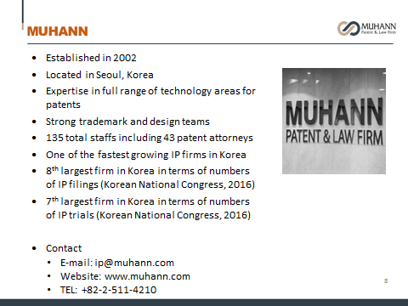
Peter Chun, from MUHANN in Korea

Slide 3

Shuichi Shitara, Japan
Founded in 1981
Total number of staff: 200
80 patent attorneys, 1 attorney-at-law
Head office: Tokyo
Branch office in Alexandria, VA, USA
2 US Patent Attorneys (one in Kansas)
4 JP attorneys passed US patent bar exam
90% revenue from JP clients
Handled 646 US patent applications (FY2017)
Received 137 JP patent applications from US (FY2017)

Slide 4
DAVID SINZ from DREISS in Germany
IP-Boutique law firm with roots in the 1930s.
14 patent attorneys, 3 attorneys-at-law.
Based in Stuttgart.
Frequently recommended for prosecution and litigation alike.
Fluctuation in attorneys is practically unknown at DREISS → we aim at longstanding client relations.
Drafting around 600 applications/Y (first filings).

Slide 5
SHENGPING – IPSunny
Established in December 2018.
15 people in total with 8 experienced attorneys & litigators.
Full IP services covering patent, trademark, copyright, trade secret, domain name etc. from prosecution, litigation, licensing, portfolio planning and managing, etc.
Main office in Beijing, satellite offices in most industrialized areas.
Contact: 1805A, Yicheng Center Tower C1, 1 Changchunqiao Rd.,
Haidian District, Beijing 100089, China
T: 86-10-5881 5456 F: 86-10-5881 5436
syang@ipsunny.com
mail@ipsunny.com www.ipsunny.com

Slide 6
Question 1
If there is/are any new legislation/laws in your country
that might affect U.S. clients,
would you introduce them?

Slide 7
EU - Unitary Patent (EU) - concept
“European Patent (EP) with unitary effect in the EU.”
Revocation, limitation, lapse, transfer: effect for all Member states (not EPC contracting states).
Single renewal fee (amount ca. DE+FR+UK?+NL).
Goal: Replace multi-forum litigation in EU countries by centralized litigation before Unified Patent Court.
Currently not available. Uncertainty due to Brexit.
Once available: reasonable choice, if patent shall be „validated“ in several EU countries (appr. >4).

Slide 8
Japan - New factory inspection system
A new bill is to be submitted to the Congress. Expected to be legislated.
Upon request by plaintiff, a designated expert inspects the alleged infringer’s facility and submits a report to the court. Designed to facilitate proof of infringement. (No discovery in Japan (lacking a strong evidence disclosure system)).
Only after institution of a patent infringement lawsuit.
The bill is supported by SMEs. Opposed by large corporations.

Slide 9
Korea - English is Permitted During IP Proceedings
Since June 13, 2018.
International Panel of Judges established at the Patent Court and the Seoul Central District Court.
    Before the first hearing takes place, a party can request that its case be handled by an international panel.
    The court reviews the request and decides whether the case shall be heard by an International Panel.
Judges review the case and conduct the trial in English.
  Evidence and arguments in English (w/o Korean translation).
  Oral Proceedings in English.
  English translation of the court decision provided.

Slide 10
Korea - Introduction of Treble Patent Damages
Since July 9, 2019
Those who knowingly or willfully infringe another party’s patents will be liable for up to three times the amount determined as damages
8 Factors to be considered when determining the amount of punitive damages
  Whether the infringer holds a dominant position over the patentee
  The degree of willfulness or awareness of the severity of harm caused by the
  infringement
  The degree of damage
  The degree of profit the infringer gained from the infringement
  The duration and frequency of the infringement
  Penalties imposed for the infringement (in case of, e.g., parallel criminal prosecution)
  Financial status of the infringer
  The infringer’s efforts to mitigate the damage

Slide 11
China
Amended Patent Law expected to be in force within this year.
    Punitive damage: up to 5 times; Proof burden easily shifted to infringer
    Patent claiming a new drug gets 5 years of additional protection
    Online service provider’s joint tort liability
    Open license
Second instance of patent, UM, Plant Variety, software, technical know-how, layout design of IC etc. are concentrated to the supreme court.
Patent re-examination board canceled.

Slide 12
Question 2
Could you give us some practical tips that could be helpful to a U.S. client preparing to file/or in the process of filing a patent application in your country?

Slide 13
Europe
Formalities in claim drafting
    One independent claim per category → divisional application
    Multiple dependencies are no problem → no additional costs
    Claim fees for the 16th and each additional claim
Amendments to the claims – Disclosure
    Strict in EP practice (inescapable trap); more lenient in DE
Arguing inventive step at the EPO
    EP → Use the “problem-solution-approach”!
    Describe advantages of your invention, use your own words
    Describe what the prior art does differently, use your own words
    File history is usually no problem (keep in mind possible cross-link to US)
PCT-EP and PCT-DE route in parallel; also utility model

Slide 14
Japan
Support requirement stricter than US
  Advisable to disclose many embodiments and examples
Lenient Inventive step standard
  High grant rate

Slide 15
Japan
Reflection of changing judgement over inventive step
Source: JPO
Definitions:
JPO: number of allowed patents / (number of allowed patents + number of refused applications + number of withdrawn/abandoned patent applications that have been examined)

Slide 16
Japan
Source: JPO
<Calculation method>
Reversal rate at Appeal = (No. of successful appeal cases)/((No. of successful appeal cases) + (No. of unsuccessful appeal cases) + (No. of abandoned or withdrawn appeal cases))

Slide 17
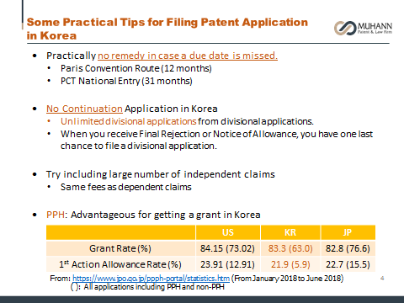
Korea

Slide 18
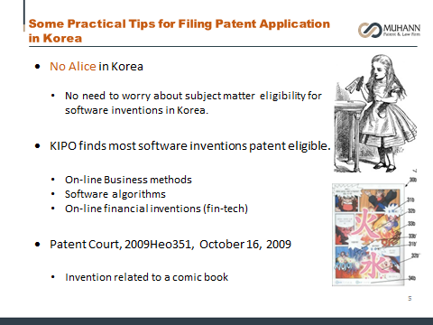
Korea

Slide 19
China
Literal support or correspondence between description and claims
    have a literal copy of the claims wording in the brief description
    Sufficient embodiments to support claims
No broken lines in design;
Patent and UM in parallel
    same applicant on same day;
    no method claims in UM

Slide 20
Question 3
Could you explain the basics of the opposition and invalidation procedures in your country?

Slide 21
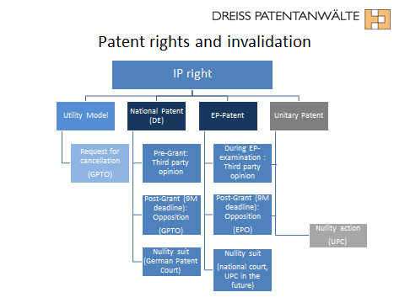
Europe

Slide 22
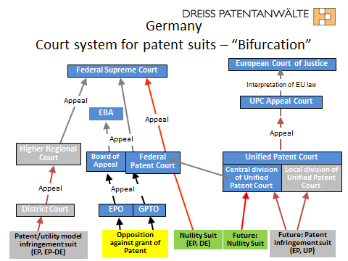
Germany

Slide 23
Japan
 | Post-grant Opposition | Invalidation Procedure
System spirit | Review of a granted patent in early stage (securing a strong patent right) | Dispute resolution measure between parties
Who may file? | Anyone | Party having interest
Where to file? | Patent Office (board of three examiner) | Patent Office (board of three examiner)
When to file? | Within 6 months after publication of patent registration | Anytime
Reason? | Novelty, inventive step, clarity, support requirement, new matter
Involvement of requester? | Limited | Inter-partes procedure
Average Pendency Period | 7.2 months (2017) | 10.6 months (2017)
Success rate | 10% (2015-2017) | 24.5% (2017)
Attorney’s fee | USD3,000 – 4,000 | USD10,000 - 15,000
Appeal | Only patentee may appeal to High Court (against Patent Office) | Either party may appeal to High Court (against each other)

Slide 24
Japan
Reflection of changing judgement over inventive step
Source: JPO
Definitions
JPO: number of invalidated patents (including partially invalidated patents) / (number of invalidated patents + number of unsuccessful invalidation requests (excluding withdrawn requests))

Slide 25
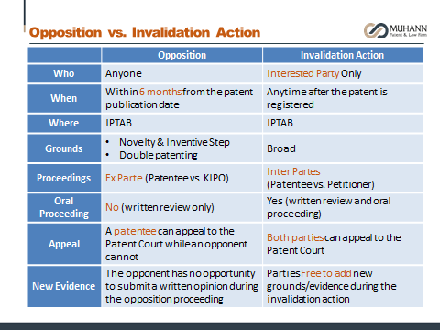
Korea

Slide 26
China – Invalidation in general; No opposition
File, possibly format correction. Failure of correction may cause the request denied.
Appeal to Beijing IP court.
Oral hearing highly possible. Mainly consider procedural matters.
Appeal to Beijing High Court. Oral hearing possible. More attention to substantive matters.
Paper exam or Oral Hearing. Basically, if request is sufficient to invalidate all claims, then possibly paper exam. If the board tend to make a decision that is negative to the requester, oral hearing.
Decision: invalid, partially invalid, maintain
Averagely less then 1 year **
Around 1 month
15 days
Around 1 month
3 months
** case 1: invention patent, 14 months
case 2: invention patent, 9 months
case 3: design patent, 5 months

Slide 27
Question 4
What are timelines and costs for enforcing patents in your country?

Slide 28
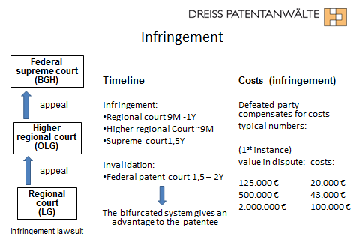
Europe

Slide 29
Japan
Timelines | Infringement argument: one year+ Damages argument: half a year
Costs | - Retainer fee / Contingency fee (% of awarded damages) - Time charge <Exemplary case> patent infringement lawsuit - request of injunction - request of US$1M damages Decision of the court - injunction granted - damages of US$800,000 awarded attorney's fee (result of survey) US$140,000 - 170,000

Slide 30
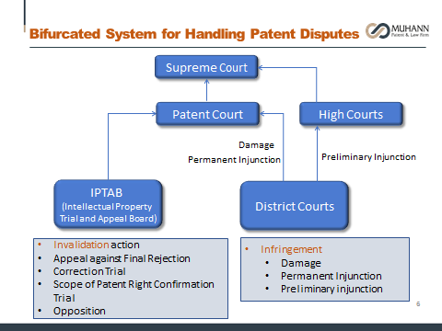
Korea

Slide 31
China Dual Track
Available official remedies
  Judicial remedy:
        Complain at a patent court;
          Averagely takes around 19 months;
          Decision effective throughout China;
          Official fee depends on amount of the subject matter;
          Attorney fee ranges €30,000-120,000.
Dual Track: Judicial & Administrative

Slide 32
1. Available remedies for patent disputes
China Timeline
7 days
6-18months *
1 month
15 days
3 months*
Complain
Evidence/document exchange
Possible pre-hearing meeting
…
Decision
Documents check**
Possible oral hearing
file
Oral hearing
Appeal
Decision
* For cases involving a foreign party, there is no time limit in practices
** Traditionally second instance did not involve oral hearing often. But in recent years, oral hearing is observed more and more often.

Slide 33
Question 6
What would be the most prominent trend or changes regarding IP matters in your country?

Slide 34
China Administrative Track
Available official remedies
  Administrative remedy:
      Complain at IP department of a local government;
      Averagely takes 3-9 months;
      Decision effective locally;
      No damages;
      Official fee varies from place to place € 10-25;
      Attorney fee around €30,000.

Slide 35
1. Available remedies for patent disputes
China Administrative Timeline
7 days
0-9months *
1 month
15 days
6 months**
Complain
Evidence/document exchange
Often on-site investigation
Possible direct seizure
…
Decision
Decision
file
Possible
oral hearing
Appeal to
court
* For obvious and bad faith infringement, immediate injunction order might be issued and enforced, raid action might be taken
** Once appealed to a court, the case becomes an administrative litigation case and follows administrative litigation procedures.

Slide 36
Europe
EPO streamlines prosecution and opposition procedures
New EPO President resolves dispute with the boards of appeal and boards of appeal finish their relocation → duration of appeal proceedings is expected to decrease
Steady decline of utility models filed in Germany, why?

Slide 37
China
New IP laws; new IP office; new IP courts;
Enforcing a patent is easier and easier;
Results more and more predictable;
IP rights more and more respected by the public;
More and more competitive.

Slide 38
Question 7
In China there appears to be new legislation regarding patent damages, could you elaborate about it, Shengping? How about the situation in each jurisdiction, everyone?

Slide 39
China
The newly expected patent law raises damages significantly:
    Statutory damage up to RMB5,000,000.
    Punitive damage up to 5 times
In practices, there are bigger and bigger damages
Proof burden in damage disputes are often shifted to the infringer

Slide 40
Europe/Germany
No treble damages
Three different ways to determine damages:
  License analogy (most common)
  Profit of the infringer (sometimes)
  Lost profits of the patentee (practically never)

Slide 41
Question 8
Is it worth it to file trademark/patent application in China? What are some practical tips related to this?

Slide 42
China
The market is big and still growing;
Enforcement is becoming easier and easier;
Publics are becoming more respectful to IP rights;
Competitors are filing
#German golden nose prize

Slide 43
Question 9
Can you obtain permanent injunction in China? Temporary injunction? Practical tips related to this? For example in the U.S. you cannot delay at all if you want to get a TRO.

Slide 44
China
Permanent injunction: very common; temporary injunction very rare.
Tips:
  to show the high possibility of infringement;
  to show the urgency of stopping infringement;
  to show irreparable damage
  deposition necessary

Slide 45
Europe/Germany
TRO possible (~4 weeks after taking notice infringement)
permanent injunction → Usual goal in infringement suit

Slide 46
Question 10
How common/exhaustive is discovery (depositions, for example)?

Slide 47
Europe/Germany
No depositions
No discovery to the US extent
German Patent law offers the possibility of filing a request for the right to an inspection.

Slide 48
China
No discovery
  But some courts, especially the Beijing IP court often organizes actions similar to discovery

