Slide 1


Design Panel
Speakers: Dan Altman (Knobbe Martens), Stefano Ferro (Bugnion), Anbar Khal (Oakley)
Moderated by: Hans Mayer (Knobbe Martens)
Washington in the West
January 29, 2019
oakley.com
bugnion.eu

Slide 2
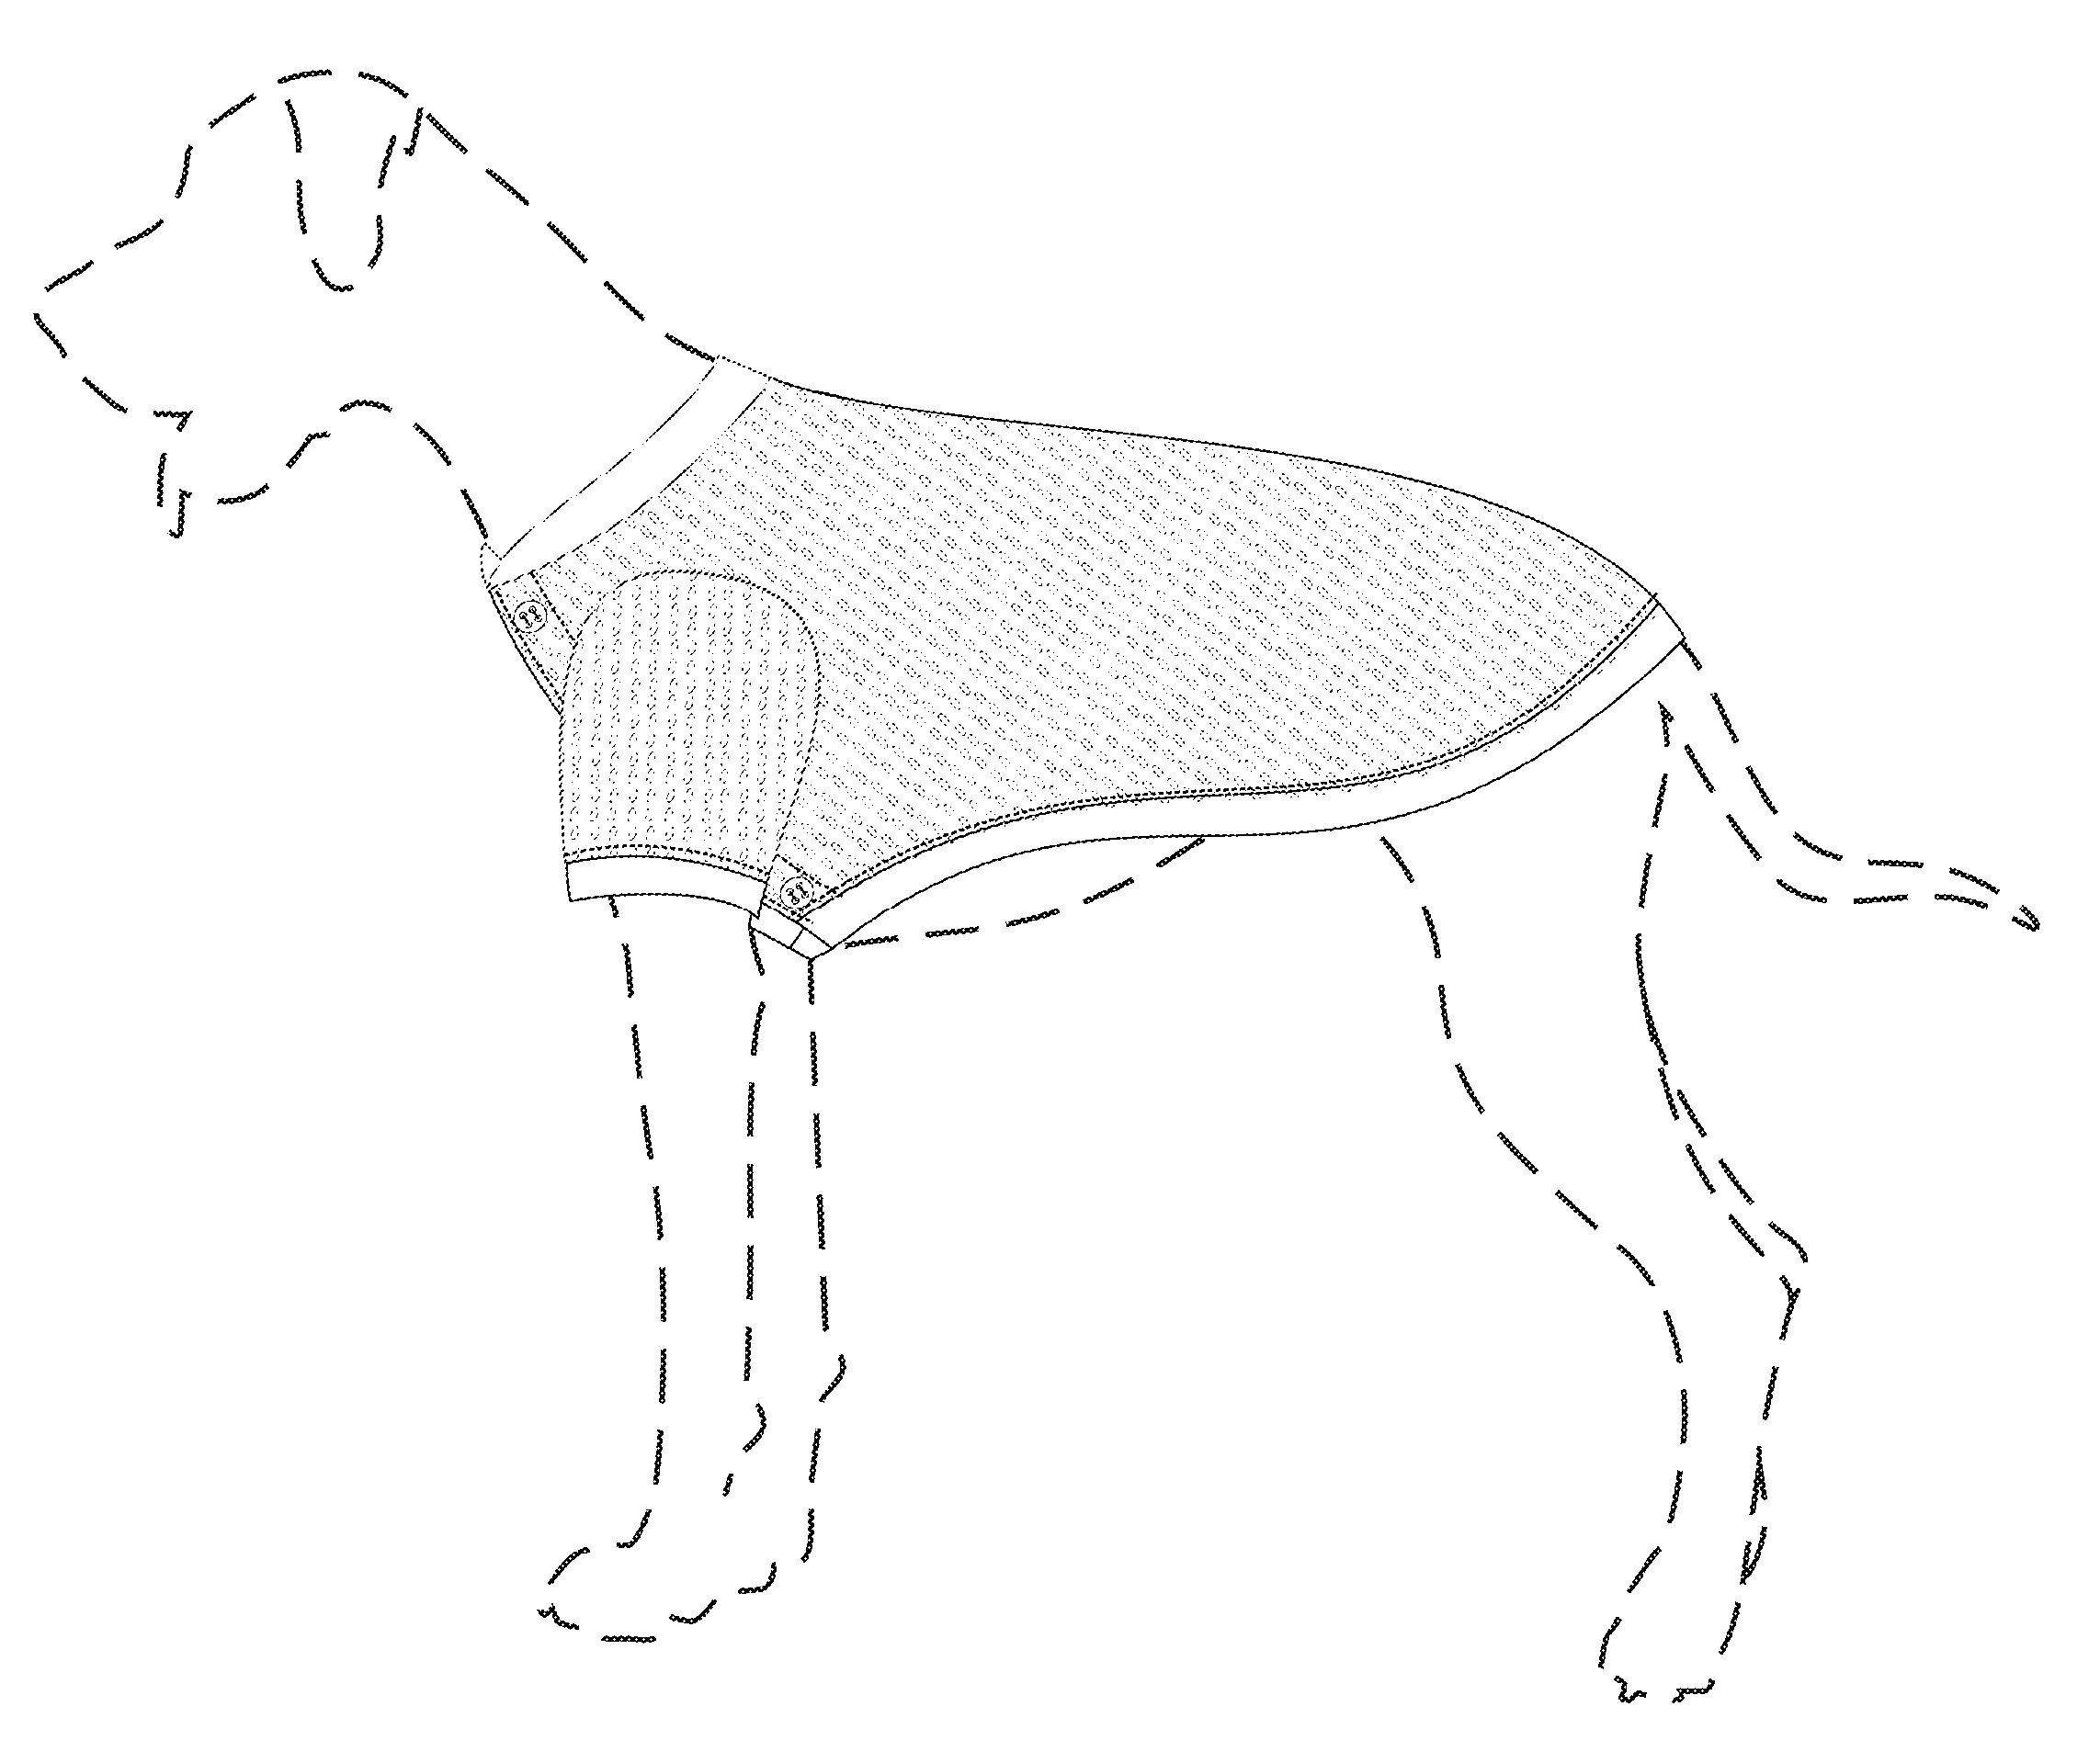
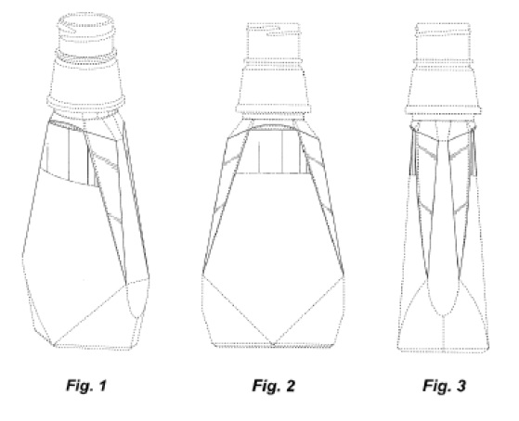
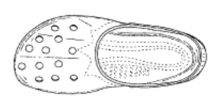
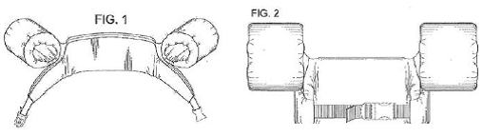
Design Patents: Important Decisions and Practical Applications
Standards and Considerations for:
  Infringement
  Novelty
  Obviousness
  Functionality
  Use of “broken lines”
The EU Standpoint
Practical Applications

Slide 3
Egyptian Goddess Inc. v. Swissa Inc., 543 F.3d 665,
88 USPQ2d 1658 (Fed. Cir. 2008) (en banc).
The standard for Infringement of design patents is the “ordinary observer test”:
  “if, in the eye of an ordinary observer,
  giving such attention as a purchaser usually gives,
  two designs are substantially the same,
  if the resemblance is such as to deceive such an observer,
  inducing him to purchase one supposing it to be the other,
  the first one patented is infringed by the other.”
Point of novelty test not applied
  Nevertheless, ordinary observer assumed to be aware of prior art

Slide 4
Egyptian Goddess
Devices for buffing fingernails
Accused Product
(abrasive on four sides)
Fig. 1
US D467,389
(abrasive on three sides)

Slide 5
Egyptian Goddess
General shape of accused and patented products is the same
Ordinary observer would take into account the prior art:
Both patented design and accused device have four sides
  Like prior art, accused device has abrasive pads on all sides
  Unlike prior art, patented design has abrasive pads on only three of four sides
Similar to patented design, but only three sides

Slide 6
Egyptian Goddess
The ordinary observer knows that prior art has pads on all sides
  Appearance of accused device and patented design must be viewed as a whole
  The patented design as a whole having a fourth side without a pad would not be viewed as substantially the same as the accused device having a pad on all four sides
  Therefore, no infringement

Slide 7

Egyptian Goddess
The EU standpoint:
A Registered Community Design has individual character only if its overall impression is different for an informed user
Who is the informed user? Half a way between the sectorial expert (or designer) and the average consumer
Who is the informed user in this specific case? Probably a woman who takes care of her nails and has some awareness of the existing designs in that sector
The two designs must be compared globally but… not all features have the same weight (in this case the difference concerns a functional element)

Slide 8
Egyptian Goddess – Practical Application
Prior Art
Patented Design
Accused Design A – NOT Infringing
Accused Design B – Infringing

Slide 9
International Seaway Trading Corp. v. Walgreens Corp., 589 F.3d 1233, 93 USPQ2d 1001 (Fed. Cir. 2009).
The test for novelty is the same “ordinary observer test” used for infringement.
  “Just as minor differences between a patented design and an accused article's design cannot, and shall not, prevent a finding of infringement,
  so too minor differences cannot prevent a finding of anticipation.”
Because differences more than minor, no anticipation
Fig. 1 of patent
Prior art

Slide 10
International Seaway
The EU standpoint:
A design is new if it is not anticipated by an identical design which was disclosed according to Article 7 CDR
Designs are considered as being ‘identical’ if their features differ only in immaterial details
Example of an immaterial detail: slight variation in shade of color pattern of the compared design

Slide 11
International Seaway Trading Corp – Practical Application
Cited Prior Art
Patented Design
Prior Art 1 –
Not substantially similar; Does not invalidate
Prior Art 2 – Substantially similar; Invalidates

Slide 12
MRC Innovations, Inc. v. Hunter Mfg., LLP, 747 F.3d 1326 (Fed. Cir. 2014)
The test for obviousness in design patent cases
  identification of a primary reference
    “something in existence”
    has basically the same characteristics of the claimed design.
  Secondary references
    used to modify the design of the primary reference.
    “so related to the primary reference that the appearance of certain ornamental features in one would suggest the application of those features to the other”
    de minimis changes may not require a secondary reference.

Slide 13

MRC Innovations
US D634,487
Eagles Jersey
(Prior Art)

Slide 14
MRC Innovations
Verbal Description
  Similarities between the claimed design and the Eagles jersey:
    an opening at the collar portion for the head
    two openings and sleeves stitched to the body of the jersey for limbs
    a body portion on which a football logo is applied
    made “primarily of a mesh and interlock fabric”
    contains at least some ornamental surge stitching
  Differences
    different "interlock fabric"
    V-neck collar
    surge stitching on the rear portion of the jersey

Slide 15
MRC Innovations
Holding
  Eagles jersey has basically the same characteristics of the claimed design
  Secondary references not necessary because differences are de minimis
Summary judgment of invalidity for obviousness appropriate

Slide 16
MRC Innovations
The EU standpoint:
European Courts do not use the word obviousness when dealing with registered designs (because they differ from patents), but…
An issue which is taken into consideration is designer’s degree of freedom: it depends on the nature and the intended purpose of the product in which the design is incorporated, as well as on the industrial sector to which the product belongs (the more the designer’s freedom is restricted… the more likely minor differences will be enough to produce a different overall impression on the informed user)
Saturation of the prior art (which could lead to a different overall impression even if differences are minor) could also have an impact, but the holder of the contested RCD must file sufficient evidence

Slide 17
Sport Dimension, Inc. v. Coleman Co. Inc., 820 F.3d. 1316, 118 USPQ2d 1607 (Fed. Cir. 2016).
A design patent cannot claim a purely functional design
  invalid if appearance is “dictated by” its function
  not invalid as long as the design is not primarily functional
    even if certain elements have functional purposes.
Where a design contains both functional and nonfunctional elements
  the scope of the claim must be construed in order to identify the non-functional aspects of the design as shown in the patent

Slide 18
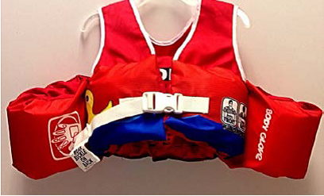
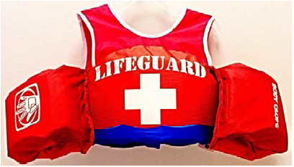
Sport Dimension
US D623,714
Competitor’s
Design

Slide 19
Sport Dimension
Factors are for determining whether a claimed design is dictated by function
  whether the protected design represents the best design
  whether alternative designs would adversely affect the utility of the specified article
  whether there are any concomitant utility patents
  whether the advertising touts particular features of the design as having specific utility
  whether there are any elements in the design or an overall appearance clearly not dictated by function

Slide 20
Sport Dimension
In valid design patents, same factors provide useful guidance to determine which elements are functional
  Claim construction cannot eliminate functional elements
  Design patents protect the overall ornamentation of a design, not an aggregation of separable elements
  Fact finder should not focus on the particular designs of functional elements when determining infringement, but rather focus on what these elements contribute to the design’s overall ornamentation
Remanded for further proceedings to determine infringement

Slide 21
Sport Dimension
The EU standpoint:
A Community Design cannot confer any exclusive right on features of appearance of a product which are solely dictated by its technical function
The aim of this limitation is to prevent technological innovations from being hampered by design protection for features which are merely technical
The design as a whole is invalid only if all essential features of the appearance of the product are solely dictated by its technical function
The rule on technical function applies also to designs of interconnections (when that exact shape or dimension is necessary in order to permit the product to be mechanically connected to, or placed in, around or against another product so that either product may perform its own function)

Slide 22
Sport Dimension, Inc. – Practical Application
Patented Design
District Court’s Claim Construction
Patented Design
Alleged Infringing Design
Noninfringement
Federal Circuit’s Claim Construction
Patented Design
Alleged Infringing Design
Remanded for decision on infringement

Slide 23
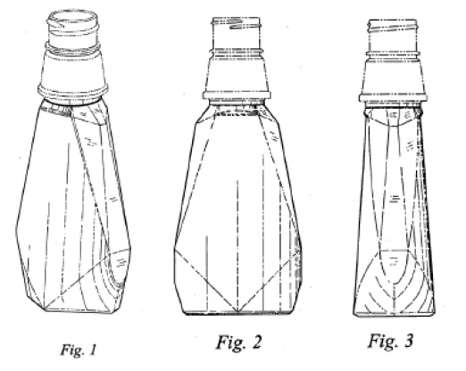
In re Owens, 106 USPQ2d 1248 (Fed. Cir. 2013)
Claimed Design
Original Application
Was it new matter to add the boundary line shown by arrow?

Slide 24
In re Owens, 106 USPQ2d 1248 (Fed. Cir. 2013)
Claim was broadened by changing a solid lines to broken lines
Broken lines can be used to show:
  unclaimed “environmental” matter (e.g. the cap shown in claimed design)
  unclaimed boundaries (e.g. the line shown by arrow)
    boundary does not exist in reality in the article embodying the design
    understood that the claimed design extends to the boundary but does not include the boundary

Slide 25
Owens
The boundary lines in the claimed design did not appear in the original application
  No basis to introduce them in original application
The broken lines formed in the cap were in the original application as solid lines
  No issue of new matter raised by converting these to broken lines
A boundary line formed from an existing solid line
  After some confusion, now accepted by USPTO

Slide 26
Owens
The EU standpoint
Up to 7 views for each design
Examination on consistency of the views (they must clearly relate to the same design)
Alternative positions – exploded views – partial views – sets of articles: allowed
Variations of the same design: not allowed (but they can be bundled in a multiple application)
Broken lines – blurring – color shades – photographs (b/w and colors): allowed
Explanatory wordings or symbols: not allowed

Slide 27
Dan Altman: dan.altman@knobbe.com, 949-760-0404
Stefano Ferro: ferro@bugnion.it, +39 45 8005310
Anbar Khal: akhal@oakley.com
oakley.com
bugnion.eu

