Slide 1

LAIPLA – Washington in the West 2019
EPO Perspectives on Subject Matter Eligibility
Freddy Thiel, VP San Francisco Liaison Office

Slide 2

Freddy Thiel
2
European Patent Attorney
13 years in-house, including 10 years at Orange harvesting inventions for the company’s international labs
Heading K&S liaison office in the Bay area
Specialist technical areas:
IT & software | Mechanical products | GUI | Telecommunications | Capturing odd inventions | Inventor mentoring

Slide 3
CII Inventions – Two step Approach
1st step: Exclusions (Art. 52, Rule 42, 43 EPC)
The claimed subject-matter must have a technical character. But claims may contain a mix of technical and non-technical features. The non-technical features are the features which in isolation are directed to non-patentable subject matter.
2nd step: Inventive Step (Art. 54, 56 EPC)
The presence of an inventive step may only be supported by those features of the claimed invention, assessed as a whole, which contribute technical character, i.e. those feature which contribute to the solution of a technical problem by providing a technical contribution.
There must be a non-obvious technical contribution over the prior art.
Easy!
Not so easy!

Slide 4
CII “Mixed Type” Inventions – The First step
Article 52(2) EPC
The following in particular shall not be regarded as patentable inventions within the meaning of paragraph 1
a) discoveries, scientific theories and mathematical methods
b) aesthetic creations
c) schemes, rules and methods for performing mental acts,
playing games or doing business,
and programs for computers;
d) presentations of information
...only excluded if application or patent relates to such subject matter or activities as such (Article 52(3))

Slide 5
CII “Mixed Type” Inventions – Examples of first step application
First step: Easy!
A method for financial-trading systems on which trades between two parties who are to exchange payment are settled by a third party in ways that reduce "settlement risk
Excluded as a business method
‘A computer with a database of parties who have traded and exchange payments settled by a third party'
Not Excluded
‘A computer-implemented method to settle by a third party payments exchanged between two parties …’
Not Excluded
‘A program to do the method of settling by a third party payments exchanged between two parties …’
Not excluded

Slide 6
CII “Mixed Type” Inventions – Second step
Not so easy!
Features with technical effect in the claim as a whole.
Obvious?
Closest prior art
Claim
Technical character
Non-technical character
Features making no technical contribution
cannot contribute to inventive step …
and therefore can appear in the formulation of the objective technical problem

Slide 7
CII “Mixed Type” Inventions – Second step
Steps of the Problem/Solution Approach applied to mixed-type inventions (Guidelines, G-VII 5.4)
Determine the features contributing to technical character on the basis of the technical effects achieved in the context of the invention
Determine a suitable starting point as closest prior art based on these features
Determine the differences with respect to closest prior art
  Determine their technical effect(s) in context of the claim as a whole
  Identify from these differences the features making a technical contribution and those which do not.
    If no differences (at all) then lack of novelty (Art. 54)
    If no technical contribution then lack of inventive step (Art. 56)
    If differences include features making a technical contribution …

Slide 8
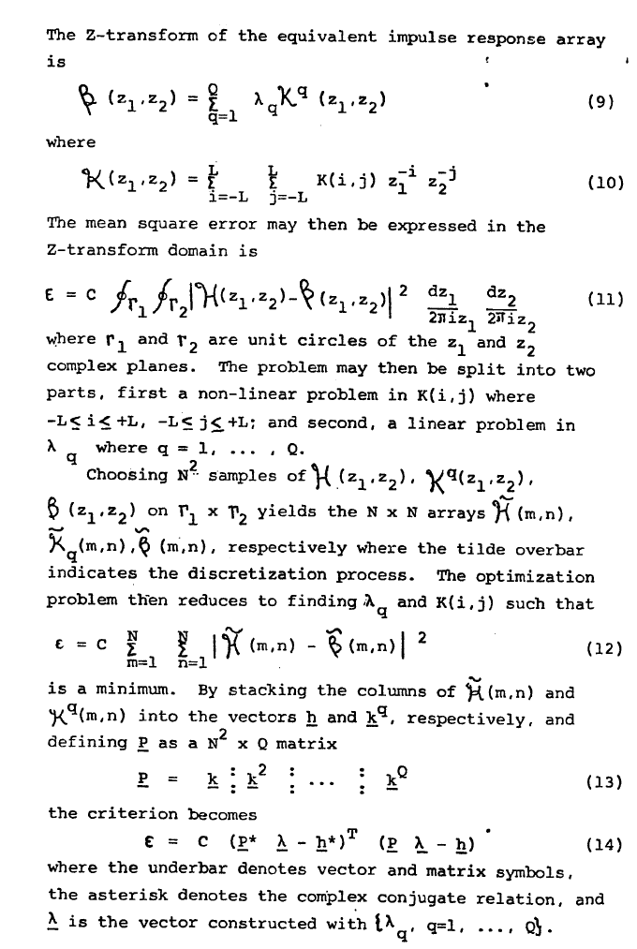
  CII Examples: Vicom decision T 0208/84
Claim:
1. A method of digitally processing images in the form of a two-dimensional data array having elements arranged in rows and columns in which an operator matrix of a size substantially smaller than the size of the data array is convolved with the data array, including sequentially scanning the elements of the data array with the operator matrix, characterised in that the method includes
repeated cycles of sequentially scanning the entire data array with a small generating kernel operator matrix to generate a convolved array and then
replacing the data array as a new data array;
the small generating kernel remaining the same for any single scan of the entire data array and although comprising at least a multiplicity of elements, nevertheless being of a size substantially smaller than is required of a conventional operator matrix in which the operator matrix is convolved with the data array only one, and the cycle being repeated for each previous new data array by selecting the small generating kernel operator matrices and the number of cycles according to conventional error minimisation techniques until the last new data array generated is substantially the required convolution of the original data array with the conventional operator matrix.
Notes:
Even if the idea underlying an invention may be considered to reside in a mathematical method a claim directed to a technical process in which the method is used does not seek protection for the mathematical method as such.
II. A computer of known type set up to operate according to a new program cannot be considered as forming part of the state of the art as defined by Article 54(2) EPC.
III. A claim directed to a technical process which process is carried out under the control of a program (whether by means of hardware or software), cannot be regarded as relating to a computer program as such.
IV. A claim which can be considered as being directed to a computer set up to operate in accordance with a specified program (whether by means of hardware or software) for controlling or carrying out a technical process cannot be regarded as relating to a computer program as such.

Slide 9


CII “Mixed Type” Inventions – Second step
Even if the underlying idea of an invention resides in a mathematical method, the claim restricted to a particular application of the mathematical method in a technical field does not seek protection for the mathematical method as such.
If the claimed invention addresses a problem in a field excluded from patentability (e.g. economics) by providing an improvement solely in that field, it is a non technical problem that can be solved by the person skilled in the art of programming as requirements to implement using a computer
a mere automation of excluded subject matter using a computer cannot be patented. More generally, non-technical features can become non-technical requirements to implement
who is the man skilled in the art: a financial expert, a salesperson, a business analyst, or a programmer?

Slide 10
CII “Mixed Type” Inventions – Second step
More examples are available in Guidelines G-VII, 5.4
What story can you tell? For each feature which:
when taken in isolation, appears non-technical as directed to excluded subject matter,
but do, in the context of the claimed invention, contribute to producing a technical effect serving a technical purpose
Such features are considered to contribute to the technical character of the claimed invention as a whole and may therefore support the presence of an inventive step.
The man skilled in the art is then a software or systems engineer

Slide 11
It’s all relative: Good data v. Bad data
A method for determining relative relationship, comprising:
receiving recombinable deoxyribonucleic acid (DNA) information of a first user and of a second user from a database comprising recombinable DNA information of a plurality of users;
determining, based at least in part on the recombinable DNA information of the first user and of the second user, a predicted degree of relationship between the first user and the second user; and,
notifying at least the first user about a relative relationship with the second user.
A method for determining relative relationship, comprising:
receiving profile information of a first user and of a second user from a database comprising profile information of a plurality of users;
determining, based at least in part on the profile information of the first user and of the second user, a predicted degree of relationship between the first user and the second user; and,
notifying at least the first user about a relative relationship with the second user.
Notes:
The first claim to the left did not get any objection from the EPO and a regular communication was provided, rejecting novelty based on prior art,
The second claim to the right would be rejected as a mere implementation using computing means of an administrative or business scheme

Slide 12
What should you have in mind when drafting a patent application for a software related invention?
Points of attention when drafting patent applications for CII
the invention must tackle a technical problem and the solution must use technical means
the problem and the solution must be clearly described in the description and the claims must contain the technical features by which the technical problem is solved (what, how and why)
you cannot rely on non-technical features w/o technical contribution to support inventive step
no technical problem can be asserted in the course of examination, if this technical problem is not mentioned in the description as filed, or can not be derived from the description as filed: tell a technical story
the description should contain adequate fall back positions (i.e. enough technical details) in case the claims need to be amended by adding more technical features: zoom in on specific features of the invention.
Notes:
the statement in bold type is the main “take home” element from the presentation

Slide 13
How can AI and ML method contribute to
technical character?
  Two ways:
    By being adapted to a specific technical implementation
    By its application to a field of technology
  Claim directed to a specific technical implementation?
    AI algorithm is specifically adapted for that implementation
    AI design motivated by technical considerations of the internal functioning of the computer
    A generic technical implementation or mere programming will not suffice
  Claim applied to a field of technology?
    Solving a technical problem in a technical field
    Specific, and not generic like “controlling a technical system”
    Claims functionally limited to technical purpose

Slide 14
Recent decision T 1463/11 - Business person versus Skilled person
invention is about the authentication plug-ins that are no longer installed in each online shop, but are installed on a separate server that can be accessed by several online shops.
idea is to avoid installation/upkeep of plug-ins on shop's server
claim 1 defines a method with both technical and non-technical elements
formulation of the objective technical problem in terms of non-technical requirements raises the question of what requirements the (fictitious) business person can actually give to the technically skilled person
outsourcing a purely commercial transaction could be a requirement given to the skilled person
yet, the business person cannot require the technically-skilled person to use, for the plug-ins, a server other than the merchant server
the choice of where a particular computation is carried out in a distributed system will normally have implications for availability, for latency and so on, and those are technical matters.
the business person can be used in a reasoning to defend features from falling into the objective technical problem provided to a software programmer.
Notes:
the statement in bold type is the main “take home” element from the presentation

Slide 15
Thank you
F. Thiel
VP of San Francisco Liaison Office
fthiel@kilburnstrode.com
Kilburn & Strode LLP
Lacon London
84 Theobalds Road
London WC1X8NL
T +44 (0) 20 7539 4200
www.kilburnstrode.com
Patent and Trade Mark Attorneys
J. Smith
Senior Associate
jsmith@kilburnstrode.com

Slide 16
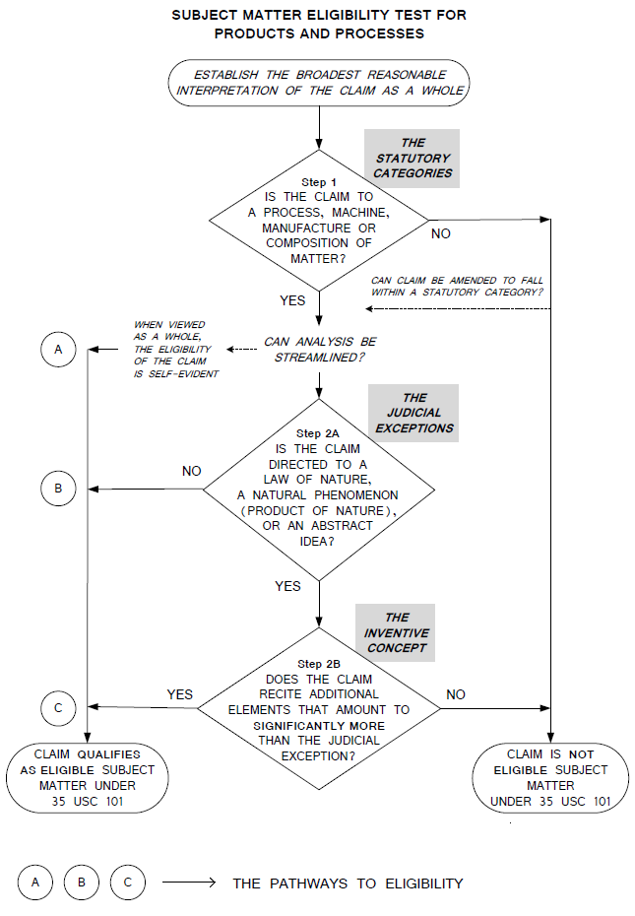
16
Is the claim directed to a judicial exception
Exception integrated into practical application

