Slide 1
Patent Intermediaries: Platforms, Pools and Defensive Aggregators

Slide 2
Panel Members
Shawn Ambwani
COO, SVP Legal and Co-Founder of Unified Patents
Ilja Bedner
Managing Director at LOT Network
Sanjeev Mehta
Associate General Counsel and Director at Verizon

Slide 3
Outline
The Problem
Definitions
Early Approaches
Defensive Aggregators
Offensive Patent Mitigation
Springing Licenses
Advantages/Disadvantages
Conclusions

Slide 4
The Problem
Operating
Company 1
Operating
Company 2
Operating
Company 1
Operating
Company 43
Operating
Company 1
Operating
Company 5
Operating
Company 1
Operating
Company 7
Operating
Company 1
Operating
Company 1
Operating
Company 14
Operating
Company 1
Your
Company
Operating
Company 1
PAE
Assert
Operating
Company 9
Operating
Company 1
Operating
Company 23
Operating
Company 1
Operating
Company 101
81% of patents assert by PAEs originate from operating companies
Operating
Company 1
Operating
Company 45
Operating
Company 1
Operating
Company 1
Operating
Company 73
Operating
Company N

Slide 5
Definitions – Historical Approaches
Standards-Based Cross-Licensing/FRAND
IEEE 802.11/3GPP
OIN (Android/Linux)
Covenants Not to Sue
Patent Pools
Offensive Patent Licensing

Slide 6
Definitions – Springing Licenses
LOT Network
LOT Members agree in advance to grant licenses to all Members to patents that they later sell to PAEs
Technically a conditional license that survives bankruptcy
Over 810,000 worldwide assets and 195+ members

Slide 7
The Solutions
Operating
Company 1
Operating
Company 1
Operating
Company 2
Operating
Company 43
Operating
Company 1
Operating
Company 5
Operating
Company 1
Operating
Company 7
Your
Company
Operating
Company 1
Operating
Company 1
Free License
Operating
Company 14
PAE
Operating
Company 1
Operating
Company 1
Operating
Company 1
Operating
Company 9
Operating
Company 23
Operating
Company 1
Operating
Company 101
Operating
Company 1
LOT Members agree (in advance) to grant licenses to all Members to patents that they later sell to PAEs.
Operating
Company 45
Operating
Company 1
Operating
Company 1
Operating
Company 73
Operating
Company N

Slide 8
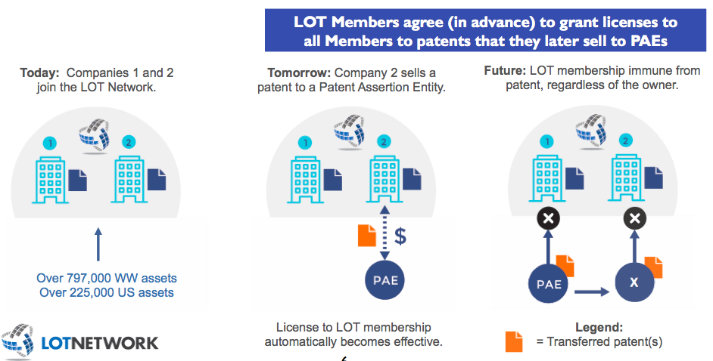

Slide 9
Definitions – Offensive Patent Mitigation
Unified Patents
Crowd-Sourced/Bounty-Based Prior Art Search
Patent Analytics
#4 Filer of IPR Petitions

Slide 10
The Solutions
Operating
Company 1
Operating
Company 2
Free License
Operating
Company 1
Operating
Company 43
Operating
Company 1
Operating
Company 5
Operating
Company 1
Operating
Company 7
PAE
Your
Company
Operating
Company 1
Operating
Company 1
Operating
Company 14
IPR
Operating
Company 1
Operating
Company 1
Operating
Company 1
Operating
Company 9
Operating
Company 23
Operating
Company 1
Operating
Company 101
Operating
Company 1
Unified Patents challenges poor PAE patents at the PTAB with IPRs
Operating
Company 45
Operating
Company 1
Operating
Company 1
Patents
Operating
Company 73
Operating
Company N

Slide 11
Definitions – Defensive Patent Aggregation
RPX
Subscription Service
Multiple Products
Patent Purchasing
Insurance Services
Monitoring/Patent Metrics
Defensive Network Effects
AST
Subscription Service
Non-Profit
Collective Purchasing/Bidding Process
Patent/Market Analysis
IP3

Slide 12
The Solutions
Operating
Company 1
Purchase Patents
Operating
Company 2
Free License
Operating
Company 1
Operating
Company 43
Operating
Company 1
Operating
Company 5
Operating
Company 1
Operating
Company 7
Your
Company
Operating
Company 1
Operating
Company 1
Operating
Company 14
PAE
Operating
Company 1
Operating
Company 1
Operating
Company 1
Operating
Company 9
Operating
Company 23
Operating
Company 1
AST / IP3 Offers collective purchasing/bidding process for purchasing patents. AST then releases the patents back to the market.
Operating
Company 101
Operating
Company 1
Operating
Company 45
Operating
Company 1
Operating
Company 1
Operating
Company 73
Operating
Company N

Slide 13
The Solutions
Operating
Company 1
Operating
Company 2
Free License
Operating
Company 1
Operating
Company 43
Operating
Company 1
Operating
Company 5
Operating
Company 1
Operating
Company 7
PAE
Your
Company
Operating
Company 1
Operating
Company 1
Operating
Company 14
Settlement
Operating
Company 1
Operating
Company 1
Operating
Company 1
Operating
Company 9
Operating
Company 23
Operating
Company 1
Operating
Company 101
Operating
Company 1
Operating
Company 45
Operating
Company 1
Operating
Company 1
Patents
RPX acquires licenses and patents for it’s subscribers
Operating
Company 73
Operating
Company N

Slide 14
Discussion
Historical Approaches
Standards
Technology Must be Standardizable
May Require Participation to Gain Access to Cross-Licensing
FRAND Concept Requires Litigation
Covenants Not to Sue
Requires Substantial Market Power
Patent Pools
Lowers Transaction Costs
Potential Antitrust Issues

Slide 15
Discussion
Unified Patents
Free Rider Problem
Third Party Patent Challenges
LOT Network
Encumbrance on Portfolios – Cost/Benefit
Free Rider Problem
Proactive vs. Reactive

Slide 16
Discussion
RPX
Simple Metrics to Determine ROI
Effective and Powerful Network
Free Riders
AST
Requires Member-Engagement to Determine ROI
Competitive Bidding on Individual Assets

Slide 17
The Solutions
Operating
Company 1
$250k-$2m/year
+ costs
Free License
Operating
Company 1
Operating
Company 2
Operating
Company 43
Operating
Company 1
$0-$1M/year
Operating
Company 5
Operating
Company 1
Operating
Company 7
Operating
Company 1
Operating
Company 1
Operating
Company 14
$250k/year
+ Patent costs
Operating
Company 1
Operating
Company 1
Operating
Company 1
Operating
Company 9
Operating
Company 23
Operating
Company 1
Operating
Company 101
Operating
Company 1
Operating
Company 45
Operating
Company 1
Operating
Company 1
Operating
Company 73
Operating
Company N
$0-$20k/year

Slide 18
Conclusions
Distinct Advantages/Disadvantages to Each Approach
Hybrid/Mixed Approach Taking Advantage of Several Solutions Depends on Ability to Absorb Costs/Risk

Slide 19
Patent Intermediaries: Platforms, Pools and Defensive Aggregators
The information provided in this slide presentation is not, is not intended to be, and shall not be construed to be, either the provision of legal advice or an offer to provide legal services, nor does it necessarily reflect the opinions of the firm, our lawyers or our clients. No client-lawyer relationship between you and the firm is or may be created by your access to or use of this presentation or any information contained on them. Rather, the content is intended as a general overview of the subject matter covered. Proskauer Rose LLP (Proskauer) is not obligated to provide updates on the information presented herein. Those viewing this presentation are encouraged to seek direct counsel on legal questions. © Proskauer Rose LLP. All Rights Reserved.

