Slide 1
Comparing subject matter eligibility in us and eu
John Cabeca, Director, Silicon Valley USPTO
Milan Kapadia, Patent Portfolio Manager, Boeing
Sandro Sandri, Partner, Bugnion
Alexander Schlee, Partner, Schlee IP
Jonathan Statman, Associate, Morrison & Foerster
January 25, 2018

Slide 2
U.S. Resources For Subject Matter Eligibility
John Cabeca
Director of the United States Patent and Trademark Office West Coast Regional Office

Slide 3
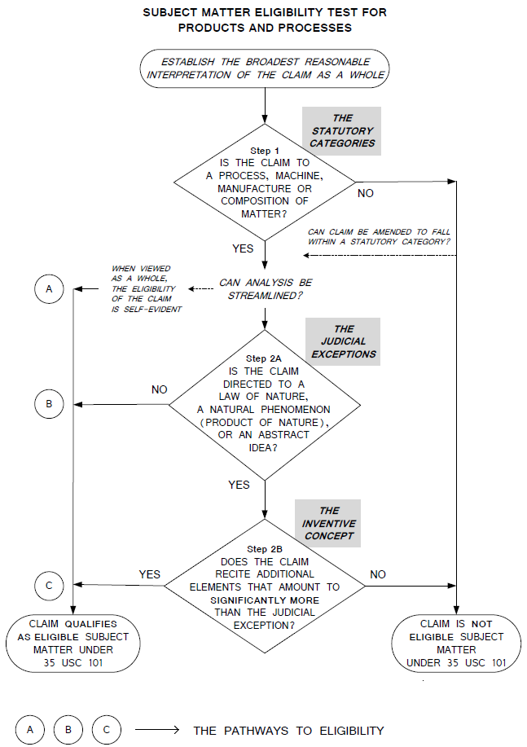
Subject Matter Flowchart
Subject Matter Test for Products and Processes:
Sets forth the only analysis for examination of subject matter eligibility under 35 U.S.C. 101

Slide 4
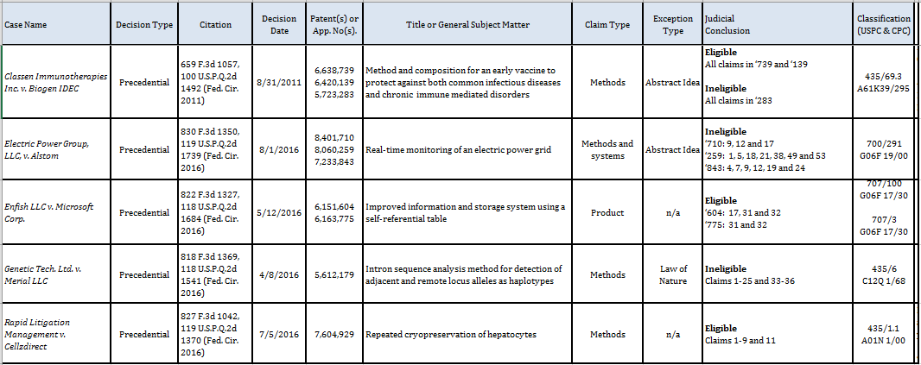
Case Law Chart
Case law chart provides additional information so examiners can look at the patent(s) and claim(s) at issue in the case
QRS & Chart are updated periodically (check 101 website)

Slide 5
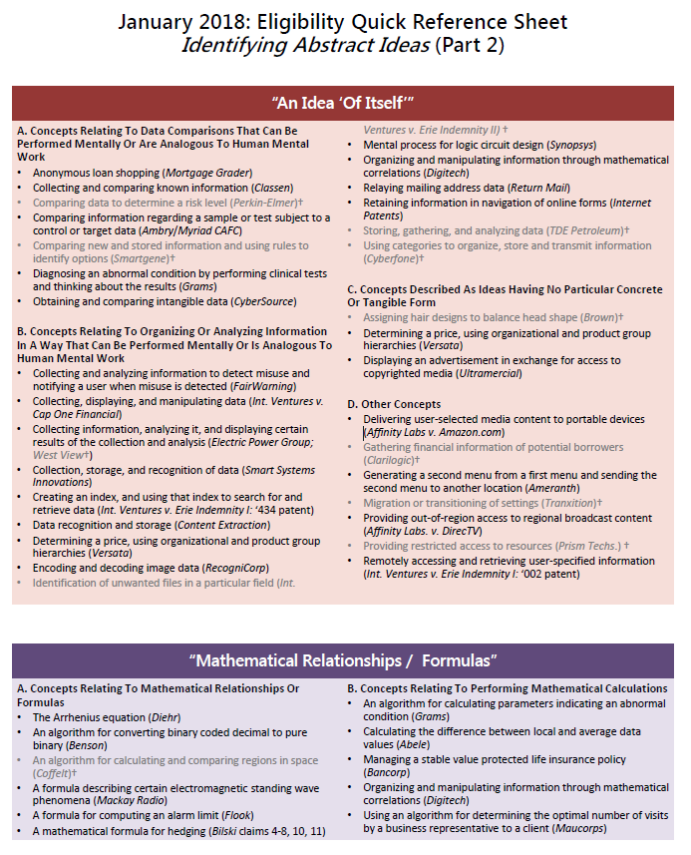
Quick Reference Sheet (QRS)
QRS groups abstract ideas to help examiners identify pertinent cases
Many cases on the QRS will be explained in further detail in the next MPEP revision, for example:
FairWarning is discussed along with other cases concerning “idea of itself” and mental process concepts
Grams is discussed along with other cases concerning mathematical relationship concepts

Slide 6
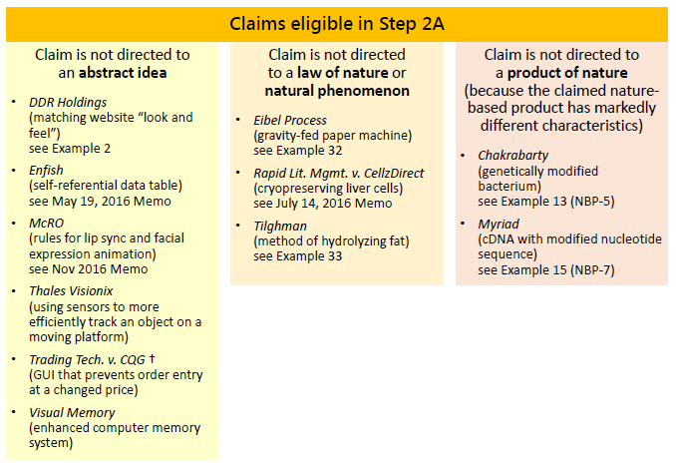
Claims That Are Eligible In Step 2A (Pathway B: Not Directed To An Exception) – Case Law

Slide 7
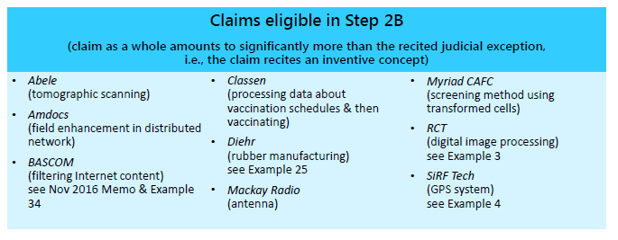
Claims That Are Eligible In Step 2B (Pathway C: Inventive Concept) – Case Law

Slide 8
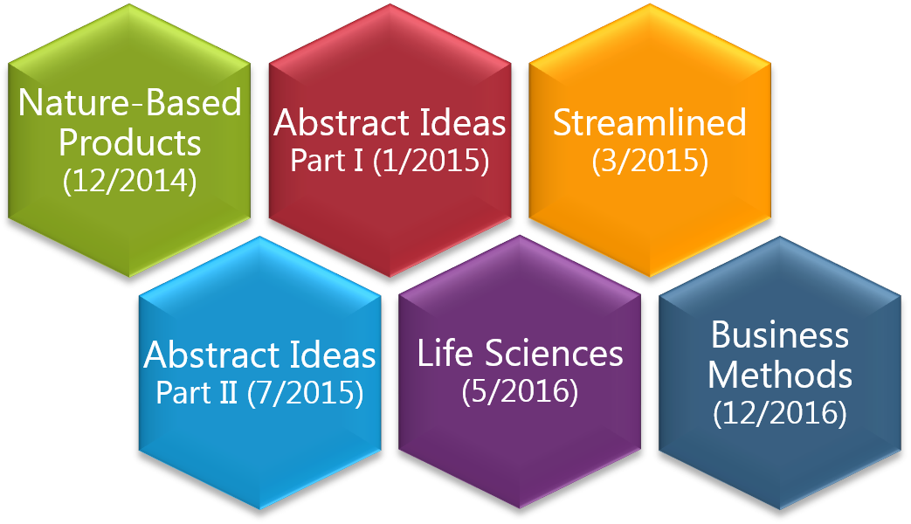
Subject Matter Eligibility Examples
Six sets of examples were issued, to explain how to apply the eligibility analysis to various fact patterns
Cover technologies including biotechnology, pharmaceuticals, business methods, computer-related inventions, and software
Include eligible and ineligible claims, in accordance with case law and based on hypothetical fact patterns

Slide 9
MPEP Revision on Interim Eligibility Guidance
The MPEP will soon be updated to incorporate the 2014 Interim Eligibility Guidance (IEG) and its updates
This updated MPEP will replace (and supersede) the IEG and prior updates
Because rejections are based on the law, this change does not affect pending eligibility rejections or create new grounds of rejection
May 2016 Memo
2014 IEG
July 2016 Memo
July 2015 Update
Nov. 2016 Memo
May 2016 Instructions
Next MPEP Revision

Slide 10
Statutory Subject Matter
Article 52 (1) EPC
European patents shall be granted for any inventions, in all fields of technology, provided that they are new, involve an inventive step and are susceptible of industrial application.
Article 52 (2) EPC
The following in particular shall not be regarded as inventions…
(a) discoveries, scientific theories and mathematical methods;
(b) aesthetic creations;
(c) schemes, rules and methods for performing mental acts, playing games or doing business, and programs for computers
(d) presentations of information
Article 52 (3) EPC
The provisions of paragraph 2 shall exclude patentability of the subject-matter or activities ... only to the extent to which a European patent application or a European patent relates to such subject-matter or activities as such.

Slide 11
Article 56 EPC Inventive step and Technical Claim features
Article 56 EPC
An invention shall be considered as involving an inventive step if, having regard to the state of the art, it is not obvious to a person skilled in the art.
Non-technical features not considered for inventive step
When technical and non-technical features are set out in the claim, the non-technical features are not considered when determining the inventive step (T 641/00; T 531/03).
Exception: Non-technical features provide a technical contribution to the state of the art (maybe together with the technical features of the claim).

Slide 12
The EPO Problem and Solution Approach
The EPO Problem and Solution Approach as an ”inventive step” test in the context of Computer-Implemented inventions (see e.g. T1043/03)
Determine Closest Prior Art
Determine differences of the claimed subject over the Closest Prior Art
Determine technical effect(s) achieved by these differences
Determine objective technical problem from the technical effect(s)
Determine whether the claimed solution of the objective technical problem is obvious in view of the entire prior art

Slide 13
Checklist and Safe Harbor Examples
Checklist for evaluating chances of success
1) Is a technical problem solved by the invention?
2) Is a technical effect achieved by the invention?
3) Are technical means used for implementing the invention (more than a common computer)?
4) Are technical considerations necessary to implement the invention (more than common considerations when implementing the invention on a common computer)?
5) Are these aspects outlined in the description in detail?
Some Safe Harbor Examples
Interactions with the physical world
Computer-external controls (e.g. anti-skid braking system ABS)
Computer-internal controls (e.g. memory controller of general purpose computer)

Slide 14
Statutory category?
U.S.
Claims
NO
YES
Judicially recognized exception (abstract ideas, natural phenomena, laws of nature)?
INELIGIBLE
35 U.S.C. 101
NO
ELIGIBLE
35 U.S.C. 101
YES
NO
YES
Additional elements amounting significantly more ?

Slide 15
TECHNICAL ???
European
Claims
NO
Art. 52(2)
Exclusion
NON-INVENTION
YES («eligible»)
Differences formed by
non-technical features?
YES
Non Inventive
Art. 56
Rejection
NO
Do technical features provide inventive differences ?
NO
YES
OK !

