Slide 2


LAIPLA
Washington in the West
State of the PTAB
Scott Boalick
Deputy Chief Administrative Patent Judge January 25, 2018

Slide 3
Patent Trial and Appeal Board
Organizational Structure
David P. Ruschke, Chief Judge
Scott R. Boalick, Deputy Chief Judge
William M.
Fink
Vice Chief Judge for Operations
Janet A.
Gongola
Vice Chief Judge for Engagement
Michael P.
Tierney
Vice Chief Judge
for Operations
Scott C.
Weidenfeller
Vice Chief Judge for Operations
Dave Talbott
Board Operations Division
Board Executive
Jacqueline W. Bonilla
Vice Chief Judge for Operations

Slide 4
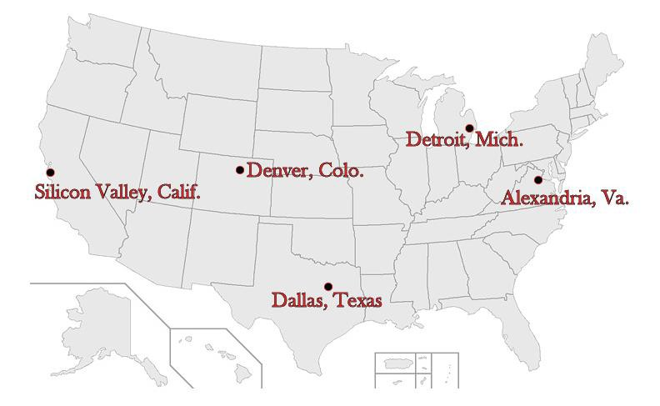
USPTO Locations
(9)
(12)
(18)
(217)
(13)
4
*Alexandria, Va. count includes judges who participate in TEAPP.

Slide 5
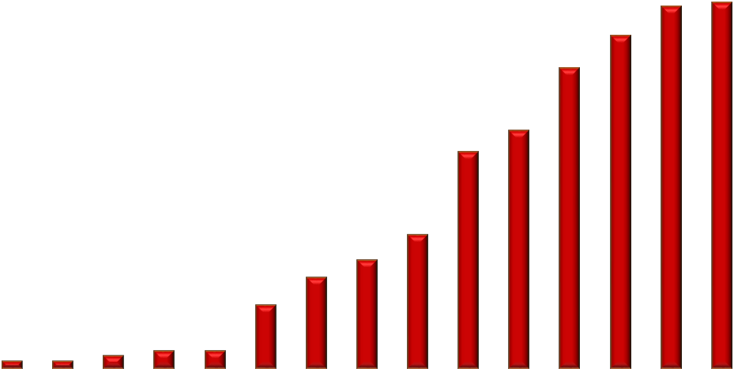
Board Size Over Time
(Calendar Year)
300
269
271
249
250
225
200
178
162
150
100
100
81
68
47
50
5 5
9
13 13
0
1900 1920 1940 1960 1980 1990 2000
2010
2011
2012
2013
2014
2015
2016
2017
5

Slide 6
Trial Statistics
IPR, PGR, CBM
Patent Trial and Appeal Board
December 2017

Slide 7
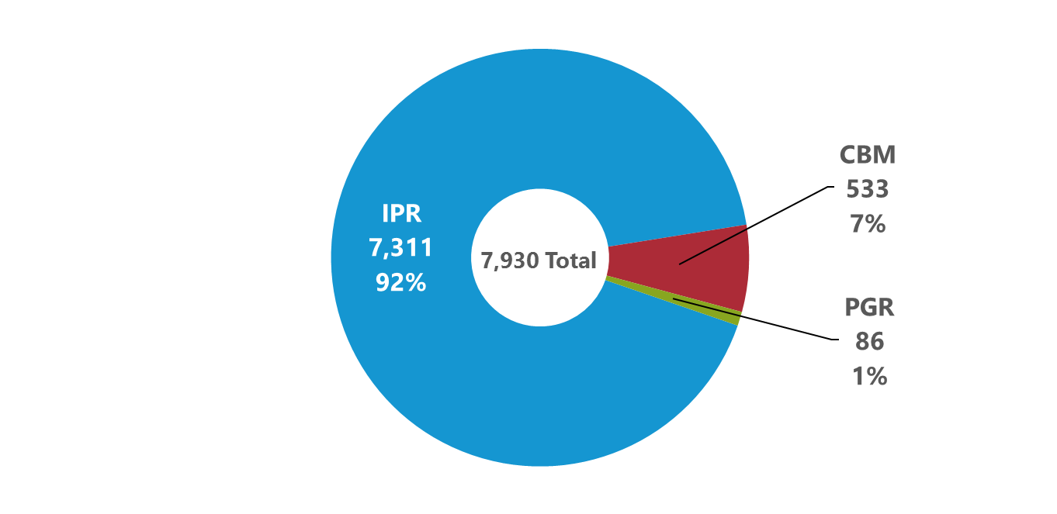
Petitions by Trial Type
(All Time: 9/16/12 to 12/31/17)
Trial types include Inter Partes Review (IPR), Post Grant Review (PGR), and Covered Business Method (CBM).

Slide 8
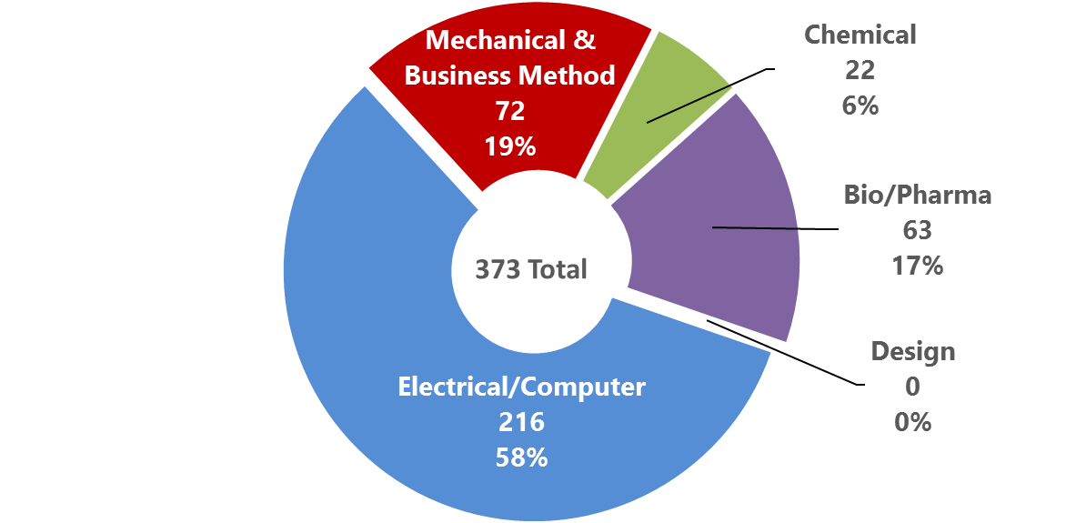
Petitions Filed by Technology in FY18
(FY18 to date: 10/1/17 to 12/31/17)

Slide 9
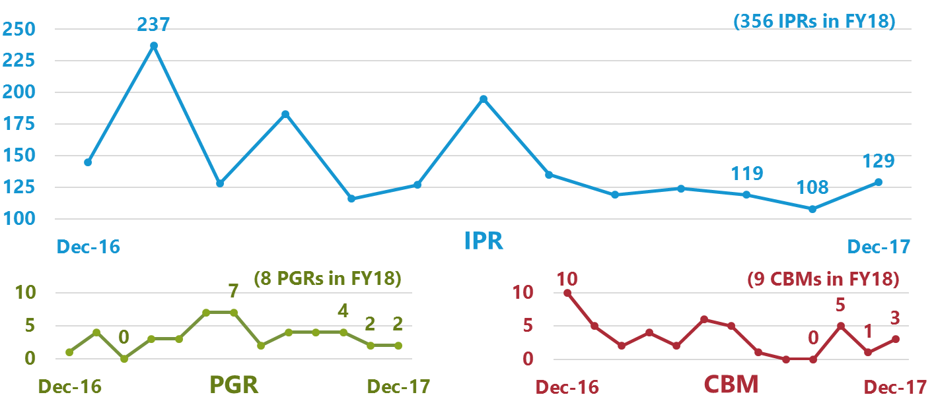
Petitions Filed by Month
(December 2017 and Previous 12 Months: 12/1/16 to 12/31/17)

Slide 10
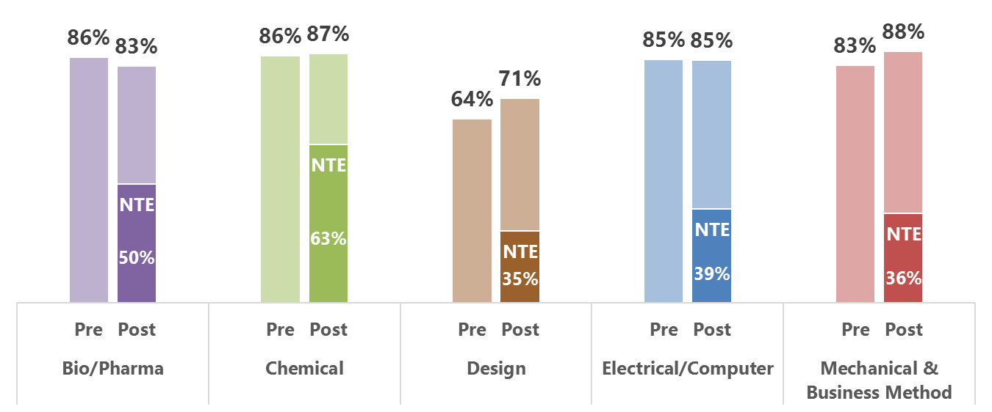
Preliminary Response Filing Rates
Pre- and Post-Rule To Allow New Testimonial Evidence (NTE)
(All Time: 9/16/12 to 12/31/17)
The rule to allow new testimonial evidence was effective May 2, 2016.

Slide 11
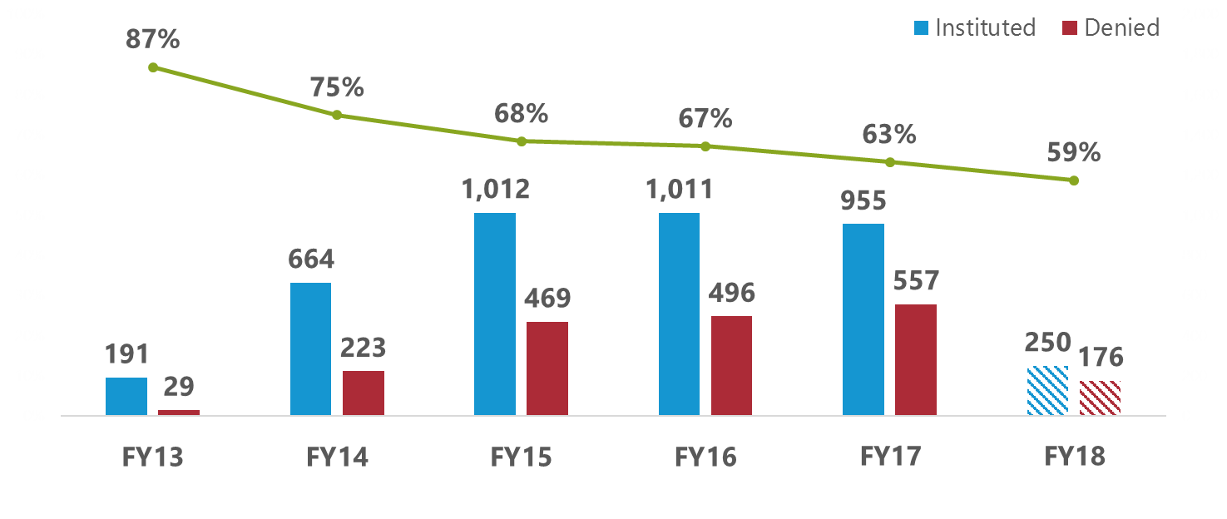
Institution Rates
(FY13 to FY18: 10/1/12 to 12/31/17)
Institution rate for each fiscal year is calculated by dividing petitions instituted by decisions on institution (i.e., petitions instituted plus petitions denied). The outcomes of decisions on institution responsive to requests for rehearing are excluded.

Slide 12
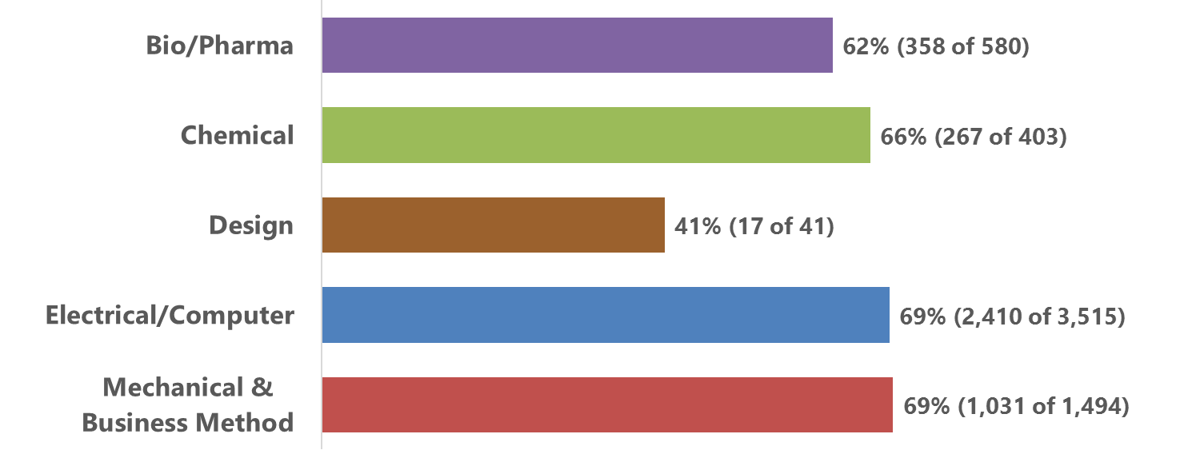
Institution Rates by Technology
(All Time: 9/16/12 to 12/31/17)
Institution rate for each technology is calculated by dividing petitions instituted by decisions on institution (i.e., petitions instituted plus petitions denied). The outcomes of decisions on institution responsive to requests for rehearing are excluded.

Slide 13
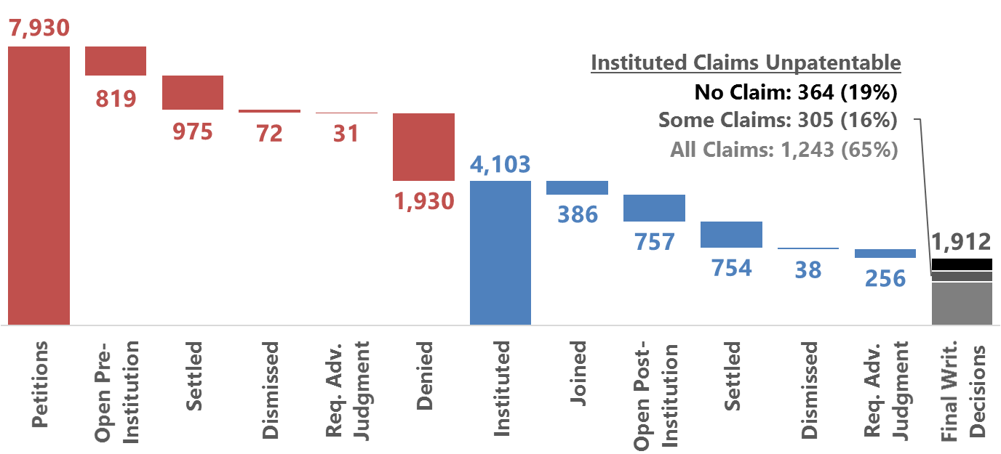
Status of Petitions
(All Time: 9/16/12 to 12/31/17)
These figures reflect the latest status of each petition. The outcomes of decisions on institution responsive to requests for rehearing are incorporated. Once joined to a base case, a petition remains in the Joined category regardless of subsequent outcomes.

Slide 14
Recent Precedential and Informative Decisions

Slide 15
Precedential
Facebook, Inc. v. Skky, LLC
  Case CBM2016-00091, Paper 12 (Sept. 28, 2017)
  AIA § 18, pre-institution statutory disclaimer
Gen. Plastic Indus. Co. v. Canon Kabushiki Kaisha
  Case IPR2016-01357 et al., Paper 19 (Sept. 6, 2017)
  AIA § 314(a), discretionary factors re: multiple petitions
Ex parte McAward
  Appeal 2015-006416 (Aug. 25, 2017)
  § 112(2), indefiniteness during prosecution
Athena Automation Ltd. v. Husky Injection Molding Sys. Ltd.
  Case IPR2013-00290, Paper 18 (Oct. 25, 2013)
  AIA § 311(a), assignor estoppel

Slide 16
Informative
Luv N’ Care, Ltd. v. McGinley
  Case IPR2017-01216, Paper 13 (Sept. 18, 2017)
  AIA § 315(b), insufficient funds at filing
Amneal Pharmaceuticals, LLC. v. Endo Pharmaceuticals Inc.
  Case IPR2014-00360, Paper 15 (June 27, 2014)
  AIA § 315(b), district court motion to amend complaint
Cultec, Inc. v. Stormtech LLC
  Case IPR2017-00777, Paper 7 (Aug. 22, 2017)
  AIA § 325(d), deny institution – examination

Slide 17
Informative (continued)
Hospira, Inc. v. Genentech, Inc.
  Case IPR2017-00739, Paper 16 (July 27, 2017)
  AIA § 325(d), deny institution – examination
Unified Patents Inc. v. Berman
  Case IPR2016-01571, Paper 10 (Dec. 14, 2016)
  AIA § 325(d), deny institution – examination

Slide 18
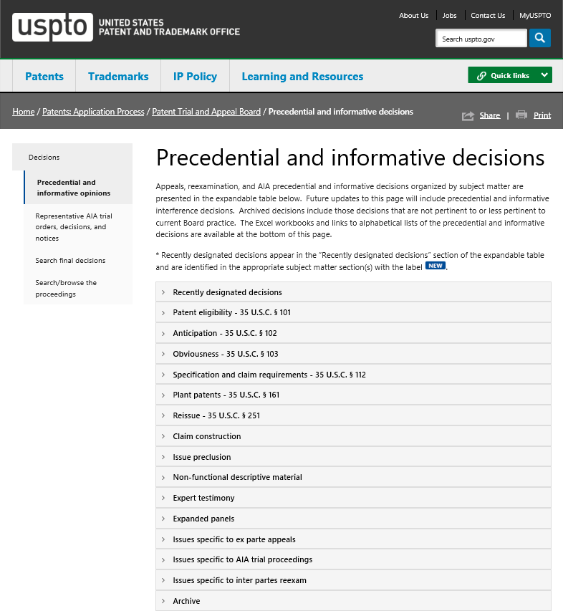
Updated Precedential and Informative Decision Website
Accessible via the public PTAB Website at the following address:
https://www.uspto.gov/patents-application-process/patent-trial-and-appeal-board/precedential-informative-decisions

Slide 19
Motions to Amend and
Aqua Products

Slide 20
In re Aqua Products: Procedural History
October 23, 2014 – Original appeal of IPR2013-00159 (Paper 71) (PTAB Aug. 22, 2014)
Board denied Aqua’s motion to substitute claims 22–24, which proposed to amend claims 1, 8, and 20 to include additional limitations
May 25, 2016 – Federal Circuit (Prost, Reyna, Stark) affirmed Board decision, citing prior court decisions
August 12, 2016 – Federal Circuit ordered rehearing en banc in relation to two questions

Slide 21
In re Aqua Products (order granting rehearing en banc)
Questions for appellant and USPTO intervenor:
  Q1: When PO moves to amend claims under 35 U.S.C. § 316(d), may PTO require PO to bear the burden of persuasion, or a burden of production, regarding patentability of amended claims as a condition of allowing them? Which burdens are permitted under 35 U.S.C. § 316(e)?
  Q2: When petitioner does not challenge the patentability of a proposed amended claim, or the Board thinks the challenge is inadequate, may the Board sua sponte raise patentability challenges to such a claim? If so, where would the burden of persuasion, or a burden of production, lie?

Slide 22
In re Aqua Products
October 4, 2017 – Federal Circuit issued en banc decision, which included five separate opinions
  As noted in lead opinion: “[V]ery little said over the course of the many pages that form the five opinions in this case has precedential weight.”
  “The only legal conclusions that support and define the judgment of the court are: (1) the PTO has not adopted a rule placing the burden of persuasion with respect to the patentability of amended claims on the patent owner that is entitled to deference; and (2) in the absence of anything that might be entitled deference, the PTO may not place that burden on the patentee.”
November 21, 2017 – PTAB Chief Judge issued Guidance in view of Aqua Products decision

Slide 23
Guidance on Motions to Amend in view of Aqua Products
Board will not place the burden of persuasion on PO with respect to the patentability of substitute claims presented in a motion to amend;
If PO files a motion to amend, Board will determine whether the substitute claims are unpatentable by a preponderance of the evidence based on the entirety of the record, including any opposition made by the petitioner;
Practice and procedure before Board will not change.

Slide 24
Guidance on Motions to Amend in view of Aqua Products
A motion to amend must meet requirements of 35 U.S.C. § 316(d)
propose a reasonable number of substitute claims
substitute claims do not enlarge scope of the original claims or introduce new matter
A motion to amend must meet requirements of 37 C.F.R. § 42.121 or § 42.221, as applicable
  set forth written description support and support for benefit of a filing date in relation to each substitute claim
  respond to grounds of unpatentability involved in the trial
Under 37 C.F.R. § 42.11, all parties have a duty of candor
  including PO’s duty to disclose information that PO is aware of that is material to the patentability of substitute claims, if such information is not already of record

Slide 25
Guidance on Motions to Amend in view of Aqua Products
Board will continue its current briefing practice as to types, timing, and page-limits of briefs;
Parties with pending motions to amend may request briefing changes or additional briefing;
PO may contact the Board to file new or substitute motion to amend under certain circumstances.

Slide 26
SOP 9 on Remands

Slide 27
Changes to SOP 9
Goal of issuing remand decisions within 6 month
Meeting with the Chief, Deputy Chief, or their delegates
Establishes default procedures for trial and appeal remand scenarios

Slide 28
Default Trial Procedures for Common Remand Scenarios
 | Remand Scenario | Additional Briefing? | Additional Evidence? | Oral Argument?
1 | Erroneous claim interpretation | Yes, unless the claim interpretation to be applied on remand was proposed by one of the parties and the effect has been fully briefed | No, unless evidence of record is insufficient to afford due process | No
2 | Failure to consider the evidence | Yes, unless the evidence was fully briefed on the record | No | No
3 | Inadequate explanation by the Board | No, unless the briefing on the issues is inadequate for the Board to have made a decision in the first instance | No | No
4 | Erroneous application of law | Yes, unless the law was fully briefed on the record but not reflected in Board decision | No | No
5 | Law of due process/denial of APA rights | Yes | Yes, for parties whose rights have been violated, unless additional briefing on evidence of record is sufficient to afford due process | Yes, if necessary to afford due process
6 | Improper consideration of the arguments | Yes, unless argument is fully briefed in the record | No | No

Slide 29
 | Remand Scenario | Prosecution/Reexamination Reopened
1 | Erroneous claim interpretation | No, unless alternative claim interpretation renders the present rejection(s) moot
2 | Failure to consider the evidence | No, unless the evidence of record is deemed entirely insufficient to support the present rejection(s)
3 | Inadequate explanation by the Board | No, the Board provides additional explanation or reverse on the present record
4 | Erroneous application of law | No, unless the correct application of the law renders the present rejection(s) moot
5 | Law of due process/denial of APA rights | Yes, typically in the form of a new ground of rejection
6 | Improper consideration of the arguments | No, arguments that were not sufficiently briefed before the Board are deemed waived

Slide 30
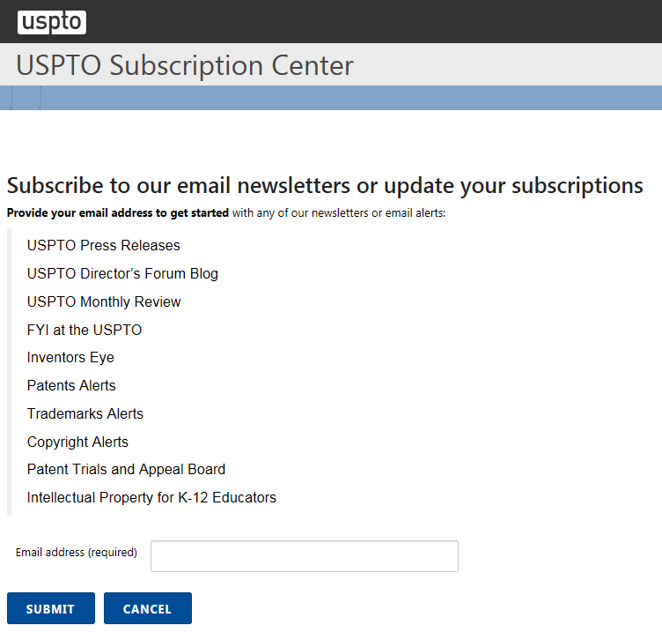
Accessible via the public PTAB Website at the following address:
https://public.govdelivery.com/accounts/USPTO/subscriber/new

Slide 31
Questions and Comments
Scott Boalick
Deputy Chief Administrative Patent Judge (571) 272-9797
Scott.Boalick@uspto.gov

Slide 33
Additional Information

Slide 34
An Analysis of Multiple Petitions in AIA Trials

Slide 35
Jurisdiction of Patent Challenges
Jurisdiction of Patent Challenge
District Court
PTAB
Approximately 85% of IPRs in Fiscal Year 2017 have a co-pending district court case
Less than a fifth of district court cases involve patents that are challenged in an IPR
Data sourced from Lex Machina PTAB Report 2017

Slide 36
Multiple Petition Study
Petitioners Per Patent
No. of Petitioners vs. Patent | No. of Patents | % Patents
1 | 3711 | 84.8%
2 | 424 | 9.7%
3 | 132 | 3.0%
4 | 59 | 1.3%
5 | 28 | 0.6%
6 | 17 | 0.4%
7 | 2 | <0.1%
8 | 3 | <0.1%
Total | 4376 | 100%
Data Through 6/30/17
Percentages may not add to 100% due to rounding

Slide 37
Multiple Petition Study
Petitions Per Patent
No. of Petitions per Patent | Patents | % of Total
1 | 2932 | 67.0%
2 | 885 | 20.2%
3 | 256 | 5.9%
4 | 142 | 3.2%
5 | 54 | 1.2%
6 | 52 | 1.2%
7 or more | 55 | 1.3%
Total | 4376 | 100%
Data Through 6/30/17

Slide 38
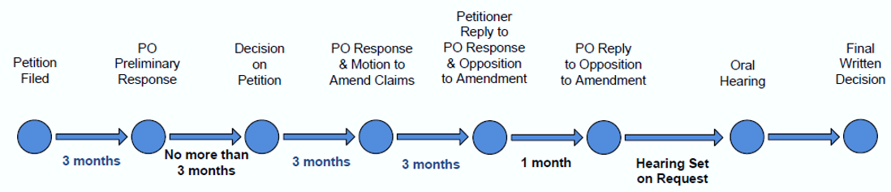
When Petitions Are Filed
“POPR”
“DI”
“FWD”
Before POPR
Before
DI
After DI

Slide 39
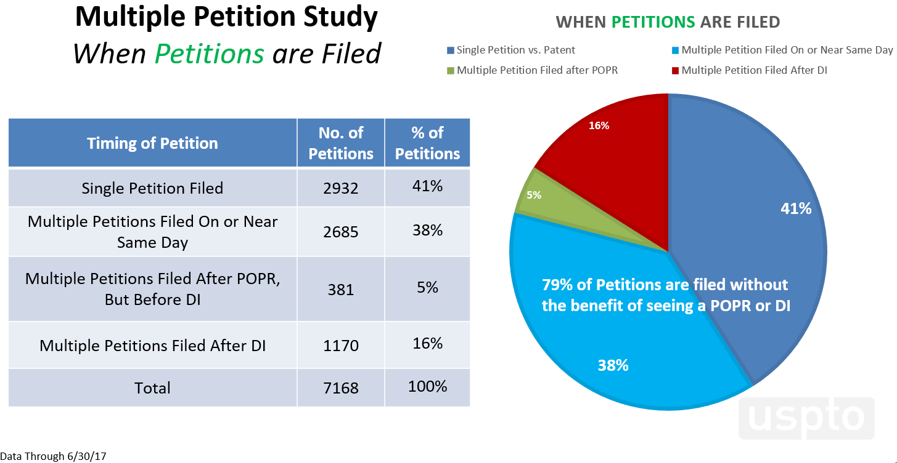

Slide 40
Multiple Petition Study
Who are post-DI Petitioners?
9-10% of petitions filed by:
Defendant-Petitioner; or
Same or Different Petitioner
  Filing due to a change in litigation; or
  Seeking to join existing trial as a party
16% of all petitions are filed after a DI
A random sample of the 1054 petitions filed after DI as of 3/1/17* was taken
The sample included 169 petitions, and the results were found to be statistically significant, such that we can use the sample (169 petitions) as an estimate of the whole (1054 petitions).
16%
6-7% of petitions filed by:
Non-Defendant Petitioner; or
Same Petitioner
  Filing not due to change in litigation; and
  Not seeking party joinder
*Random sample taken on 3/1/17 using data through 2/28/17

Slide 41
Multiple Petition Study
Rounds of Petitions
95% of petitions are filed in a given petitioner’s first round
A “round” is all petitions filed before receiving a DI on one of those petitions
Rounds of Petitions | No. of Petitions | % of Petitions
First Round of Petitions | 6481 | 95%
Second Round of Petitions | 369 | 5%
Third or Fourth Round of Petitions | 7 | <0.1%
Total | 6857*
95% of petitions are filed in a given
Petitioner’s first round
95% of a Given Petitioner’s Petitions are filed
in One Round
Data Through 6/30/17
*Not included are 311 Petitions filed where a request to join as a party to another proceeding was granted

Slide 42
Multiple Petition Study
Institution Rate
Institution rate as measured by patent is only slightly higher than the institution rate as measured by petition
“By patent” accounts for whether any one petition against particular patent is instituted
  Example against Patent A:
    Petition 1 instituted
    Petition 2 not instituted
    Net result = 100% institution rate
“By petition” accounts for whether a particular petition was instituted; publicly reported monthly
  Example against Patent A
    Petition 1 instituted
    Petition 2 not instituted
    Net result = 50% institution rate
42
Data Through 6/30/17

Slide 43
Status of Petitions
(All Time: 9/16/12 to 12/31/17)
These figures reflect the latest status of each petition. The outcomes of decisions on institution responsive to requests for rehearing are incorporated. Once joined to a base case, a petition remains in the Joined category regardless of subsequent outcomes.

Slide 44
Multiple Petition Study
Ultimate Outcome
69% of all petitions result in a patent being unchanged; 58% of patents are unchanged at the end of one or more AIA proceedings
“By patent” accounts for whether any one petition against particular patent results in any unpatenable claims
“By petition” accounts for whether a particular petition results in any unpatentable claims
Data Through 6/30/17

Slide 45
Multiple Petition Study Highlights
  Studied: 7168 petitions addressing 4376 patents
  Who: 84.8% of patents are challenged by a single petitioner
  What: 87% of patents are challenged by 1 or 2 petitions
  Where: 85% of IPRs have a co-pending district court case
  When:
    79% of petitions are filed before any Patent Owner Response or a Decision on Institution
    95% of petitions are filed in a given petitioner’s first round
  Why: Often a petitioner could not have filed a petition earlier or may be prompted to file later because of the litigation circumstances
  How:
    Institution rate by patent (FY17: 70%) is only slightly higher than by petition (FY17: 64%)
    58% of patents challenged at the PTAB are unchanged

Slide 46
Motion to Amend Study

Slide 47
Motion to Amend Study
Data current as of: 9/30/2017

