Slide 2
LAIPLA –
2018 Washington in the West
January 25, 2018
John Cabeca
Director of the United States Patent and Trademark Office West Coast Regional Office

Slide 3
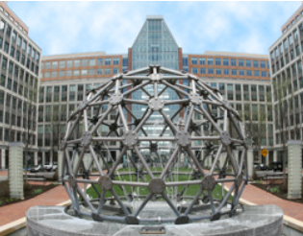
The USPTO in FY17
8,152 Patent Examiners
647,000 Patent Applications Filed
347,243 Patents Issued
530,270 Trademark Applications
327,314 Certificates of Registration
12,600 Employees
548 Trademark Examining Attorneys
269 Patent Trial & Appeal Board Judges
24 Trademark Trial & Appeal Board Judges
Patents
Trademarks
USPTO Headquarters in Alexandria, VA

Slide 4
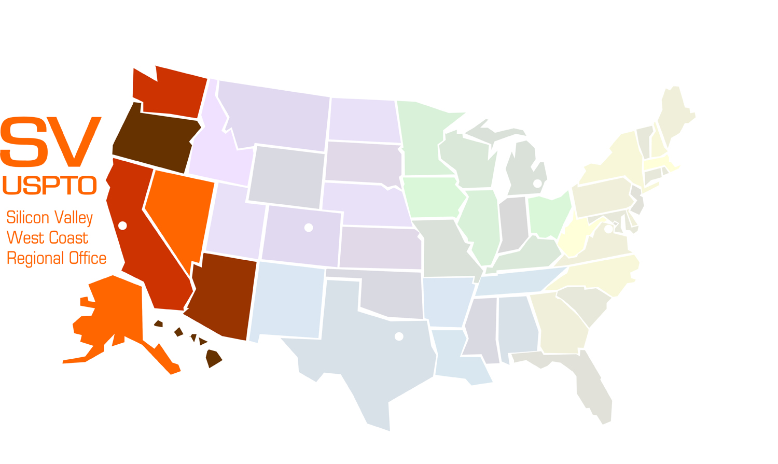
USPTO Offices
Midwest – Detroit, MI
Elijah J. McCoy
Opened July 2012
Rocky Mountain – Denver, CO
Byron G. Rogers Federal Building
Opened July 2014
West Coast – Silicon Valley
San Jose City Hall
Opened October 2015
Texas – Dallas, TX
Terminal Annex Federal Building
Opened Nov. 2015

Slide 5
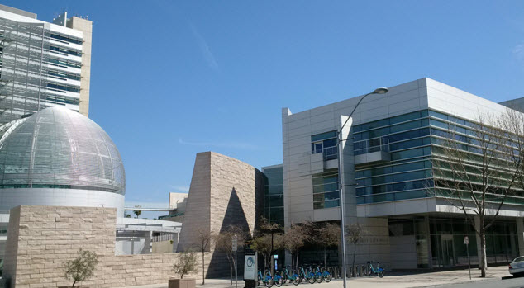
Silicon Valley Regional Office
San Jose City Hall | 26 S. Fourth Street, San Jose, CA 95113
Employees:
81 Patent Examiners
25 Patent Trial and Appeal Board (PTAB) judges
22 Management/Support/ IT/Security Staff
Office Hours: 9:00 AM – 5:00 PM PT
Services
Public Search Facility
Available from 9:00 AM – 4:30 PM PT
Examiner Interview Rooms
Hearing Room
Public Meeting Spaces

Slide 6
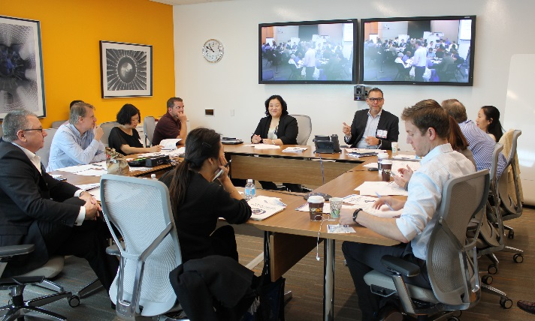
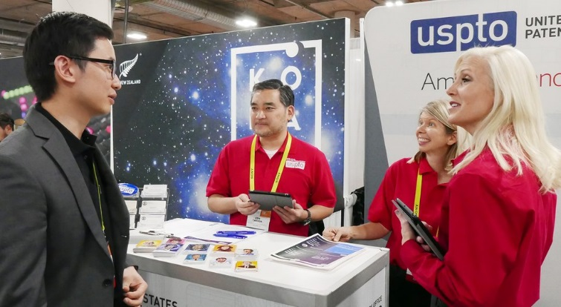
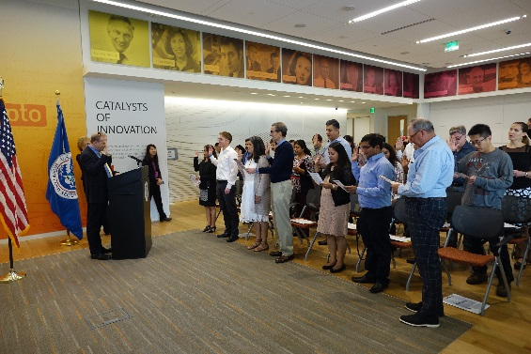
Serving the Innovation Ecosystem
At All Levels – From K-12 to IP professionals
From basic facts to IP Policy, Law and Procedure
Stakeholder roundtables & roadshows
Inventor conferences w/ focus on startups
Tech Specific Partnership Meetings
- Software, BioTech, CyberTech, Additive Manufacturing
Facilitated USPTO IP Webinars
Lunch & Learn Programs
International programs
1 on 1 assistance, both in-person and virtually
Just-in-time programming (FITF, §101, Paralegal Workshops, etc.)
Co-host programs with strategic community partners

Slide 7
Recent Updates

Slide 8
Revised Fee Schedule
Sets or increases certain patent fees
Small and micro entity discounts remain
Maintenance fees unchanged
Effective Date: January 16, 2018
Patents
Fee | Previous Large Entity Fee Rate | Final Rule Large Entity Fee Rate | Percent Change | FY 2015 Unit Cost
Utility Filing Fee | $280 | $300 | 7% | $277
Utility Search Fee | $600 | $660 | 10% | $1,773
Utility Examination Fee | $720 | $760 | 6% | $2,205
Utility Issue Fee | $960 | $1,000 | 4% | $314
Total | $2,560 | $2,720 | 6% | $4,569

Slide 9
Regulatory Reform Efforts
Seeking ways to revise, improve, streamline or remove existing USPTO regulation.
Departmental Regulatory Reform Task Force and USPTO Working Group
Trademark proposal to remove interference rules (Oct. 2017)
Patent proposal to remove redundant rules (Jan. 2018)
Next steps…

Slide 10
Options for Applicants
Enhancing Examiner-Stakeholder Experiences

Slide 11
Expanded Collaborative Search Pilot (CSP)
Shared searching between the USPTO, Japanese Patent Office (JPO) & Korean Intellectual Property Office (KIPO)
Requirements:
Unexamined counterpart applications in USPTO and either or both KIPO & JPO
Petition filed at USPTO & desired partner office
Effective: November 1, 2017- November 1, 2020

Slide 12
First Action Interview Pilot (FAIP)
Allows for interviews prior to issuance of a first office action on the merits
Advances examination of applications
Enhances compact prosecution
Gives applicants more options for resolving patentability issues

Slide 13
FAIP Cases Compared to All New Cases

Slide 14
Percent of Serial Disposals Having at Least One Interview by Month FY 2008 – FY 2017
33.1% of Serial Disposals completed in September 2017had at least one interview.

Slide 15
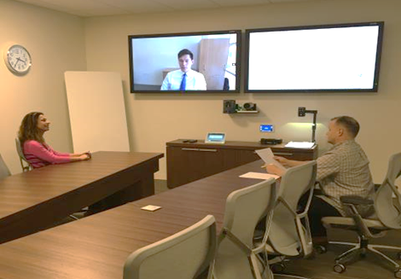
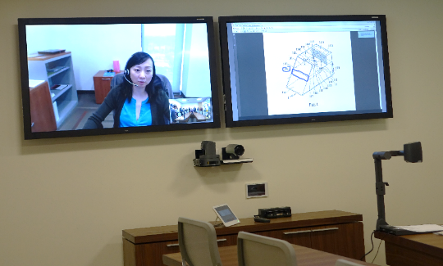
Public Interview Rooms
Connect and collaborate with patent examiners.
Rooms are equipped with multiple videoconferencing systems and HD document camera
Replicates in-person experience between applicant and patent examiner
On-site Interview Specialists available to assist with IT equipment and to help ensure interview goes smoothly

Slide 16
Stakeholder Training on Examination Practice and Procedure (STEPP)
3-day training on practice and procedure for practitioners
Provide external stakeholders with a better understanding of examiner decisions
Aid in compact prosecution by disclosing how examiners are taught to use the MPEP

Slide 17
In-Person STEPP Training
Title | Dates | Audience | Location | Registration
Agent/Attorney 3-Day Course | March 20-22, 2018 | Agents and Attorneys | Detroit, MI | January 8 – February 11, 2018
Agent/Attorney 3-Day Course | May 22-24, 2018 | Agents and Attorneys | Alexandria, VA | March 12 – April 8, 2018
Agent/Attorney 3-Day Course | July 17-19, 2018 | Agents and Attorneys | San Jose, CA | May 7 – June 3, 2018
Inventor 3-Day Course | August 14-16, 2018 | Inventors | Alexandria, VA | April 30 – June 18, 2018
Agent/Attorney 3-Day Course | September 11-13, 2018 | Agents and Attorneys | Alexandria, VA | July 2 – July 29, 2018

Slide 18
Virtual Instructor Led Training
Title | Dates | Audience | Registration
Claim Interpretation - Preambles | February 13, 2018 | All | January 8 – February 4, 2018
Claim Interpretation - Product By Process | April 3, 2018 | All | March 5 – March 25, 2018
Functional Language Workshop - Claim Interpretation and Definiteness Under 35 U.S.C. 112(b) - Computerized Color Editing | April 17, 2018 | Agents and Attorneys | March 5 – April 8, 2018
Claim Interpretation - Functional Language including Means Plus Function | June 12, 2018 | All | April 30 – May 28, 2018
Inherency, 35 U.S.C. 102/103 Rejections, and Official Notice | August 7, 2018 | All | July 2 – July 29, 2018

Slide 19
Patent Performance

Slide 20
YTD FY 2018 Filing Trends
Serialized filings are up 5.4%
Planned 0.8% growth
RCE filings are down 11.4%
Total UPR filings are up 0.1%
Design filings are up 10.6%
Provisional filings are up 0.3%

Slide 21
Unexamined Patent Application Inventory FY 2011 – FY 2018 Q1
539,235 Unexamined Applications as of January 10, 2018

Slide 22
First Action Pendency and Total Pendency FY 2011 – FY 2018 Q1
Total Pendency: 24.2 months.
First Action Pendency: 15.7 months.

Slide 23
Utility Serialized and RCE Filings FY10-18 Q1

Slide 24
Need Patent Protection Fast?
Need to FAST track your patent? Use Track One!
Move your ideas quickly with USPTO's Track One
www.uspto.gov/patent/initiatives/usptos-prioritized-patent-examination-program

Slide 25
Track One
Pendency continues to be extremely low
Average time from Filing to Petition grant: 1.3 months
Average time from petition grant to first action: 1.8 months
Average time from petition grant to final disposition: 7.2 months
Annual cap reached for first time in FY 2016
FY18 filings in line with reaching cap

Slide 26
Track One Filings

Slide 27
Design Filings FY 2009 – FY 2018 Q1
11,745 applications received in FY18 Q1

Slide 28
Design Unexamined Application Inventory FY 2011 – FY 2018 Q1
FY 2018 Q1 is 44,636

Slide 29
Design First Action Pendency and Total Pendency FY 2011 – FY 2018 Q1
Design Total Pendency: 18.8 months.
First Action Pendency: 13.4 months.

Slide 30
FY18 Appeal Results by Tech Center

Slide 31
Trial Statistics IPR, PGR, CBM
Patent Trial and Appeal Board December 2017

Slide 32
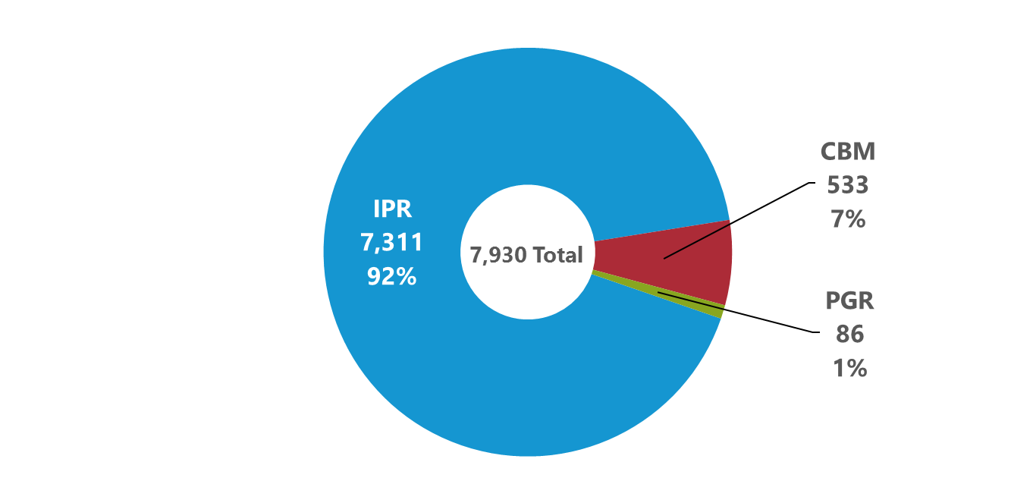
Petitions by Trial Type (All Time: 9/16/12 to 12/31/17)
Trial types include Inter Partes Review (IPR), Post Grant Review (PGR), and Covered Business Method (CBM).

Slide 33
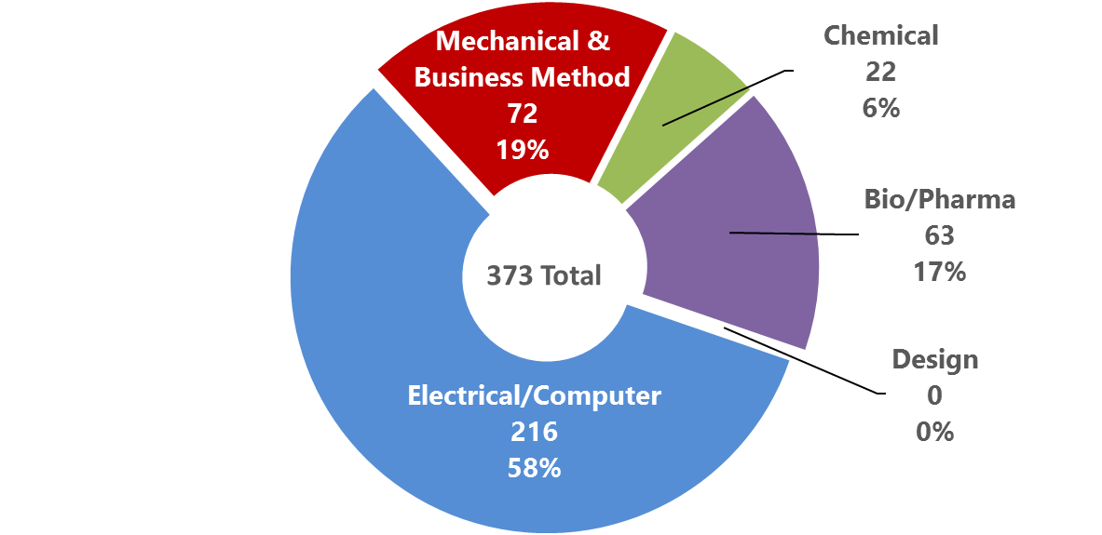
Petitions Filed by Technology in FY18 (FY18 to date: 10/1/17 to 12/31/17)

Slide 34
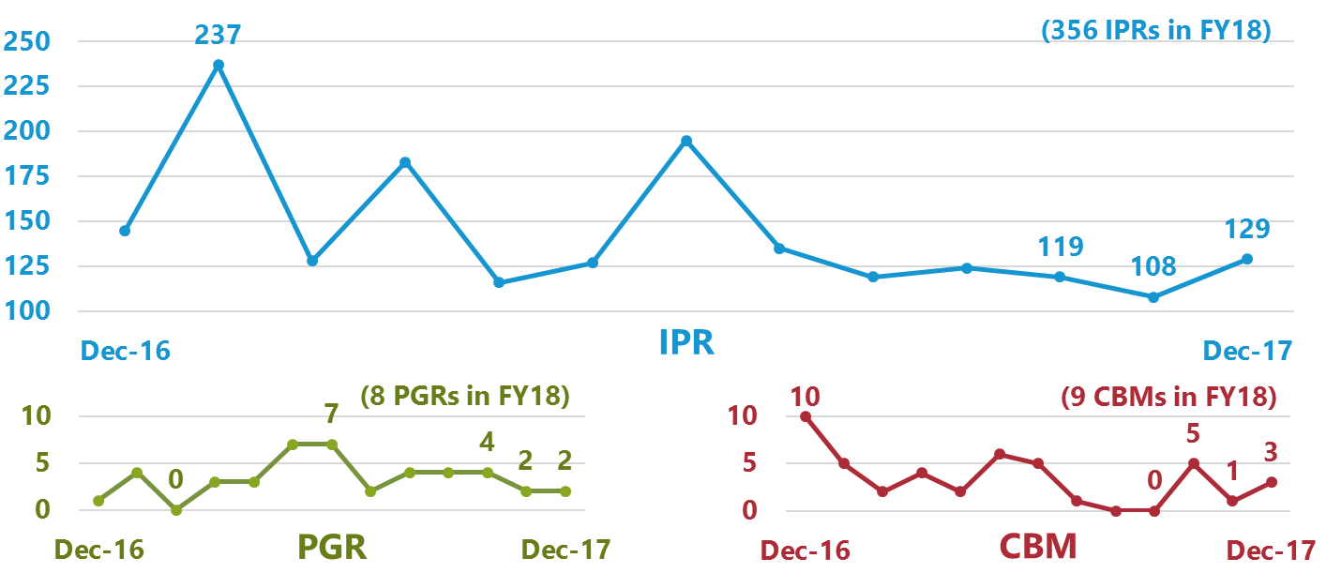
Petitions Filed by Month
(December 2017 and Previous 12 Months: 12/1/16 to 12/31/17)

Slide 35
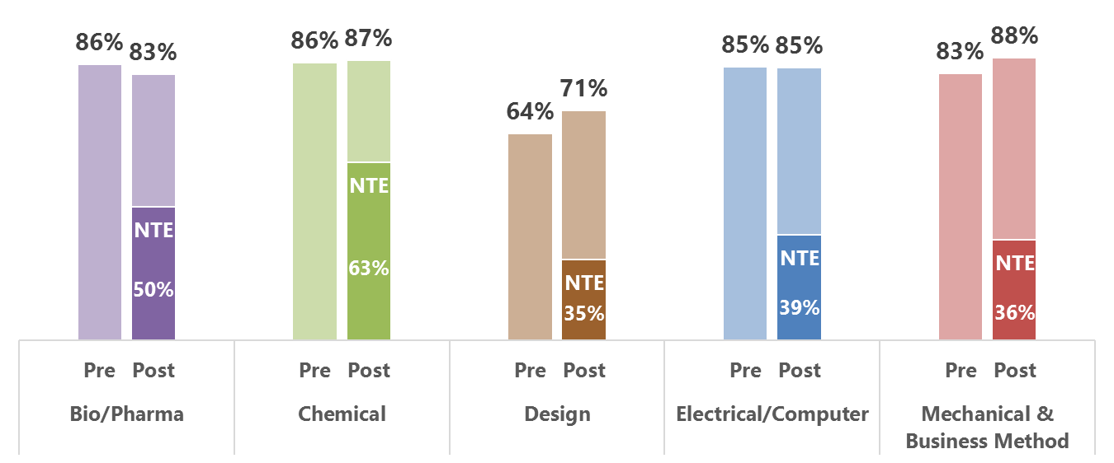
Preliminary Response Filing Rates Pre- and Post-Rule To Allow New Testimonial Evidence (NTE) (All Time: 9/16/12 to 12/31/17)
The rule to allow new testimonial evidence was effective May 2, 2016.

Slide 36
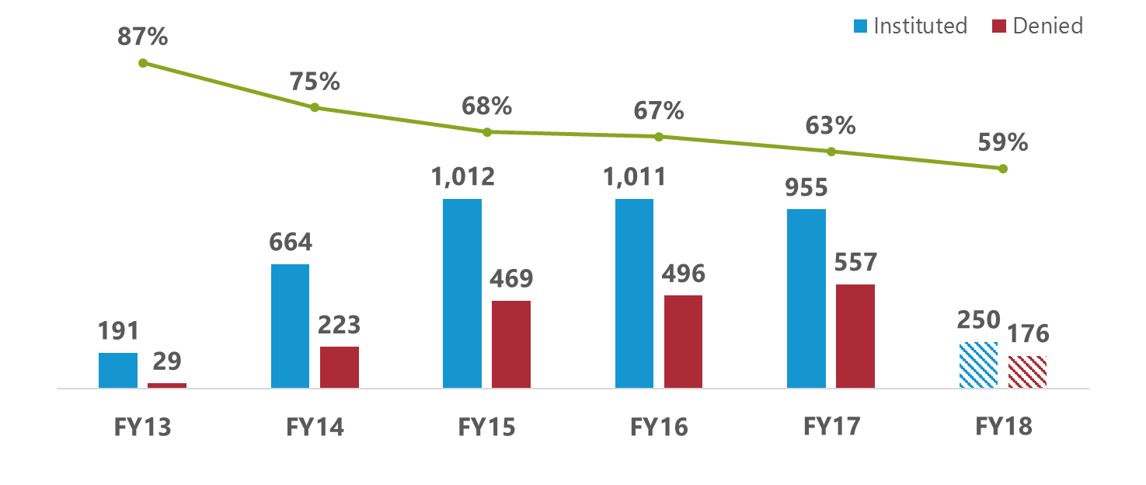
Institution Rates
(FY13 to FY18: 10/1/12 to 12/31/17)
Institution rate for each fiscal year is calculated by dividing petitions instituted by decisions on institution (i.e., petitions instituted plus petitions denied). The outcomes of decisions on institution responsive to requests for rehearing are excluded.

Slide 37
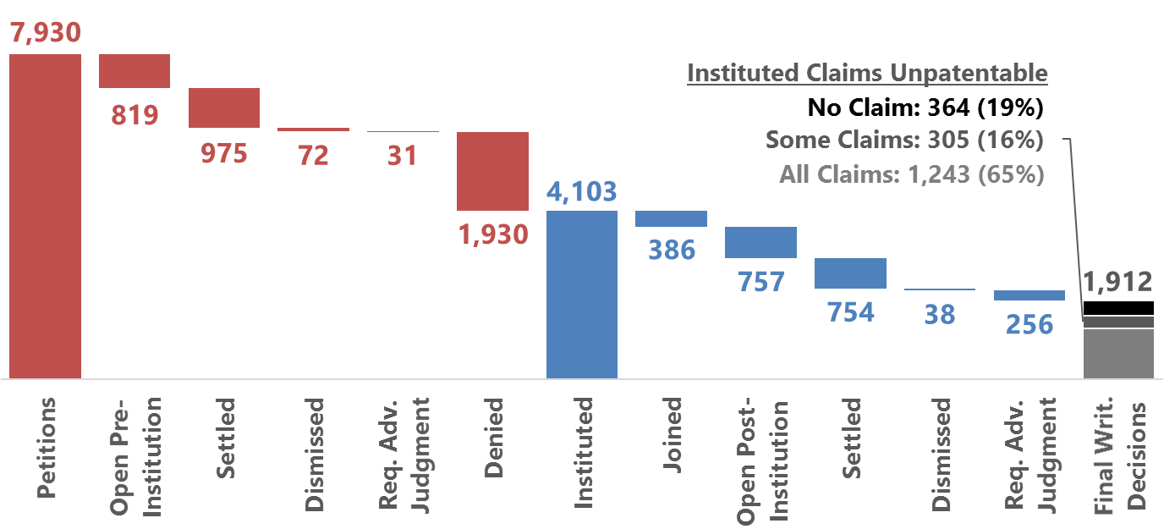
Status of Petitions
(All Time: 9/16/12 to 12/31/17)
These figures reflect the latest status of each petition. The outcomes of decisions on institution responsive to requests for rehearing are incorporated. Once joined to a base case, a petition remains in the Joined category regardless of subsequent outcomes.

Slide 38
Resources
Working with Stakeholders

Slide 39
Site Experience Education, Patent Examiner Technical Training Program, Business Partnership Meetings & Technology Fairs
Provides examiners with technical training from innovators, scientists, engineers, and experts working in examined technology areas
Open to companies and academic institutions located within the continental United States
Speakers contribute to improvement of examination quality

Slide 40
Provides assistance throughout the application process
Helps stalled prosecution get back on track
Not intended to circumvent normal communication during examination

Slide 41
Patent Pro Bono Program
File and Prosecute Patent Applications: The Program matches financially under-resourced inventors and small businesses with registered patent attorneys.
~22 regional non-profit programs across all 50 states
Contact your local regional program to volunteer today!
California: California Lawyers for the Arts
www.uspto.gov/probonopatents

Slide 43
Thank You
www.uspto.gov/SiliconValley
https://www.facebook.com/uspto.gov
http://www.youtube.com/user/USPTOvideo/

